Slide 1

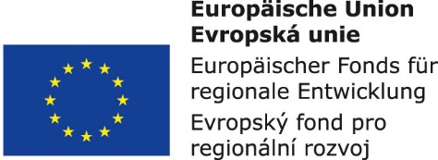


Air Transport Management and Technology:
9. Airline business models
Methodological concept to effectively support technical key competencies using foreign languages ATCZ62 – the CLIL as a university teaching strategy

Slide 2

Airline business models – basic distribution
Based on regularity
  Scheduled - Flights according to the flight schedule
  Non-scheduled - Charter or leisure airlines
Based on served markets
  Domestic
  International (US vs EU approach)
Based on payload type
  Passengers - traditional airlines vs. Low-Cost Carriers model (LCC)
  Combi - cargo on the main deck behind the passengers’ area and in the belly
  Cargo
  Mail
  Integrators

Slide 3
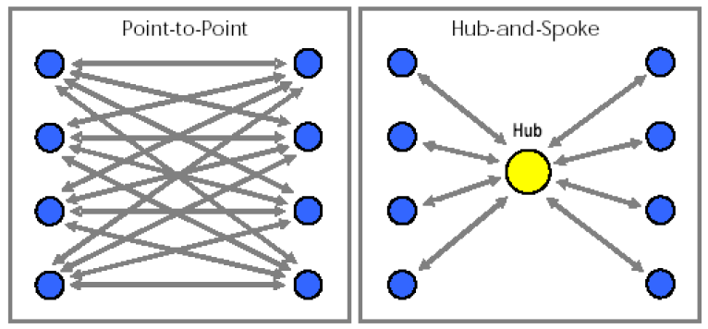
Air routes network conceptions
Source: Rodrigue et al., 2006
There are two very different ideas for planning flight routes:
Hub-and-Spoke model (H&S);
Point-to-Point model (P2P).
Hub-and-Spoke (benefits):
Significantly less routes are needed to serve the network.
Since there are less routes, assuming the number of planes are the same, airlines can schedule more frequent flights along each route and make full use of the capacity of each plane.
Centralizing operations at the hub leads to economies of scale.
Point-to-Point (benefits):
Minimizes connections and travel time.
No interdependency of flights and hubs – a delayed flight or a closed airport will not significantly affect other flight schedules.

Slide 4
Traditional passenger airlines
Main features:
Seat capacity is offered to general public according to published schedule
  Hub and spoke system
  Traditional services (2-3 classes, food and beverages, on-board entertainment, business lounges, frequent-flyer programmes, other)
  Offering of flights via travel agents
  Cooperation with other airlines – multisector tickets offered also on flights of partner airlines (complex revenue management)
  Transfer flights

Slide 5
Low-Cost Carriers (LCCs)
    How is it possible they are offering flight tickets for low prices? (main examples)
    Operating at costs consistently below its revenues
    Strategy of operating short sectors, low and unrestricted fares, high point-to-point frequencies, excellent punctuality
    No traditional frills such as free meals, pre-assigned seats or connecting flights
    Mainly using secondary airports – lower airport charges
    Operating aircraft longer hours – spreading fixed costs over more hours
    Mainly using single type fleet (of economic aiplanes with high density seats)
    Mainly using on-line booking
    Selling the meals, drink and souveniers on-board.

Slide 6
Charters
Main features:
Low cost model – no frills, high seat density
Whole capacity sold to the customer (usually travel agencies or interest clubs) under a “charter contract”
  Competitive pricing based on real costs but also external factors
  Low utilisation during winter season (wet lease as solution)
  Very high utilisation during tourist season (15 to 17 hours)
  Absolute necessity of flying during the night
Customer responsible for using the seat capacity
Customer’s choice of destinations

Slide 7
Cargo airlines – all airplane capacity for freight
General (or heavy) air freight
  larger commodities
  traditional airport-to-airport services (pure cargo carriers - for example CargoLux)
  around 85% of the total
Express freight
integrated door-to-door services (Integrators - for example FedEx, UPS, DHL, TNT)
  around 11% of the total
Mail
  distribute as part of the national mail system
  international shipping by airlines contracts
  around 4% of the total

Slide 8
Global Alliances of airlines
The highest form of cooperation, especially of traditional passenger airlines - the globalization of offer and distribution of air transport services. Main features:
Coordination of Alliance partners flight schedules;
Harmonization of seat capacities offered on flights;
Unification of reservation and check-in systems;
Offering of continual prices of tickets to Alliance destinations;
Creating a common "frequent flyer program" (FFP);
Alliance offer of additional services to passengers;
Unification of the fleet and repair capacities;
Integration and sharing other activities ..

