Slide 1
Air Transport Management and Technology: 8. Air Transportation Process
Methodological concept to effectively support technical key competencies using foreign languages ATCZ62 – the CLIL as a university teaching strategy

Slide 2
The air transportation process can be referred to as the sum of the stages that passengers pass during the use of air transport. The overall impression, comfort, and speed of the air transport process is influenced by other indirectly related stages that passengers have to undergo in order to participate the flight.
Transport to the airport
Check-in
Security check
Waiting for the departure
Boarding the plane
Services on board
The actual air transport
Exit to the terminal
Departure from the airport

Slide 3
Passenger check-in
The check-in process of the passenger is intended to ensure that boarding the airplane is only allowed to passengers who have:
confirmed reservation and fare paid for the flight;
personal, visa, health documents corresponding to the requirements of the receiving state;
the number, volume, or weight of checked-in baggage corresponding to the paid fare;
number, size, weight, and contents of cabin baggage corresponding to the safety regulations and regulations of the carrier.

Slide 4
Check-in process
Passengers present a ticket from which a flight coupon corresponding to the section of his journey is taken.
Passengers present an ID (national ID card, passport).
Passengers’ luggage is taken over to carry and they are offered a seat corresponding to the paid fare and personal preferences (in case of vacancies).
Passengers are alerted to safety regulations and are asked questions related to ensuring the safety of their luggage contents.
Passengers receive a boarding pass and luggage ticket.
The boarding pass is then presented together with the prescribed personal identification document for inspection by the state passport authority (for passengers traveling to countries with a visa requirement).

Slide 5
From the point of view of the organization of check-in, the following types of check-in are usually used:
Common check-in - at the counters it is possible to check-in for any line of scheduled airlines departing in a certain period of time (e.g. 12 hours, 24 hours, 6 hours).
Flight or company check-in - individual counters or a certain number of counters are intended to check a particular flight or multiple flights of a particular company.
Express check-in - is only for passengers without registered luggage and is specially marked.
Gate check-in - check-in right at the exit. It can only be used if the passenger, including luggage, has already been checked in earlier, e.g. in a city office or hotel.
Self-check-in - Passengers usually identify themselves with their payment card, and they check in for the flight themselves using interactive communication with the check-in facility. The checked baggage is handed over at the drop off counter.
Internet check-in - allows the passenger to check in before traveling to the airport. The checked baggage is handed over at the drop off counter.

Slide 6
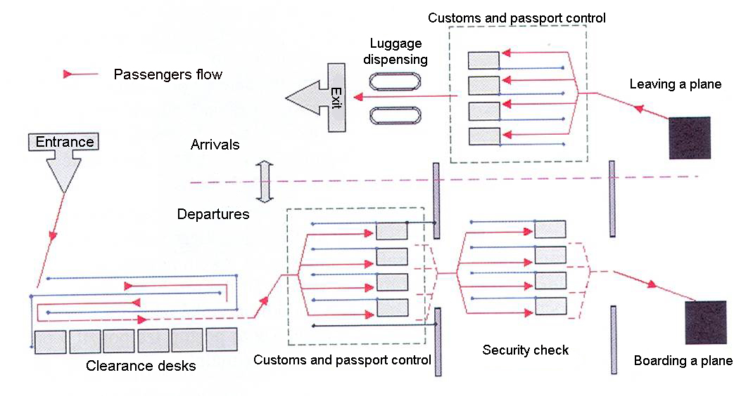
The process of passenger check-in at departures and arrivals

Slide 7
Aircraft ground handling
Aircraft ground handling defines the servicing of an aircraft while it is on the ground and (usually) parked at a terminal gate of an airport. Many airlines subcontract ground handling to airports, handling agents, or even to another airline.
Cabin service - the crew is cleaning the airplane before the flight and supplies onboard consumables
Catering - includes the unloading of unused food and drink from the aircraft, and the loading of fresh food and drink for passengers and the crew.
Ramp service - This includes services on the ramp or apron, for example:
Electric power supply (plugging/unplugging the Ground Power Unit GPU)
Refueling
Passenger stairs (or airbridge)
Airstart units
Deicing
Guiding the aircraft into and out of the parking position (by way of aircraft marshalling),
Towing with pushback tractors, and others.

Slide 8
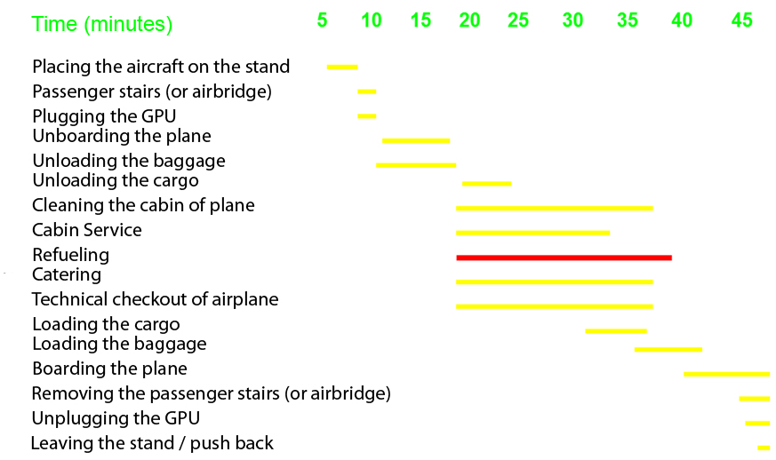
An example of a timetable for technical handling operations between two flights

