Slide 1
Air Transport Management and Technology: 7. Propulsion systems of airplanes
Methodological concept to effectively support technical key competencies using foreign languages ATCZ62 – the CLIL as a university teaching strategy

Slide 2
Propulsion unit
The propulsion unit is one of the important elements of the airplane because it generates its thrust.
Important parts of the propulsion unit include:
Propulsor – aircraft engine, which generates mechanical power;
Air intake and flue gas outlet;
Propeller (only piston engines or turboprop engines);
Wheels and axles, thrust reversing devices and other.
The most used engines for transport airplanes can be distinguished by:
Shaft (piston) engines with propeller – used on small airplanes only;
Reaction engines – turbojet or turbofan;
Combination – turboprop.

Slide 3
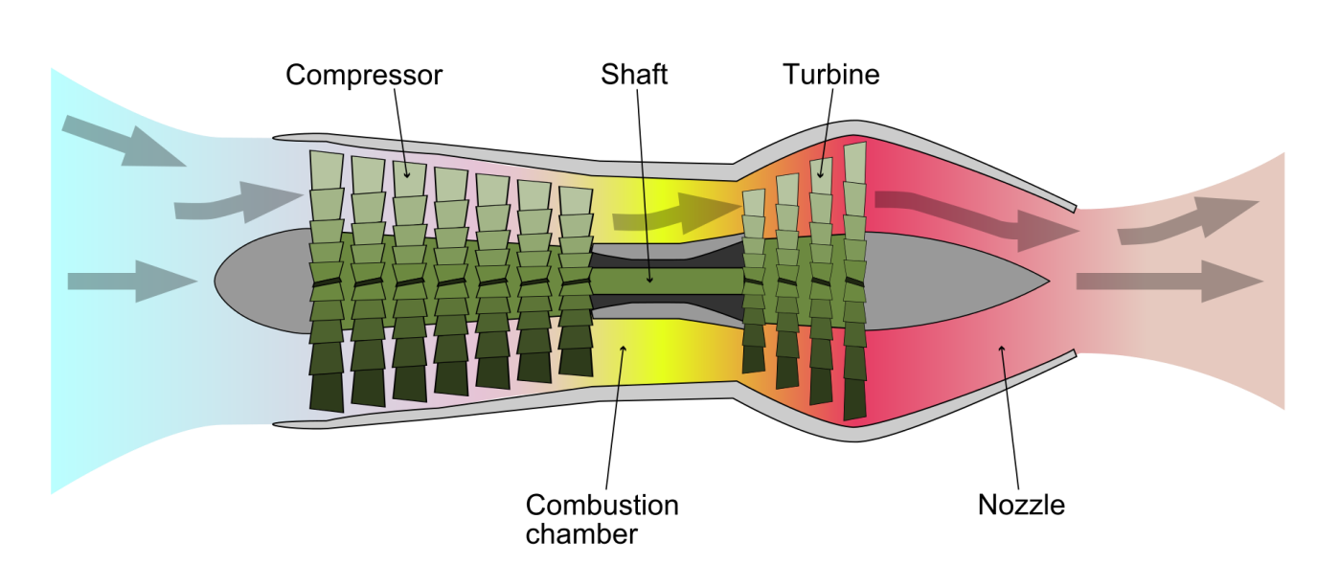
Turbojet
Its basis is the turbo compressor part. Part of the exhaust gases energy is converted into mechanical energy on the turbine shaft. With even engine running, turbine power is fully consumed to drive the compressor. The compressor provides the desired air mass flow rate of the turbo-compressor engine part and its compressing to the desired value. The energy status of the gases (exhaust gases) at the outlet is higher, the exhaust gases provide part of the energy to accelerate the aircraft.
Author: CC BY 2.5, https://commons.wikimedia.org/w/index.php?curid=7586542

Slide 4
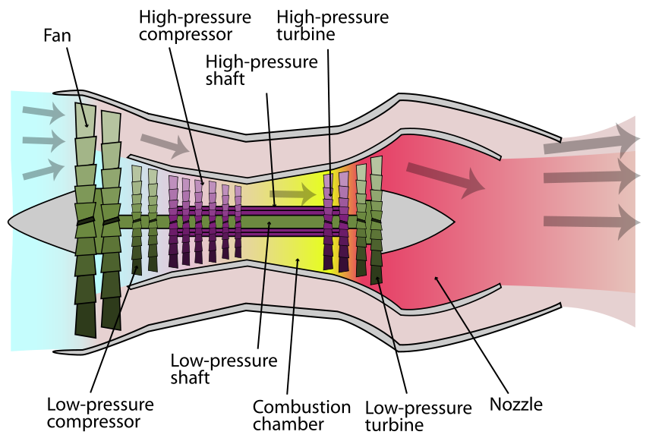
Turbofan
Turbofan is a type of aviation engine that works on a similar principle as a jet engine, that is, on the principle of action and reaction law. In contrast to the jet engine, it also contains a fan and a low-pressure compressor driven by another turbine. The air entering the engine is first pressed by the fan. Its part (given by bypass ratio) flows into the high-pressure part of the engine, but the rest flows through the so-called bypass channel. The engine thrust is caused by the effect of both gas streams.
Author: K. Aainsqatsi – Vlastní dílo, CC BY-SA 3.0, https://commons.wikimedia.org/w/index.php?curid=4008470

Slide 5
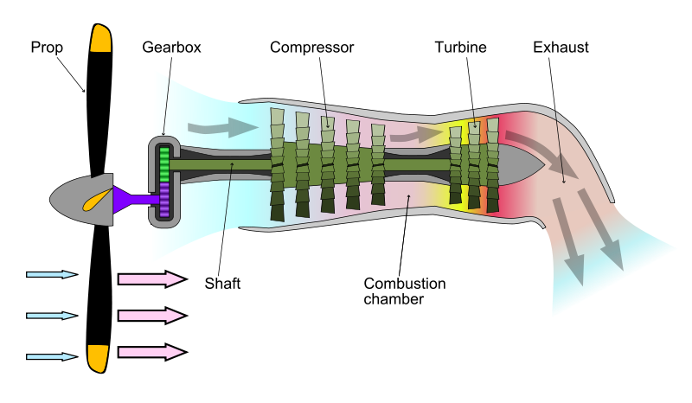
Turboprop
The exhaust gases flow from the turbocharger (generator) part transmits a substantial part of its energy to a low pressure turbine for propeller propulsion. The residual tensile force of the exhaust gases in the outlet nozzle is very small. The tensile force of these motors is from 85-90% created by propellers. Because the speed for maximum propeller efficiency is lower than that of the turbocharger rotor and propeller turbine, it is necessary to use a reducer.
Author: Turboprop_operation.png: Emoscopesderivative work: M0tty (talk) – Turboprop_operation.png, CC BY 2.5, https://commons.wikimedia.org/w/index.php?curid=7611409

