Slide 1




Air Transport Management and Technology:
5. The Classification of Aircrafts and Flight Physics Fundamentals
Methodological concept to effectively support technical key competencies using foreign languages ATCZ62 – the CLIL as a university teaching strategy

Slide 2

Definition of aircraft
Aircraft is a flying means of transport, according to the definition of the Czech standard it refers to: "A device capable of exerting forces carrying it in the atmosphere from air reactions that are not reactions to the Earth's surface."
Airplanes can be divided according to many aspects, but the basic classification is as follows:
    Aircraft lighter than air – they use aerostatic forces to fly
    Aircraft heavier than air – in order to fly they mostly use aerodynamic force (lift) on lifting surface that can be moving or fixed (wing).

Slide 3
Classification of aircraft
Aircraft lighter than air (aerostats)
  With propulsion - for example airships
  Without propulsion- for example hot air balloons
Aircraft heavier than air (aerodynes)
  Without propulsion with fixed lifting surfaces (wings) – e.g. a parachute or a glider
  With propulsion with moving (rotating) lifting surfaces – e.g. a helicopter
  With propulsion with fixed wing/wings – e.g. a rogalo or a classic airplane
  With propulsion without lifting surfaces – a rocket
There are also combinations of the above – e.g. a convertiplane, which changes the method of achieving lift during the flight.

Slide 4
Classification of transport airplanes
Depending on the length of the flying range we distinguish:
Short-haul airplanes with a range of up to 1,000 km, sometimes referred to as regional.
Medium-haul airplanes with a range of 1000 to 3000 km. These aircraft are mainly used on international routes.
Long-haul aircraft with a range of more than 3000 km are deployed on transcontinental flights.
Depending on seat capacity:
Light aircrafts - aerotaxi: 3 to 10 passengers;
Small transport airplanes: 10 to 30 passengers (sometimes called as feederliners);
Medium-sized transport airplanes: 30 to 100 passengers;
Large transport airplanes: 100 to 200 passengers;
High capacity aerobuses : over 200 passengers

Slide 5
Classification of transport airplanes (continued)
Depending on the seat arrangement in the airplane:
Narrow-body airliners – with single aisle, 2-2 or 3-3 seats abreast;
Wide-body airliners – with two aisles and 2-3-2, 3-3-3 or 3-4-3 seats abreast.
Depending on the type of propulsion system:
Propliners (past) or light airplanes with propeller (piston-powered engines);
Propjet (Turboprop powered);
Jet airliner (Turbofan or turbojet powered).
Transport airplanes can also be distinguished according to the location of lifting surfaces, the number and position of the engines, the type of landing gear or the shape of the wings (and others).

Slide 6
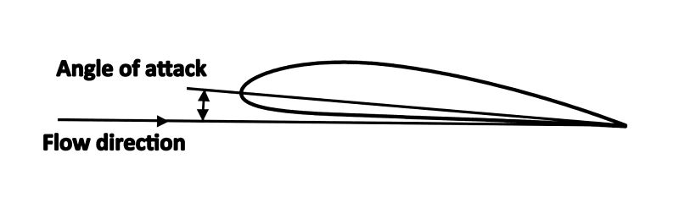
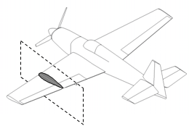
Generation of aerodynamic force
  An airfoil generates lift by exerting a downward force on the air as it flows past. According to Newton's third law, the air must exert an equal and opposite (upward) force on the airfoil, which is the lift. (Simplified physical explanations).
  For aircrafts heavier than air, the aerodynamic force must be equal to or greater than the weight of the flying object.
  To generate the aerodynamic lift it is necessary to ensure the airflow around lifting surfaces (wings) at a certain velocity v, the wing must also have a certain profile (airfoil) and sufficient area S, and it is also necessary to ensure the efficient „angle of attack“ of an airfoil.
V

Slide 7
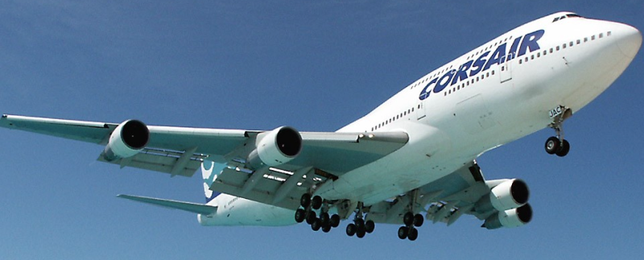
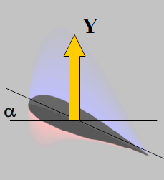
Aerodynamic force Y
Y
Y = c_{y} . S . ρ . v² / 2
S – size of lifting surfaces [m²],
ρ – air density [kg/m³]
v – airplane velocity [km/h]
c_{y} – „angle of attack α“ function – aerodynamic coefficient
G

