Slide 1
Air Transport Management and Technology: 12. Air Freight Shipments
Methodological concept to effectively support technical key competencies using foreign languages ATCZ62 – the CLIL as a university teaching strategy

Slide 2
Air Cargo – Types of shipments
Separate consignments (shipments) and shipments loaded into containers (ULD) as subsidiary transport on scheduled flights in transport airplanes for passengers, their luggage and mail.
Separate consignments (shipments) and shipments loaded into containers or pallets (ULD) - Cargo shipments transported within scheduled or non-scheduled air cargo routes (mostly All Cargo carriers who focus only on pure freight).
Another categorization of shipments :
Non-Special Consignments (low-value items);
Shipments requiring special care.

Slide 3
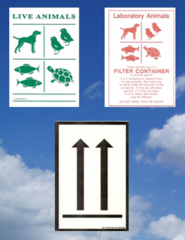
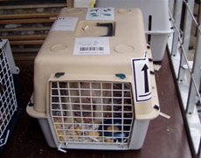
Shipments of a special nature
For these items, it is necessary to request transportation in due time, especially due to "booking" of the space in the aircraft for the consignments. In particular, such items include :
Transport of dangerous goods - Carried out according to IATA Dangerous Goods Regulations (IATA DGR).
Transport of live animals - Carried out in accordance with the specific IATA regulations (LAR Manual) that the shipper and the participating airline must observe for transport. The LAR Manual determines e.g.:
Veterinary regulations of individual countries
Transport box requirements (space, double bottom, ventilation...)
The presence of the animal keeper
Vaccination
Documentation, etc.

Slide 4
Shipments of a special nature (cont.)
Transport of perishable goods – include goods which can change their properties due to temperature, therefore require special care during transportation. The consignments must be labelled with “Perishable” label and if the item contains liquids, “This Side Up” label is attached as well.
Transport of valuable items - These are objects and goods, otherwise referred to as valuable, expensive, protected, etc. In particular, it includes all goods in the price of 1000 US dollars or more.
Transport of fragile and easily breakable items - Requires special attention during handling and transport. It must be packed in two inner and outer layers, the interspace must be filled with shock-absorbing material. The consignments must be labeled with “Fragile Handle with Care” label.

Slide 5
Shipments of a special nature (cont.)
Transport of goods that may not be turned upside down - must be labelled with "This Side Up" label. They most commonly include liquids, which are to be packed in two containers; the interspace is filled with absorbent material; the liquid is filled to 9/10 of the container content.
Transport of human remains - Cremated human remains must be accompanied by a certificate of cremation. Non-cremated remains can only be transported in a sealed lead or zinc coffin, which must be further stored in a wooden coffin. It can be further wrapped or covered with a canvas so that the nature of the shipment is not obvious. Remains are always transported in a separate cargo compartment of the aircraft, separate from other goods.

Slide 6
Shipments of a special nature (cont.)
Transport of weapons and ammunition - Weapons of all kinds may be accepted for international transport to such countries where permitted by applicable regulations, and only if the consignment is accompanied by all documents required for export, import and transit, and if its acceptance to transport is not inconsistent with the transport regulations of the participating carriers. The ammunition is accepted for transport under the conditions laid down by the IATA DGR. Extreme security measures are valid for the export of such consignments.
Transport of damp goods - Damp goods (where fluid or moisture may escape during transport) are only accepted for transport in watertight containers. These are mainly refrigerated goods, fresh wet flowers, fruits and vegetables.
Transport of bulky goods - accepted for transport on condition that they fit into the cargo compartment of the aircraft and that there is a free space available.

Slide 7
Shipments of a special nature (cont.)
Transport of partial shipments - If a larger weight consignment consisting of several pieces cannot be loaded into one plane, it can be divided into several parts and transported one-by-one by two or more aircraft of the same airline.
Transport of heavy goods - These are shipments exceeding the maximum weight per m² of floor. Such consignments must be deposited on underlying materials in order to spread the weight on a larger surface.
Unaccompanied baggage or baggage shipped as cargo – If passengers exceed the free baggage allowance (20 kg or 30 kg), they pay the surcharge on the excess baggage. In addition, passengers are allowed to carry a certain baggage as unaccompanied, thus making cargo from the baggage.

