Slide 1




Air Transport Management and Technology:
11. Air freight transport
Methodological concept to effectively support technical key competencies using foreign languages ATCZ62 – the CLIL as a university teaching strategy

Slide 2

Air Cargo – basic forms
Additional transport of cargo on scheduled passenger flights, using the spare volume in the airplane's baggage hold (the "belly") that is not being used for passenger luggage.
Scheduled freight transport by cargo aircraft. This method is operated by large aircrafts dedicated for the job.
Charter based cargo transport - ie. renting all capacity in cargo aircraft. It is often used in the transport of live animals, emergency supplies during natural disasters and the like.
Forms of freight:
Separate shipments
Unit load device – pallets or containers for air transportation
Combination

Slide 3
Acceptance of goods for air transport
General conditions and steps:
The sender (consignor) agrees to the shipping conditions of the airline (for example IATA conditions of carriage for cargo) – type of cargo must comply with the general conditions.
Goods received for carriage must meet all requirements (for example properly packed consignment, whether documents are required, etc.)
Shipments of a special nature must also meet all the specific requirements for the transport of each type of commodities.
Transportation of specific goods is not prohibited by laws or regulations of the countries concerned.
An air carrier's worker or its agent, after checking the goods, chooses an appropriate tariff and issues the air waybill (AWB) to the customer. The rate is calculated according to the Air Cargo Tariff and Rules (TACT) or a special tariff is selected.

Slide 4
Air Waybill (AWB)
It is the most important document in air freight transport issued by an air carrier or its agent. The basic functions of AWB are as follows:
Verified by the consignor and the carrier is proof of the conclusion of a transport contract between the consignor and the carrier;
AWB is a proof of receipt of goods for carriage;
AWB is also an invoice;
AWB is proof of payment of premiums;
AWB is also a customs declaration;
AWB is a source of information (from when does AWB apply, cargo handling, dispatch and delivery of shipments, etc.).
The air waybill consists of 3 originals and copies. Originals acquires major carrier, sender (consignor) and consignee (at the destination). The remaining copies will be received by the entities involved in the transportation process.

Slide 5
The Air Cargo Tariff and Rules TACT
The tariff for air freight is governed by the TACT document, which sets rates per kilogram of freight or minimum flat rates for given transport routes. The calculation of the shipping cost has its own rules, the type and dimensions of the cargo are taken into account. These are rates for goods:
General Cargo Rates (GCR) – are applied to the carriage of goods not included in another class.
Specific Commodity Rates (SCR) - are used for a certain type of goods, specified by the four-digit code in the TACT.
Class Rates (CR) - These rates are only used for goods listed in the TACT document. These goods are:
Live animals, valuables, human remains in coffins and urns, newspapers and Periodicals, unaccompanied baggage sent as cargo, and others.

Slide 6
Special tariff concepts
„Home-to-Home“ tariff,
Express tariff,
flat rate per piece / unit,
Contractual rates,
Tariff for air containers and pallets (ULDs).
Additional charges, such as a fee for issuing an air waybill, customs clearance, a certificate of origin, etc. may be charged for the shipment transport.

Slide 7
Unit Load Devices (ULDs)
    These are unified air containers and pallets approved by IATA. The price for the transport of containers and pallets is valid up to the specified weight limit („Pivot weight).
    Air freight container is a compact box, which can be made from different materials (molded paper, fiberboard, metal, plastics). The walls of the container are firm. The container forms a single unit for the transport of large quantities of packages (general cargo).
    The pallet is a platform made of compact or non-compact material on which individual shipments are deposited, so that the whole constitutes one load unit. The pallet has handles and the goods are fastened to it by means of mesh.

Slide 8
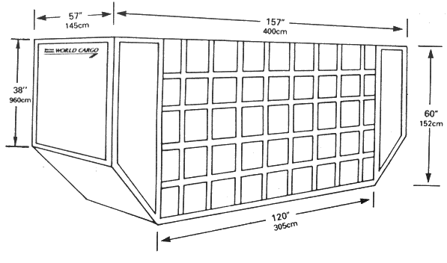
Unit Load Devices (ULDs)
    Examples of unified ULDs and their characteristics
Container type | Volume | Linear dimensions (base width / overall width × depth × height)
LD1 | 4.90 m³ | 156 / 234 × 153 × 163 cm
LD2 | 3.40 m³ | 119 / 156 × 153 × 163 cm
LD3 | 4.50 m³ | 156 / 201 × 153 × 163 cm
LD3-45 | 3.50 m³ | 143 / 243 × 142 × 109 cm
LD6 | 8.95 m³ | 318 / 407 × 153 × 163 cm
LD8 | 6.88 m³ | 244 / 318 × 153 × 163 cm
LD11 | 7.16 m³ | 318 × 153 × 163 cm
Pallet type | Volume | Linear dimensions (base width / overall width × depth × height)
LD8 | 6.88 m³ | 153 × 244 cm
LD11 | 7.16 m³ | 153 × 318 cm
LD7 (2 pallet variants) | 10.8 m³ 11.52 m³ | 224 × 318 cm 244 × 318 cm

Slide 9
Cargo terminals at airports
    Cargo terminals for air freight are used for storage and handling of shipments (among others). Cargo terminal must be equipped with the following in particular:
    Truck center - Each terminal must be connected at least to road transport infrastructure, there is a direct automated transloading of the palletized units from the aircraft to the trucks and vice versa.
    Automated warehouse for air freight containers and pallets equipped with forklift loader - similar to other logistics centers and terminals in other transport modes.
    X-ray equipment for checking larger size shipments.
    Refrigeration and freezing areas for storage of perishable shipments.
    Other special areas - such as areas for live animals, dangerous goods or radioactive shipments.

