Slide 1




Supply systems management:
9. Storage systems and warehousing in the supply chain
Metodický koncept k efektivní podpoře klíčových odborných kompetencí s využitím cizího jazyka ATCZ62 - CLIL jako výuková strategie na vysoké škole

Slide 2

Functions and types of warehouses
Storage fulfills important functions in value-creating chains. If chain processes are to be optimal, it is necessary to balance capacity and time disproportion among raw material suppliers and their processors, among individual technological or logistics processes in the production or assembly, among the rhythm of production and requirements of the products users, among the dates of supplies of construction materials and the construction procedures, etc.

Slide 3
Warehouses are divided according to many criteria:
1. In terms of warehousing type:
  free
  stacking
  warehousing in racks
2. In terms of construction, we distinguish warehouses:
  free, adjusted surfaces
  covered
  open
  closed

Slide 4
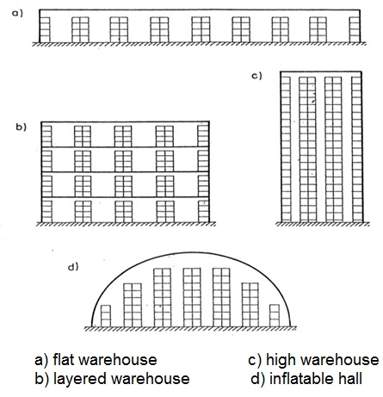
Whereby, such warehouses may be:
  flat
  layered
  high
  inflatable halls, etc.

Slide 5
Organization and communication in the warehouse management
Warehouses and warehouse management organizations are one of the relevant factors influencing the quality level of processes in elements of the value-creating chain, and thus, the level of enterprise logistics. What requirements are placed on the organization of warehouses?
We can divide them into two fields:
  warehouse regime field,
  administrative field.

Slide 6
The first field consists of:
  stocks and storage places management,
  handling and auxiliary equipment management,
  receipt and management of orders,
  orders formulation,
  assignment of orders and handling equipment,
  orders issue.
The second field consists of:
  invoicing,
  inventorying,
  statistics.

Slide 7
Picking
Picking (commissioning) is to assemble (collate) a certain amount of logistics objects from the prepared quantity of required assortment based on information about the assigned requirements. This activity can be done through employees or using the equipment.

Slide 8
Logistics objects
The most important effect on the method of logistics processes realization and on the handling machines and equipment selection has for obvious reasons the material itself - a logistics object.
If only one kind of logistics objects appears in the logistics process, we are talking about a sigle-type problem, otherwise (and such cases are in the majority) we are talking about a multi-type problem.

