Slide 1

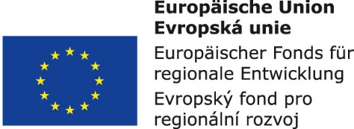


Supply systems management:
4. Structure of the procurement, production and distribution logistics
Metodický koncept k efektivní podpoře klíčových odborných kompetencí s využitím cizího jazyka ATCZ62 - CLIL jako výuková strategie na vysoké škole

Slide 2

Alternative logistics structures
The value-creating chain forms a sequence of technological and logistics elements in which undergo transformation processes in which the products required in the market are created.
The value-creating chain begins by suppliers of raw materials for production and has a different structure depending on:
  the type of commodity,
  supplier's location,
  the way and organization of transport,
  customers requirements, etc.

Slide 3
Alternative supply chain structures include:
1. individual deliveries ,
2. one-stage with tranship areas ,
3. one-stage with a distribution center ,
4. two-stage structure .

Slide 4
Storage and transport strategies:
external distribution warehouse,
transhipment concept,
Randez-Vous system,
the concept of regional carriers,
logistics centers.
Supply chains:
direct deliveries,
shipments through the central warehouse,
transhipment,
crossdocking.

Slide 5
Physical distribution and distribution networks
Physical distribution stands for not only the movement and storage of goods (primary logistics objects), but also the related information and financial flows running through the distribution space.
The distribution space consists of all distribution points, distribution equipment, distribution network and their mutual relationships.
The distribution network consists of distribution sources, distribution centers, customers and mutual relationships between these elements.
The distribution node stands for a distribution point, a distribution station or a distribution warehouse, in which the collection, distribution or storage of logistics objects and their subsequent distribution.

Slide 6
Distribution laws
1st distribution law:
The sum of the logistics objects entering the distribution node and located at that node is equal to the sum of the logistics objects exiting from that node and remaining there.
2nd distribution law:
The sum of logistics objects at the exit of a distribution source over a given period of time is equal to the inventories volume at the distribution nodes at the end of that time period, the number of objects dispatched from the distribution nodes during that period, the amount of objects on the route between the source and the distribution nodes, and the difference in the sum of inventory volumes in distribution nodes at the beginning of this period.

Slide 7
Supply Chain Management (SCM)
Supply Chain Management, due to its characteristics, offers much more options, i.e. due to the interconnection of all internal and external participants along the entire process chain, from the customer of the final product to the raw material supplier, the necessary information is exchanged in real time.

