Slide 1

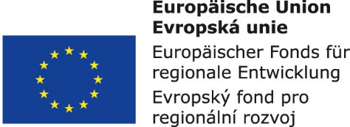


Supply systems management:
2. Value-creating chains, characteristics, system functions, process approach
Metodický koncept k efektivní podpoře klíčových odborných kompetencí s využitím cizího jazyka ATCZ62 - CLIL jako výuková strategie na vysoké škole

Slide 2

Functional model of a logistics chain element
Logistics ensures and manages the movement of objects (products, pallets, orders, etc.) through partial chain processes. In the individual partial processes, the transformations of objects are performed:
  the excavation of foundations,
  their concrete,
  masonry,
  or brick molding,
  their control,
  storage,
  handling,
  transportation, etc.

Slide 3
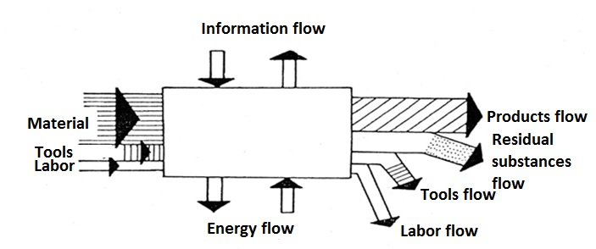
Each element acts in the process chain both as a customer and as a supplier, and has to handle a number of partial processes that have a character of business processes.
Structure and characteristics of process chain elements
The process chain elements model in Figure 2-1 shows an element in the "Black Box".

Slide 4
Processes management, Supply Chain Management
From the point of view of logistics goals, the influencing the process chain elements or the whole chains is limited to four basic factors. These factors are:
processes,
management,
tools,
structures.

Slide 5
From these four factors, a set of 17 classes of rationalization potentials, which are the building blocks of strategic logistics planning, can be derived by:
customer,
supplier,
structure of processes.
Management includes:
normatives,
administrative,
networks,
control.

Slide 6
Tools are represented by:
personnel,
space,
stocks,
work tools,
aids (ancillary tools),
organizational tools.
Structure is represented by:
layout,
organizational structure,
communicational structure.

