Slide 1

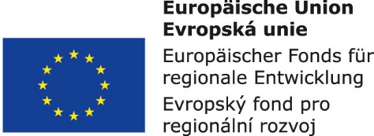


Supply systems management:
12. Trends in the supply systems and processes
Metodický koncept k efektivní podpoře klíčových odborných kompetencí s využitím cizího jazyka ATCZ62 - CLIL jako výuková strategie na vysoké škole

Slide 2

Process chains among suppliers and final customers
  The corporate strategy is the basis for successful business management and the starting point for creating all the business plans. Corporate strategy means the formulation of basic enterprise development processes. Enterprise strategy includes its strategic goals and strategic operations.

Slide 3
Logistics provides and controls:
  the movement of objects (e.g. products, pallets, orders, etc.),
  through partial process of the chain processes.
Transformation of objects, i.e. machining, storage, handling, control, etc., takes place in individual processes.
Among processes, the exchange of material (matter, substances) and information occurs. The task of logistics is to control the integrated material and information flows. The level of interactions among process chain elements affects the quality of logistics and the level of communication systems is therefore the main aim of logistics experts.

Slide 4
RFID – Hardware and Software integrated into material flows
  Recently, many research and development studies and works have been carried out in the field of improving the properties and implementation of radio frequency identification. Especially, as far as the introduction of these executive elements into intralogistics is concerned.

Slide 5
RFID (Radio Frequency Identification) - of radio frequency identification, at the current stage of development, enables unambiguous contactless identification of almost any object using means of electromagnetic waves.
Establishing the RFID technology enables to optimize the value-creating processes.

Slide 6
Transponders are systems that enable to exchange the data via transmitting and receiving units. The transponder consists of a transponder antenna, which for obvious reasons is smaller than the antenna system of the communication unit, and a chip. The chip is used to store the data and performs the function of controller. Active transponders also have an energy source and can process and transmit the information.

