Slide 1

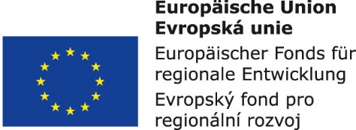


Supply systems management:
1. Integrated material and information flows of the supply systems
Metodický koncept k efektivní podpoře klíčových odborných kompetencí s využitím cizího jazyka ATCZ62 - CLIL jako výuková strategie na vysoké škole

Slide 2

Material movement - an essential part of the reproduction process
The process of constant restoring the production is the material basis of reproduction. This process raises the constant need for transport and storage and associated loading, unloading and transhipment of raw materials, semi-finished products and final products..
Production, characterized by the labor shift, takes place in different places and usually other than consumption and at times other than consumption.

Slide 3
Smooth processes in production and entire market mechanism require so that labor, resources and objects (both work and consumer) are:
  in the required quantity,
  assortment and quality,
  ecologically and economically optimally,
  in a determined time,
  and at the desired location.

Slide 4
Transformation of technological or logistics character of material objects is realized in the individual elements of process chains. During these transformations, their state changes occur.
In processes of a technological nature:
  shape transformations (for example, in forming or machining) or,
  structures of material objects (eg., in chemical reactions) occur.
In logistics transformation processes:
  time,
  position,
  or orientation of objects in space change.

Slide 5
System approach and integrated conception of material and information flows
The term system represents a purposeful defined set of elements and set of relationships (relations) between them which together determine the properties, behavior and functions of the system as a whole. Mathematically can be expressed as :
System S = (A, R),
where A = (a₁, a₂, a₃ ... a_{n}) set of elements
R = (r₁, r₂, r₃, ... r_{m}) is a set of relationships between them

Slide 6
The structure of the system is a set of system elements and a set of relationships between them.
Thus, the task of logistics is :
  to collect,
  process the information flow from the sales market,
  transform the information content into the purchasing market side and integrate it with the flow of material objects (raw materials, semi-finished products and final products),
  and optimize these integrated flows.

