Slide 1




Information and communication technologies:
9. Film, its history, development and future. Film technology.
Methodological Concept for Effectively Supporting Key Competencies Using the Foreign Language ATCZ62 - CLIL as a Learning Strategy at the College

Slide 2
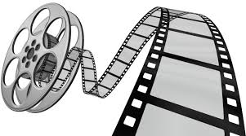
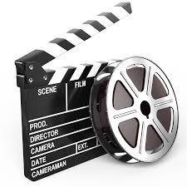

The film is a composite sign for cinematography and all its aspects - artistic, technical, commercial and social.
The way information is transmitted, the source of entertainment,
means of communication.
While watching the movie, the human eye sees a sequence of consecutive images.
Quickly rotate the projected images in very short order
The time period with our eye nerve and consequently the brain appears as an uninterrupted activity (the image does not tear and is perceived by the brain as a continuous motion).

Slide 3
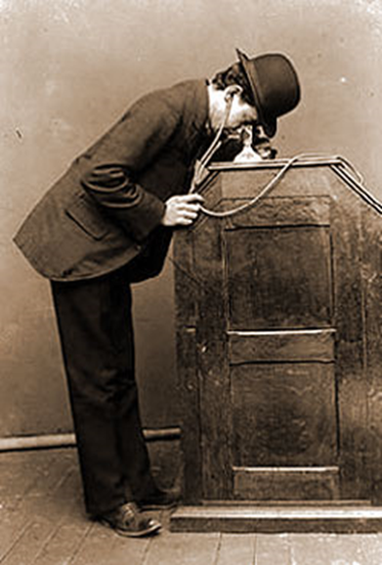
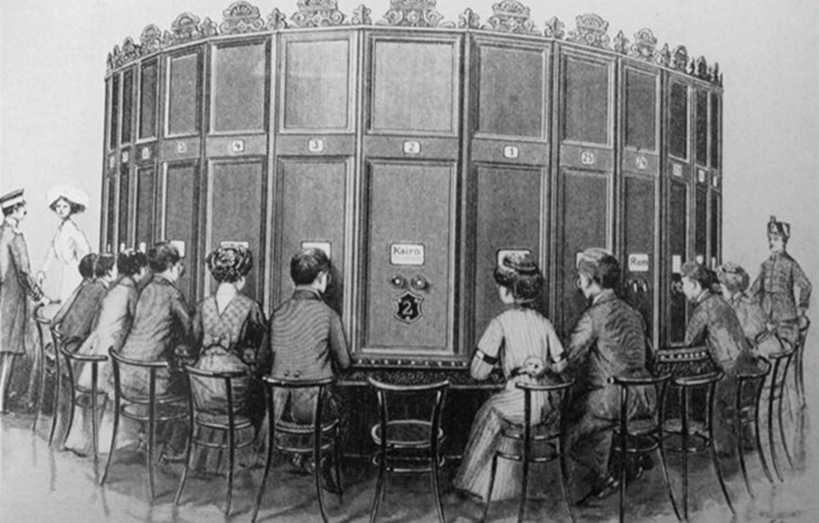
HISTORY
1893 - kinetoscope - William Kennedy Laurie Dickson,
Viewfinder for one viewer,
The film could be watched only through a small peephole on the body of the device.

Slide 4
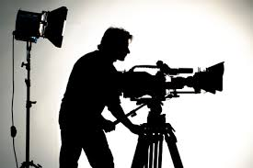
Film development
The development of film as a technical invention as a kind of art, cultural, social and economic phenomenon occurred in the late 19th century.
The first public performance was made by the French inventors of the cinematographic apparatus by the brothers Auguste and Louis Lumière on December 28, 1895 in Paris.
The film was 35 mm wide and 16 frames per second (fps).
Brothers Lumiere have dealt with documentaries and
travel videos. The first short feature film is
Considered to be their Upper Sprinkler. Comedy with
Gardener and irrigation hose.
Georges Méliès – roku 1897 v Evropě první filmový ateliér. Autor filmových triků.

Slide 5
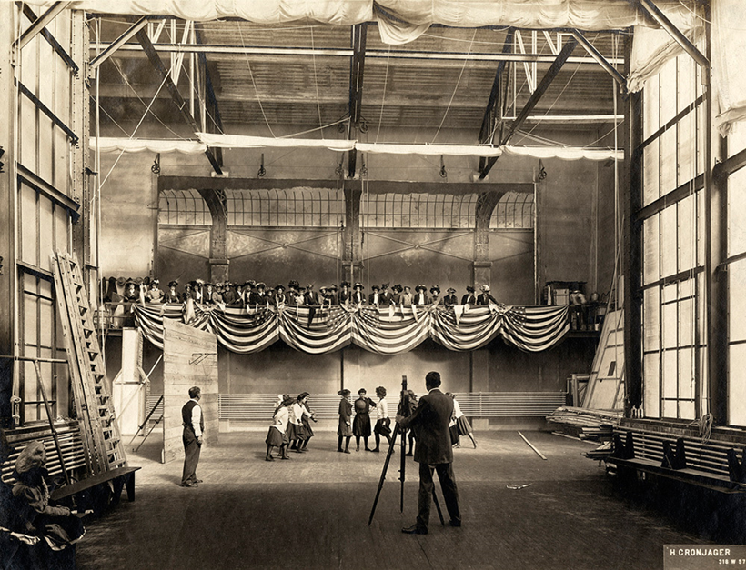
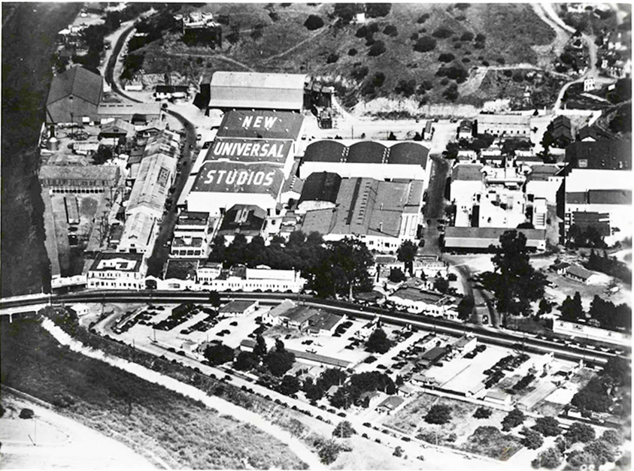
In the 20s of the 20th century there was a change that completely changed the form of the film.
In California, there was a period to set up film studios. The quality of the films played an increasingly important role in the competitive struggle, and it was necessary to gain the audience with something that differed from the average production.

Slide 6
Various film sizes and film editing allowed the film tension to grow and lead to narratives on several levels, which was for example difficult to realize in the theater.
Deepening and refining the film expression in the area of editing and using the camera.
With the use of multiple lenses, the range of shots ranging from large units to detail has been fully utilized, and the camera has also been detached from the place and used to ride.
During this period, the film was completely detached from the theater, it found its visual rhythmic way of expression, but also a new cinematic way of acting, writing scenarios, etc..

Slide 7
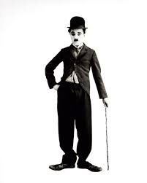

Silent movie
Charlie Chaplin - one of the most famous and best-paid artists.
Every time, he played socially declassified characters that fight against the beautiful and successful people.
Joseph "Buster" Keaton,
created a new, completely distinctive type of film comedy.
The uniqueness of the comic hero is the respect he holds in all, even in the most abusive and unexpected situations.

Slide 8

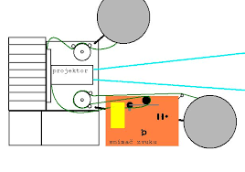
Sound film
The Jazz Singer (1927), by Warner Bros., launched the era of soundtrack.
In the next five years, all technology, instrumentation and the face of the film have changed fundamentally.
The sound made the audience more interested in the film.
However, many actors who did not speak English lost their work, as well as pianists who made soundtracks in silent cinemas.

