Slide 1




Information and communication technologies:
8. Photography, its history. Digital Present and Future.
Methodological Concept for Effectively Supporting Key Competencies Using the Foreign Language ATCZ62 - CLIL as a Learning Strategy at the College

Slide 2
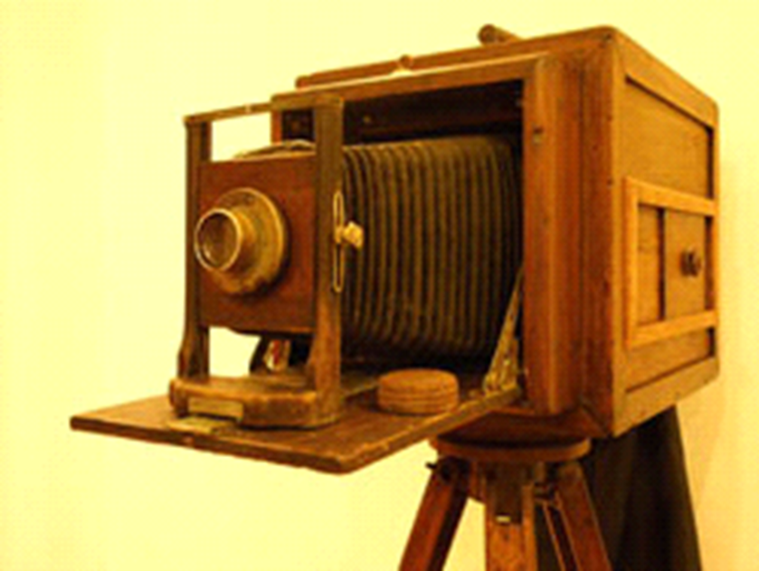

The history of photography

Slide 3
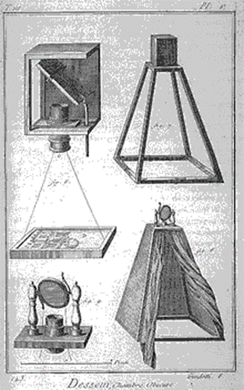
The history of photography
The invention of chemical photography
Color photograph
Beginning and photography enlargement
The invention of digital photography

Slide 4
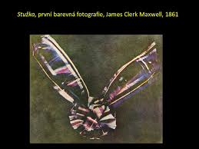
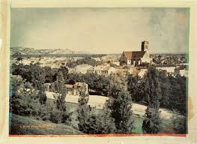
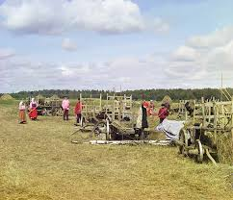
The history of photography
Strip, the first color photograph, 1861
View of Agen, France in 1877 by Louis Ducos du Hauron, French pioneer of color photography
Early color shot by Sergei Prokudin - Gorski around 1909

Slide 5
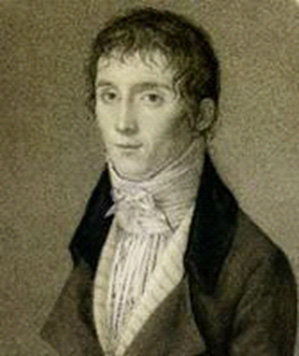
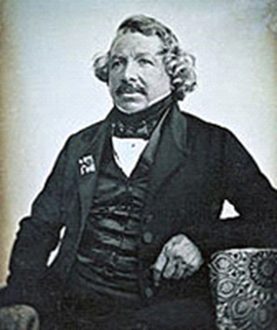
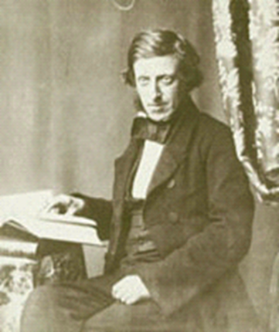
Important personalities in photography
Joseph Niecephore Niepce
Luis Jacques Mandel Daguerre
F.S. Archer

Slide 6
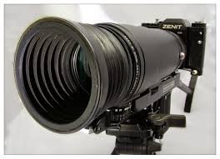
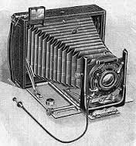
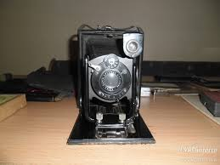
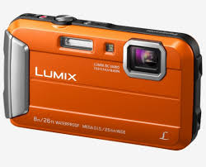
Types of cameras
According to the sensitive layer:
Plates
Movie
Digital
Instant
By design:
Cameron service
Board camera
Photographic camera
Folding camera

Slide 7
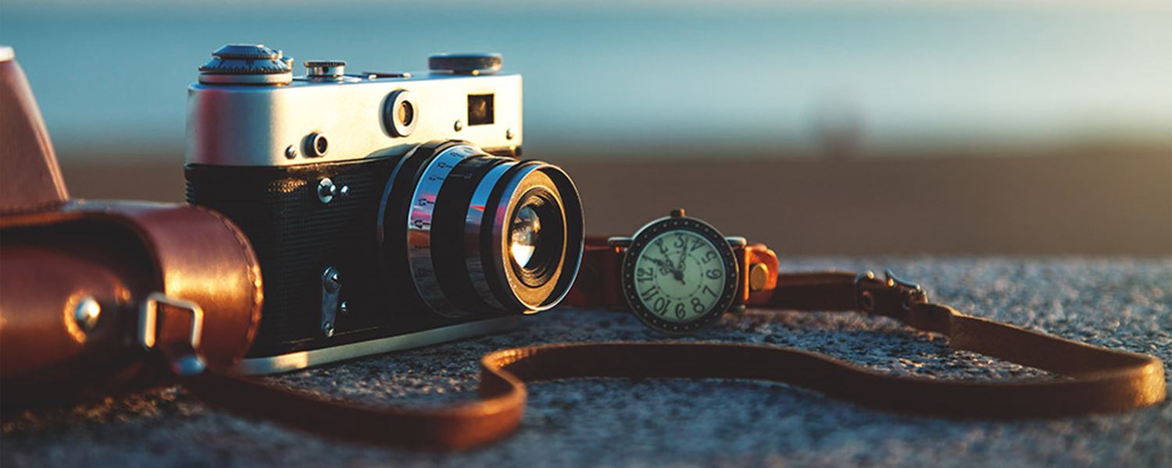
Present of photography

Slide 8
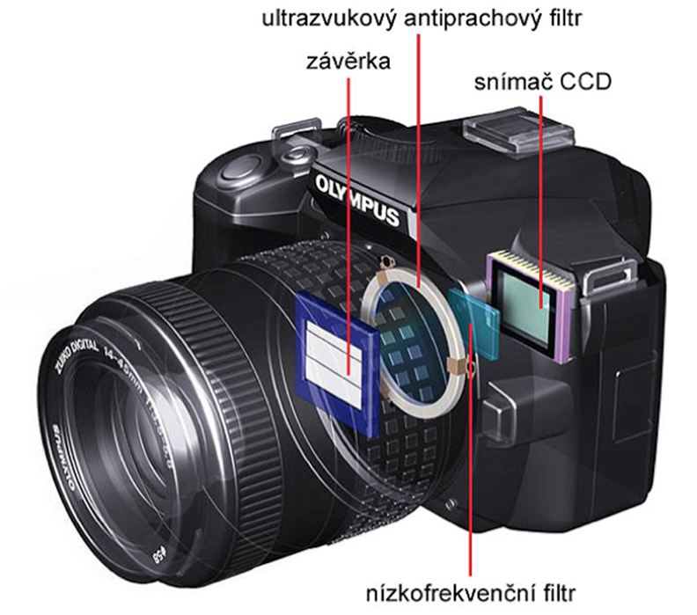
Present of photography
Closed dust filter
.
Shutter
CD sensor
- One image gives a thousand words
- digital x chemical process
- at present, every professional photographer
- Documentary photography
Low frequency filter

Slide 9
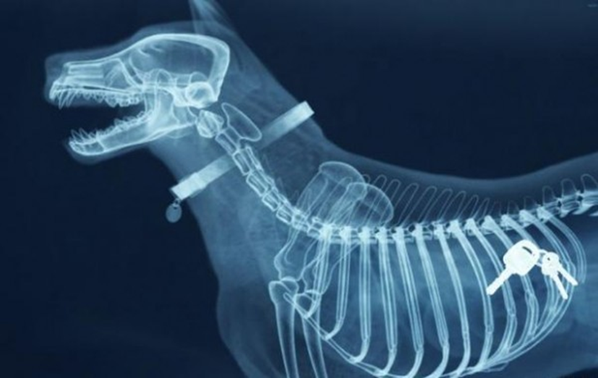
Benefits of photography
Media.
Art.
Army, police and security forces.
Marketing and advertising.
Science.
Medicine.
Keeping memories.

Slide 10

Negatives of photography
Virtual reality,
Voyerism,
Unreality,
Photo Handling,
Paparazzi,
Cyber-bullyingj,
The phenomenon of selfie,
Media manipulation.

