Slide 1




Information and communication technologies:
7. Media education as a defense against the negative effects of media communications.
Methodological Concept for Effectively Supporting Key Competencies Using the Foreign Language ATCZ62 - CLIL as a Learning Strategy at the College

Slide 2

Media Education
The relationship between media education and media literacy is simply a relationship between the means and the goal.
Media education is thus defined by means of media literacy as education for orientation in mass media, their use and at the same time their critical assessment as a deliberate educational influence on achievement of a certain degree of media literacy, or simply as education for life with the media.
Media education was gradually formed, and its roots are sometimes laid at Comenius, sometimes up to ancient Greece, but the real development came after the Second World War.

Slide 3


Reasons for Media Education
Lots of information, knowledge, opinions;
The changing conditions of human life;
Development of media literacy as part of general education;
Media literacy = a set of competencies that help the user to search, analyze and evaluate information and pass on it;
The content and the way of implementation are different → education system
Conceptual questions:
What should be the content of media education?
What is the mission of media education?
What is the way of realizing the media?
Education?

Slide 4
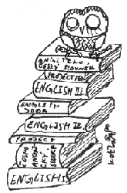
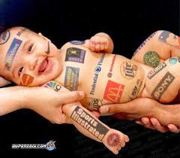
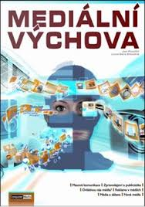
Concept of media education
Two basic components:
Knowledge - typical of Canada and Scandinavia - is based on a critical branch of media theories, the Frankfurt School, and British cultural studies.
Skill - typical of the US, assumes that pupils acquire the necessary knowledge and skills by trying out how the media work.

Slide 5
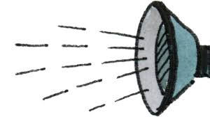
Negative effects of media communications
Radio
I believe that the role of radio as a means of influencing the views and the value system of children and youth is at present the smallest of all information technologies.
Most young people use radio only as a sound background.
The only thing that can affect the listener is the need for advertisements that are often subject to a sneaky melody and the memory of the listener, and some slogans are constantly remembered.

Slide 6

Negative effects of media communications
TV
One of the most important media on the child's psyche is television.
When a child watches 24 McLUHAN TV, Herbert for a bad action movie, he considers everything that happens to him and of course he also wants to try without the consequences
DVD player
Children spend their time looking at dvd discs instead of going out with friends, but this hobby can also lead to copying DVDs that are illegal from the point of view of copyright.
Children watching a movie at DVD do not develop their rhetorical skills, they do not use fantasy.
Which can lead to small vocabulary, poor speech and obesity.

Slide 7

Negative effects of media communications
Mobile phone
With a mobile phone, there is a danger that school students will use their phone for cheating.
It leads to inattention at class, to a lack of concentration.
Often used to play games, to write sms while teaching.

Slide 8


An example of negative effects
Everyday communication takes place via e-mail
We manage e-banking with e-banking
We read news mostly on the Internet
The influence of the media on the individual's psyche - especially on children and youth
Social networks - children
The most effective way to alleviate the negative effects is the family

