Slide 1

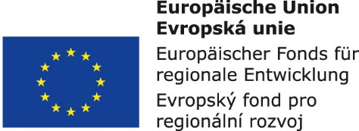


Information and communication technologies:
6. Media communication. Social communication: verbal, nonverbal communication.
Methodological Concept for Effectively Supporting Key Competencies Using the Foreign Language ATCZ62 - CLIL as a Learning Strategy at the College

Slide 2

Media Education
The relationship between media education and media literacy is simply a relationship between the means and the goal.
Media education is thus defined by means of media literacy as education for orientation in the mass media, their use and at the same time their critical evaluation as intentional educational influence on achievement of a certain level of media literacy, or simply as education for life with the media
Media education was gradually formed, and its roots are sometimes laid at Comenius, sometimes up to ancient Greece, but the real development came after the Second World War.

Slide 3
MEDIA COMMUNICATIONS
Great power, creates its reality;
Used to increase the range or self-presentation;
It is good to maintain a positive relationship with the media;
Neighboring sectors - public realitons and media realitons.
TYPES OF COMMUNICATION MEDIA
Primary - "character sets and rules for their use (native language)"
Secondary - means of recording and transmission of messages (pictures, fonts, print, transmission and broadcast technology, computer communication networks).

Slide 4
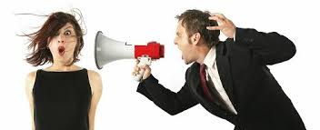
Communication
The word communication comes from the Latin communicare, which means "to share something together, to do something in common.
. Communication is a basic condition for the existence of every social relationship. It is also a means of socially integrating the individual into the human community. For a perfect interaction with the environment, it is essential to learn to listen to the inner impulse - to consciously observe your thoughts, to cultivate a constant inner conversation, to monitor feelings and to learn to understand them.

Slide 5
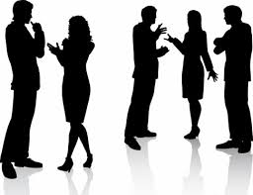

Communication - by number of participants
Intrapersonal communication takes place within an individual and takes the form of an inner dialogue. It is a "self-talk", a self-reflection of one's own behavior and communication with the outside.
Interpersonal communication takes place between two or more people between whom there is a relationship. A specific type of interpersonal communication is group communication.
Mass communication is characterized by a one-way flow of information from one and more communicators (resources) to many communicators (recipients). This is communication through media, such as radio, television, the press, and the Internet. There is no direct feedback in mass communication, so it is important to critically evaluate the information received.

Slide 6
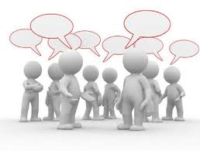
Communication features
Vybíral (2009) defines five basic communication functions:
inform
brief
convince
Negotiate
entertain

Slide 7
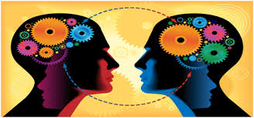
Types of communication
What was to be communicated
communication
Chat
Phone
Sms
e-mail
social networks
discussion
Blog
Direct
Indirect
As the other really understood
Online - communication - offline
Verbal - interpersonal, group
Nonverbal - kinetics, proxemics, many others

Slide 8
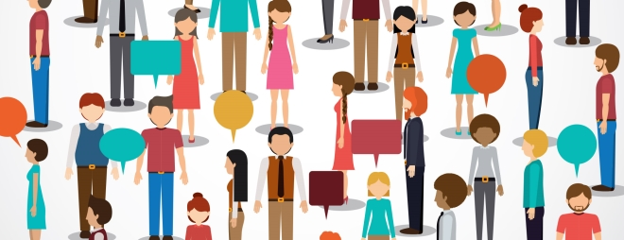
Social communication
Is a condition and prerequisite for the existence of any human community.
Communication factors:
Source of communication - communicator,
Determination of communication / recipient /
- communicant,
Communication / communiqué /,
Communication space - channel.

