Slide 1




Information and communication technologies:
5. The role of image in culture. Teaching using an image.
Methodological Concept for Effectively Supporting Key Competencies Using the Foreign Language ATCZ62 - CLIL as a Learning Strategy at the College

Slide 2
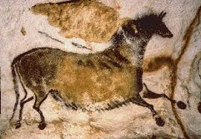
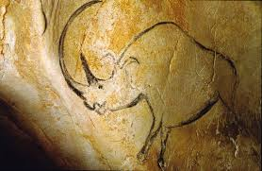
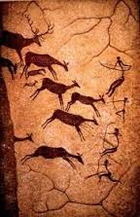

THE PICTURE AND THE PAINTING PROVIDE THE HUMAN FROM THE FIRST TIME
The oldest paintings we know today are paintings in the Chauvet Cave in France
(31 000 ± 1300 B.C.
From this moment on, the person constantly accompanies an image that over time has various informative and aesthetic functions.

Slide 3

The role of image in culture
The important educational role of visualization can be noticed in the Middle Ages.
As a typical example of the then "pictorial Education "can serve the Bible pauperum - The Bible of the poor.
The important educational role of visualization can be noticed in the Middle Ages.
Side of the Woody Bible of the Poor of the 15th Century. In the middle we see the "Annunciation"
On the left "Temptation"
Right "Gedeon's fleece" .

Slide 4
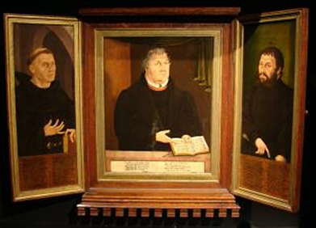
Correlation of image with text
It was very common to link the picture to the text in order to more fully illustrate a particular story. Over the course of a century, symbols, allegories and emblems that represented the text appeared in many paintings; on the contrary, the text itself was often accompanied by images, often in the form of initials or illuminations.
It was very common to link the picture to the text in order to more fully illustrate a particular story. Over the course of a century, symbols, allegories, and emblems that represented the text appeared in many paintings; on the contrary, the text itself was often accompanied by images, often in the form of initials or illuminations.

Slide 5
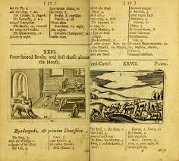
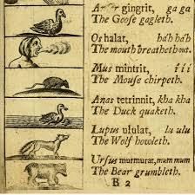
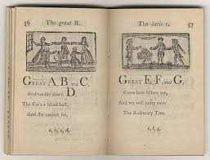
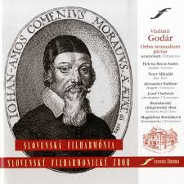
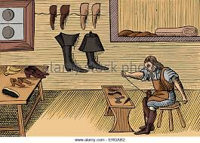
.
Image-based teaching
John Ámos Komensky, a writer,
Which in 1658 wrote Orbis sensualium pictus, has also enrolled in the tradition of image-based learning
It was an illustrated "Encyclopedia", divided into 150 chapters with 150 woodcuts.
The world in the pictures showed and named all the things of the spiritual and material world that were necessary for the children.

Slide 6
Visualization
- visual technique - diaprojection, retrospection, backward projection by Loveček and Čadílek (2008, s.91, 94-95), besides audiotechnics, technical teaching aids, programs and programs presented by didactic technique, belongs to so-called teaching aids (cf. Kolář, 2011, Maňák, Průcha, 2009)
Teaching aids and so-called didactic techniques together form material didactic means.
What, however, the didactic means combines across their categories is the principle of clarity. It consists of the combination of Extrasensory perception, active activity and abstractive thinking. In order to remember the clients as much as possible, it is necessary to involve all senses as much as possible. It is reported that the most information is received by sight (87%) and then by hearing (9%) and other senses (4%).

Slide 7
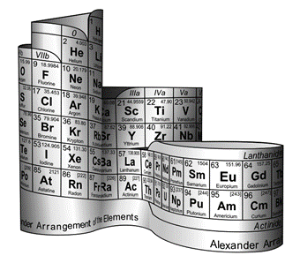
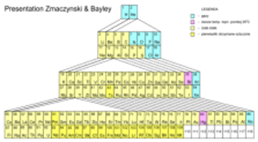
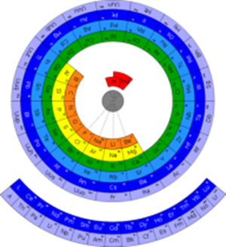
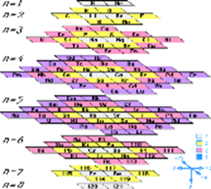
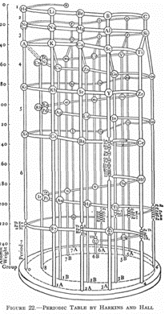
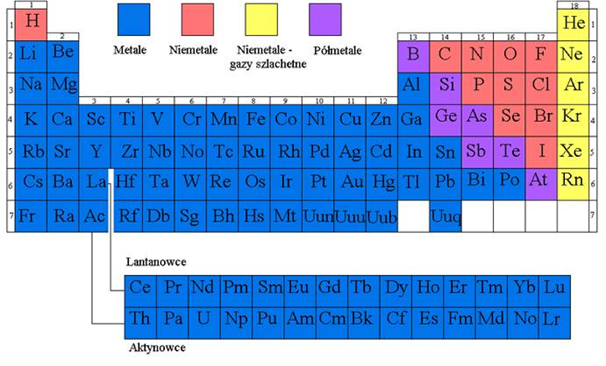
VISUALIZATION
- SUMMARY OF INFORMATION
http://slideplayer.cz/slide/2810422/

Slide 8
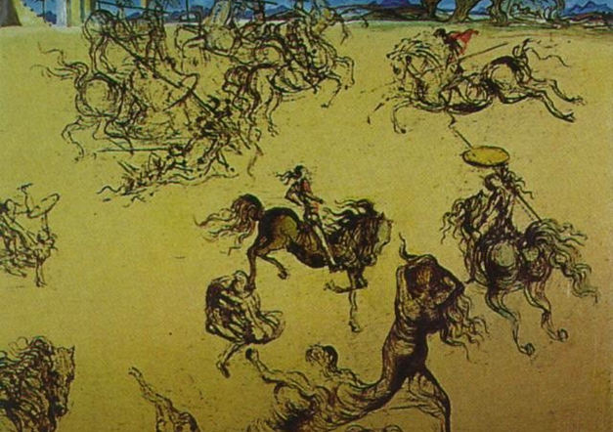
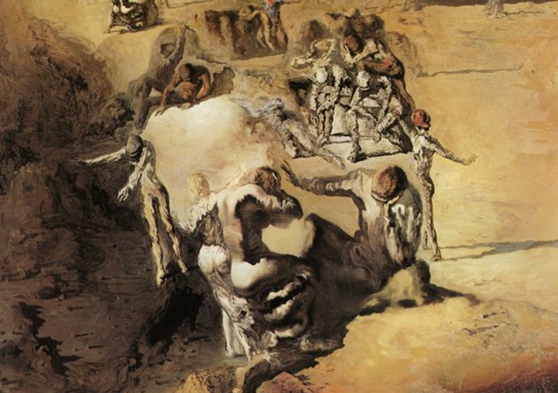
VISUALIZATION: EXPLANATION OF THE PROBLEM
Images can not only serve the role of illustration, but sometimes it is also possible to explain problems that are hard to imagine. As an example of such an approach is the text of prof. Janusz Rachon of Gdansk Polytechnics, in which he describes how he explains to students the resonance theory of Linus Pauling using the paintings by Salvador Dalí.
Both canvas represent more than one image:

