Slide 1
Information and communication technologies: 4. Assumptions of a new dynamic computer model - visualization
Methodological Concept for Effectively Supporting Key Competencies Using the Foreign Language ATCZ62 - CLIL as a Learning Strategy at the College

Slide 2
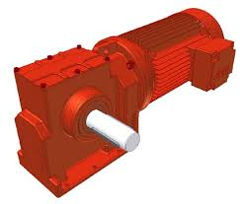
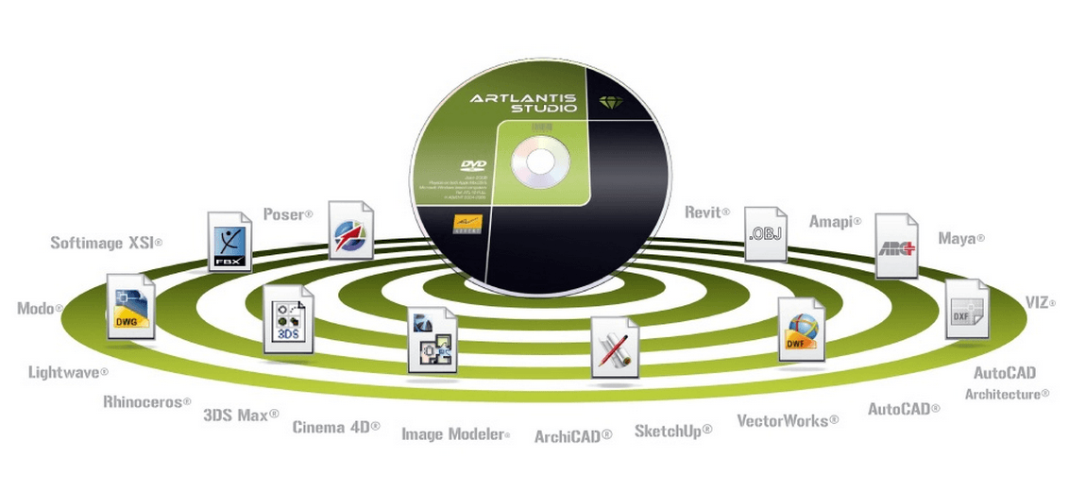
APPEARANCE OF VISUALIZATION
.
To view objects in the learning process, more interactive 3D models are currently being used, offering different viewing possibilities in varying degrees of detail, as opposed to 2D visualization, which is not sufficiently visual, and does not fully decipher reality, at the same time it sometimes happens that some processes , Which are modeled in the background, inadvertently merge together).
3D interactive models bring us closer to the real reality that we can see in the real world is difficult to see or explore or no longer exists.
The information obtained can then be associated with the "experienced" experience, remembering them better and "re-equipping" if necessary. In our paintings, we and our experience mirror us.
In the picture, it constantly creates an attractive force and mystery at the emotional level, which stimulates man to interactivity, social communication, and to create his or her own knowledge, knowledge structures, and critical assessment of information (Scruton, 2005).

Slide 3
https://www.youtube.com/watch?v=PZWYgcKT-V8&list=UUYjjA6-6J_PYtgeSMS2hv-A
https://www.youtube.com/watch?v=abYd1d5Qv2k
Projection and visualization technology
- projector, TV
- glasses for virtual reality
- interactive whiteboard
- Enhanced perception
- across objects

Slide 4
STRUCTURALISM AND VISUALIZATION
In recent years → implementation of constructivism in both technical and multimedial, humanitarian and foreign language education.
The constructivist concept is referred to as the ideal pedagogical basis for visualization, ie for the visualization of reality perceived through visual receptors
Constructivist pedagogy puts the client at the center of the learning process. Similarly, the visualization associated with the application of the principle of clarity assumes an independent client who can partly manage and organize his learning.
The traditional role of a teacher naturally changes → becomes a constructivist tutor, facilitator and guide.
Communication between actors should be encouraged and activated both by creating a pleasant atmosphere of open space for sharing opinions and by a suitable concept of group / cooperative or collaborative / work.
The main features of constructivistically conceived teaching can be considered the transition from transmissive teaching, so-called "self-esteem" to self-evaluation, self-organization, self-determination, self-realization.

Slide 5
Evaluation / self-evaluation ASSUMPTIONS for the success of AUTOEVALUATION AUTOEVALUATION
- want to - create a constructive atmosphere for her at school
Evaluation / self-evaluation Evaluation plane: - individual - children / pupils, teachers, parents - school management - director, deputy, educational counselor, school psychologist - institutional - the final outcomes of the educational and educational process at school level as a system - the motif of the educational system -
A external
A1 – Legislative framework for the management of the operation of the educational institution
A2 - Legislative framework of VET
EVALUATION/SELF-EVALUATION
AUTOEVALUATION - as a systematic activity - process - Planned - Regular - according to predetermined criteria - collecting information is targeted
B1.1 Implementation of the legislative framework B1.2 Strategy and Planning B1.3 Human Resources Management B1.4 Management of education and training processes B2.1 inputs B2.2 course B2.3 outputs
B - internal self-evaluation B1 control B2 training and education process
Uses research methods and tools for data processing Is relatively objective Example: self-retirement of the whole PS for the needs of further development and needs

Slide 6
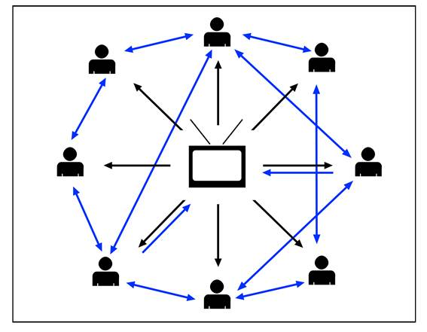
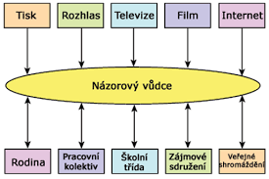
Print radio tv movie internet
Media pedagogy
print
Radio
TV
Film
Internet
Opinion leader
family
Working team
School class
Interest association
Public assembly
Educational media Mass communication means Pedagogical aspects of software Media identity Media fascination and leisure Rational access to the media Age specificities of media

Slide 7
.
Media approaches
1) Media Optimism - The optimistic reception of the media, considering the media to be a pervasive businessman. Transhumanism, extracism, singularitarianism, techno-utopism.
2) Media Pessimism - Critical opponents of media-optimistic directions pointing to the negative aspects of technological and media development, rejecting the merger of man and technology (media).
3) Mediacism - too much reliance on the media. Belief in the fact that mankind will be able to fully control the technological media and all the problems it involves and to use it effectively for its well-being.

