Slide 1




Information and communication technologies:
3. Modeling. Definition. Theoretical models.
Methodological Concept for Effectively Supporting Key Competencies Using the Foreign Language ATCZ62 - CLIL as a Learning Strategy at the College

Slide 2
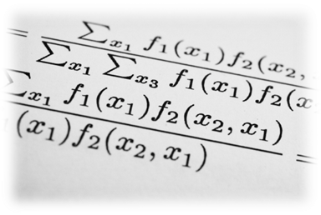
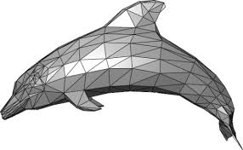

Definition of "model"
The term "model" is used in various contexts:
This term means:
Mathematical and mental approaches to the problem,
Didactic means.
In the spoken language, the term most often means:
The original pattern of something created;
A prototype, such as a car model;
The ideal pattern we want to implement in a particular activity or function, such as the model of a perfect teacher;
The structure of what is in our interest, such as the model of the school;
In art, it is a thing or a person to be painted, cured.

Slide 3
Definition of "model"
The ideal model is a view of the phenomenon under investigation, which may contain hypothetical explanations and can help verify the correctness of the hypothesis.
Ideal models that are associated with a particular theory are called theoretical models.
Material models are existing objects whose properties permit the reconstruction of the structure or the essence of the subject being studied or the course of the process.
These are simplified and distorted reproductions of ideal models and can therefore be recognized as "model of models". Before the material model arises, it must exist in the scientist's mind as a certain idea, that is, as an ideal model. It follows that models are in their original form abstract concepts that can later be rendered in a concrete way.
For scientific and educational purposes, the most important are those models that are linked to the creation of new knowledge.

Slide 4

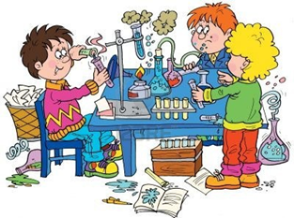

Theoretical models
They can perform the following functions:
To pass on information to the client about the theory and its interconnection with relevant experimental data;
To familiarize clients with the concepts of the field of the theory and to develop the ability to use models to solve the problems;
Verify the model with experimental confirmation or denial of assumptions based on it in order to familiarize clients with the scope and conditions of its use;
Verbalize the model, which leads to the formulation of the assumptions of the relevant theory.

Slide 5

Another explanation
A model system of baseline data, concepts and relationships between them that allow an approximate way to describe (model) an aspect of reality;
It is generally expressed in the mathematical language because such a method of writing enables its empirical verification.
Dictionary of literary Czech
A pattern according to which something is or is to be created;
An object that is a copy or pattern of a given item, usually made in smaller dimensions, of replacement materials;
A test specimen of a series of products; Prototype, template.

Slide 6
Theoretical models and tools in practice
In didactics, models perform many functions depending on the nature of the information we receive based on the results of the research carried out on the models and for what purposes they will be used.
Szeromski introduces these model features
Piosik distinguishes between models functions::
Paško distinguishes between these model features:
:
Visualization of the learning process
Simplification of thought processes
Helping with the use of laboratory exercises and gaining practical experience
Exponing materials that engender client benefits
Information - Provides information about the original
- computational - allows you to perform model calculations whose results can be used in relation to the original, eg the law of constant ratios
- Classification - simplifies the systematization of knowledge, eg types of chemical reactions
- Demonstration - Helps to create adequate images of the original. It is largely connected with the transmission of information about the microcosm
- explaining - this function becomes an exhaustive source of knowledge and leaves no room for any doubt about the subject matter described, eg explaining chemical laws and concepts.
- Interpretative - allows to outline the general possibilities of using the studied theory in practice, to make preliminary conclusions about the phenomenon or theory studied
- descriptive - due to the definition of the most important features of the phenomena or objects studied, it simplifies their knowledge
- Experimental - is that clients solve problems by their own thought processes
-

Slide 7

.
THE ASSUMPTIONS OF THE NEW,
DYNAMIC COMPUTER MODEL
The first and most important assumption is that the newly designed microscope model and its corresponding visual teaching aids are correct in substance (meritorily).

