Slide 1

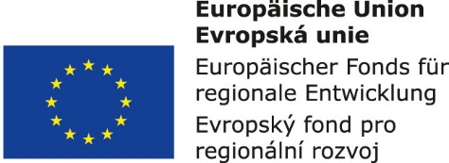


Information and communication technologies:
2. Didactic technique
Methodological Concept for Effectively Supporting Key Competencies Using the Foreign Language ATCZ62 - CLIL as a Learning Strategy at the College

Slide 2

Components of didactic techniques
Means of "DT" didactic technique (apparatus and technical devices for the provision of visual, auditory and audiovisual information)
- absolute universality
Teaching aids (any appropriately processed curriculum)
- very specific
Http://www.slideserve.com/brady-sutton/u-ebn-pom-cky-a-didaktick-technika

Slide 3
MULTIMEDIA DIDACTICAL MEANS
Multimedia - systems for technical elements for interactive audio-visual presentation; Allow the user to work with several types of communication means - media: text, image, sound, computer graphics and animation, video, and interactivity between the system and its user. I.e. Multimedia is characterized by the following features:
Textem ✓ Audiovisual ✓ Image ✓ Animation ✓ Video ✓ Interactivity ✓
Interactivity may include various options:
-the user selects content, combines its parts,
-the user influences the pace at which the multimedia system presents information,
-the user exchanges information with the system (eg by question-answer)
-the user controls the process by which the system presents information,
- the user inserts the content of the system, compares it, etc.
Multimedia didactic means - eg:
- educational software (eg interactive multimedia DUMs), multimedia presentations, multimedia recordings of teaching - eg video lectures, didactic computer games,
- Learning Management System (LMS): planning, creating, presenting and managing content and a suitable environment, tools for both LEKTOR and CLIENT and their mutual communication (eg Moodle)

Slide 4
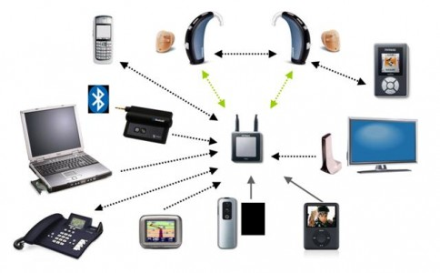
Multimedia is a combination of content forms

Slide 5
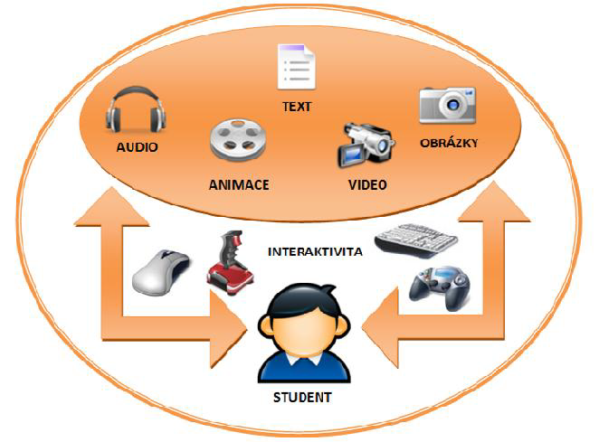
MULTIMEDIA & HYPERMEDIA

Slide 6
Hypermedia and hypertext didactic means
-Hypertext - a text composed of blocks of words or symbols electronically linked by paths (electronic lines) in an open and still unfinished texture structure (network).
-Hypermedia - a digital resource that contains active links not only to texts, but also spreadsheets, animations, pictures, sound, video.
-Hypertext and hypermedial didactic resources - digital resources containing hypertext and hypermedial elements. They have the form of a network in which the main lines of the text are interconnected with lines of texts and media elements that develop, complement, illustrate, illustrate the main text, etc. The learning subject proceeds in these networks in a unique, individual, unpredictable way.

