Slide 1

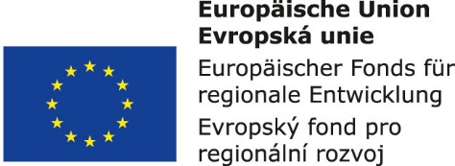


Information and communication technologies:
12. Multimedia in the mirror of time.
Philosophy of the media.
Methodological Concept for Effectively Supporting Key Competencies Using the Foreign Language ATCZ62 - CLIL as a Learning Strategy at the College

Slide 2

What are the media?
DAILY PRESS,
MAGAZINES,
FILMS,
RADIO AND TELEVISION BROADCASTING,
INTERNET (news, tutorials, entertainment portals, social networking, blogs, vlogs, spoken word, movies, music ...).
These means of communication have in common that they are available to a potentially large number of users at regular intervals (diaries, magazines, radio and television) or almost constantly on demand (Internet portals, mobile operators and the due to Internet increasingly Television and radio).

Slide 3

The power of the media
TARGETED INFLUENCE OF PUBLIC DEFINITION
Manipulation
Deliberate selection of messages and their shortening
Messaging and evaluating comments
Exaggeration (Positive Message sounds more positive, Negative more negative).
The force of editing (only a part of the sentence is left), image manipulation (the order of images can be confused with cause and effect).
Speech rendering

Slide 4
Media features
INFORMATION FUNCTIONS
Especially journalism, where news, commentaries and reports are used.
ENTERTAIMENT FUNCTION
It brings music, art, sports transmissions, but also today's phenomena - TV series, reality show, cooking, ....
COMMERCIAL FUNCTIONS
Provides media with funding for broadcasting and guarantees profit
It is realized mainly by advertising, but also by teleshopping and sponsorship.
EDUCATION, EDUCATION
POLITICKÉ, SOCIÁLNÍ PŮSOBENÍ
Sometimes there is a merging of individual functions

Slide 5
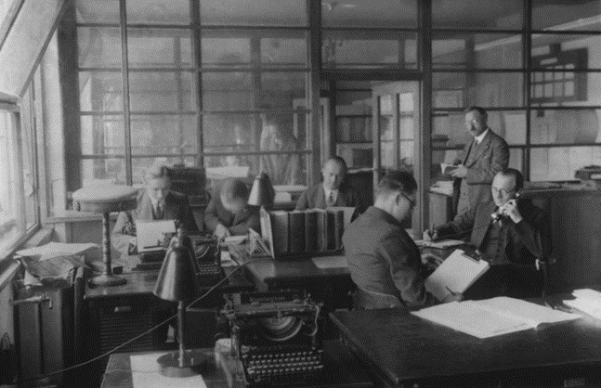
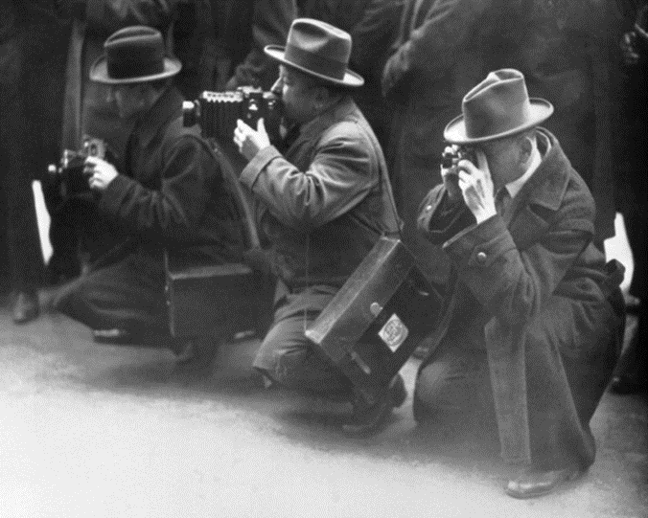
1900-1925
A journalistic industry emerged,
1 field reports and photo reports.
1918 - Czechoslovak Press Office "ČTK" founded
Political diaries.
Independent diaries.
Tabloits.

Slide 6
Restriction or freedom of the press
Even though the system of the First Republic is today a model for many of democratic establishment, the functioning of the periodical press has been much more limited at this time than today.
The Press Act determined what must be stated in the titles of each periodical form, and it also established
INSTITUTE OF THE RESPONSIBLE EDITOR
Who has been criminally liable for any violation of the letter against the laws in force

Slide 7
Role of radio - entertainment, news
In 1925, news began to play a new and more active role on the radio, not just reporting messages, but trying to bring events closer.
First attempts at reporting.
The first sports report.
RADIO AND EDUCATION
Gradually, radio courses for foreign languages, such as French, were included in the program offer.
Lectures,
Interviews,
Discussions,
The bands,
Radio games,
Professional broadcasting.
In May 1924 an article was published in the National Letters, in which editor J.D. Richard (Richard Durdil) who first proposed using the word „wireless" instead of the word "radio" ... The station of the received message or the music actually tells all of us and therefore is certainly entitled to propose a title Wireless

Slide 8
1930 - 1960
TV
A pioneer in our country was Jaroslav Šafránek (associate professor of experimental physics at Charles University in Prague) in the 1930s.
In 1935 he completed the first television reception apparatus in Czechoslovakia.
Great interest in television was shown by Czechoslovak radio amateurs.
THE FORCE OF INTERVIEW CONTINUES
1939 - Radio broadcasting to the Protectorate (all employees of Jewish origin have to leave).
The transmitter only served to investigate the propagation of very short waves. However, Czech TV broadcasting could not develop in the occupation. It did not recover until 1945
In March 1939, Czechoslovakia was occupied by Nazi Germany. Actor Zdeněk Štěpánek read the news about this event via ČTK radio news.

Slide 9
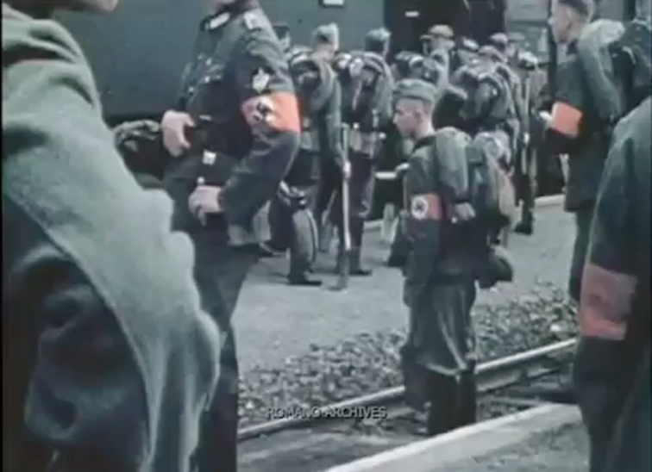
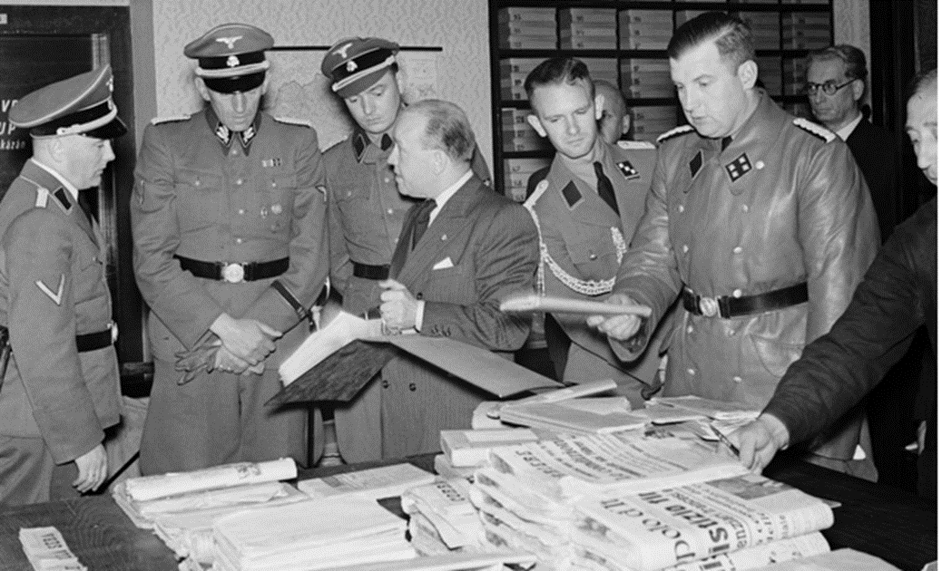
Film and war propaganda
A series of movies were depicted
Territorial expansion of
Third empire
These films had no significant artistic value and served primarily to promote war. Images that could have attracted great attention were sharply criticized, censored or banned.
In 1942 home news is completely subordinate to the protectorate power of the Nazi press union headed by Wolfgang Wolfram von Wolmar.

Slide 10
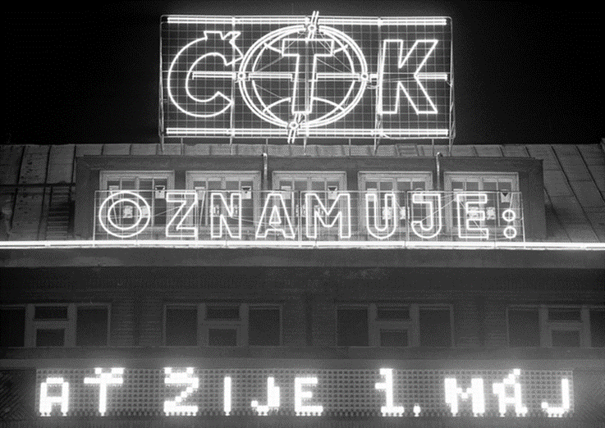
Media and Communism
In 1948 CTK was under Communist dictatorship.
The instrument of political propaganda of the ruling party;
Strong censorship;
Nationalization of radio.
Two types of news:
for public,
Non-public.
(For high party and state officials)
Agentura je formálně podřízena vládě,
fakticky ji ale řídí ústřední výbor Komunistické strany
Československa.

Slide 11
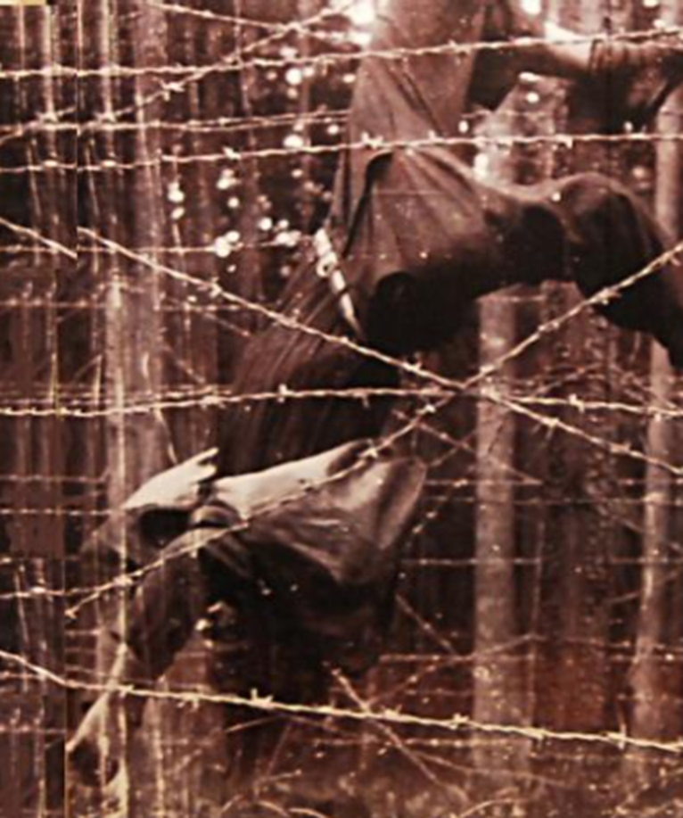
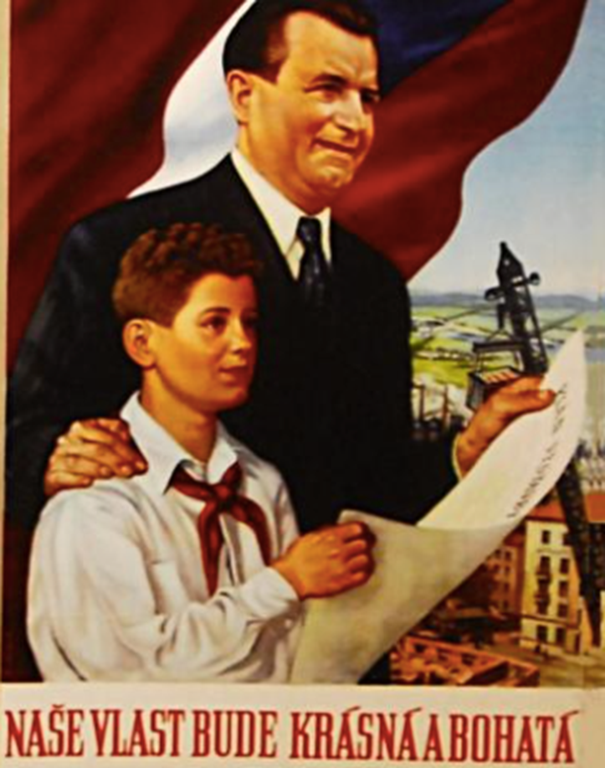
Years of the 50th - Sharpened Ideological War
For the next 40 years the media started to serve in Czechoslovakia
to "People and the Communist Party",
1952 - Establishment of the Main Press Office Administration,
1952 - Czechoslovak Radio began to cancel the broadcasts of Free Europe (broadcasting started in 1950).
Ideology versus reality

Slide 12
1960 - 1990
The media before the occupation
Radio
Natural civil speech, criticism, openness,
Reception of world radio stations - extension of supply, but weakening of control by the state.
TV
Only one program,
A huge increase of concessionaires,
"Cukrák" - completing the construction of the base network of transmitters.
1967 - Prague Spring
1968 - Invasion of the Warsaw Pact troops
1969 - Jan Palach - personnel cleansing on television and radio
1969 - Transfer of World Cup in Czechoslovakia - Soviet Union
1966 - Zdeněk Svěrák broadcasts from the "fictive Vinárna at spider" - here was born the character of Jára Cimrman

Slide 13
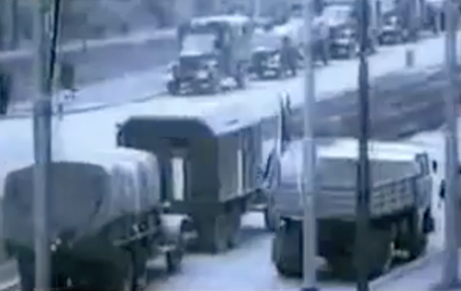
1968 Occupation - Time of Normalization
RADIO
Jammers of foreign stations (Free Europe, Voice of America),
TV
Transmitter for second program, 1973 - first color broadcast,
Personal cleansing,
Renewing censorship,
Ideological concept,
Attacks on dissent representatives.
PRINTING
Illegal publishing of newspapers and magazines.

Slide 14
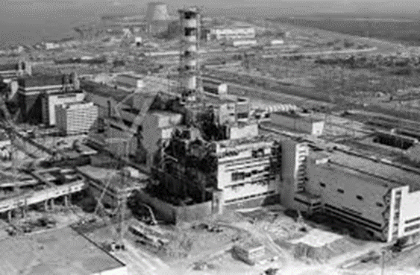
80s and others
1986 - Chernobyl,
1989 - The Velvet Revolution,
A big change is the development of personal computers →
1981 - 4th generation computers.
1990-2017
Early 1990s - media transformation,
End of censorship - the media are heading into personal property,
The media are an institution of freedom of expression, a forum for discussions on matters of public interest and private business.
1991 - Introduced 1st Web Browser - WorldWideWeb at CERN

