Slide 1

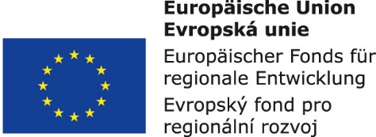


Information and communication technologies:
11. Television world in history. Analog and digital.
Metodický koncept k efektivní podpoře klíčových odborných kompetencí s využitím cizího jazyka ATCZ62 - CLIL jako výuková strategie na vysoké škole

Slide 2

History of television in Czechoslovakia
Pioneers:
František Pilát - later post-war technical director of Barrandov Film Studio, himself built a television receiver
Pilát was the first in Czechoslovakia to receive experimental Baird's "thirty-line" broadcast, spread in the early 1930s (1929-1935) from Great Britain to the mid-wave of 261.5 meters.
The most active pre-war pioneer of the television is dr. Jaroslav Šafránek, associate professor of experimental physics at Charles University in Prague
In 1935 Šafránek built his own functioning television equipment, with which he later traveled to the Republic and presented him in public.

Slide 3
History of television in Czechoslovakia
The Ministry of Post and Telegraph refused to authorize Šafránek to broadcast television in the air.
Šafranek´s ​​equipment could only work in the laboratory and lecture halls.
While Šafránek, radio amateurs and their interest organization, Czechoslovak Radio Broadcasting Corporation requested permission for experimental broadcasting of a mechanical low-line (30 line) television mainly serving radio amateurs, the Ministry of Post and Telegraph, which since 1934 closely watched developments abroad, wanted to provide frequencies for television broadcasting to some more developed Projects. He was guided by the principle - to wait, to study foreign facts and then to decide.
In 1939, television research on the territory of former Czechoslovakia ended. (Threats to the Republic, Munich, and the Nazi occupation).
At that time, Shafranek was working on a more advanced 240-line image decomposition device.
On November 17, Germans concluded Czech universities.
Šafránek's television experiments ended. He lost his position at the university and his German Institute of Physics closed the German authorities.
Šafránek allegedly managed to take some equipment to the Pardubice Telegraph factory, where he stayed throughout the war.

Slide 4
History of television in Czechoslovakia
Even before the end of the war, in April 1945, Fernseh A.G. Top German experts
moved to Austria
In May, the Czech local authorities occupy institutions, institutions in Smržovka Fernseh A.G. Is immediately renamed Televid.
At the beginning of June, the Czechoslovak Ministry of Defense takes over Televid under its administration.
However, in July 1945, the security of the company was taken over by the Soviet military administration, for which the race was part of the war booty, and several Soviet experts came from the Leningrad Television Institute.
At this time, Doc. Šafránek often goes from Prague to Smržovka . But according to memories of witnesses, he did not intervene in technical development, because his 240-line mechanical system was outdated and Televid worked on an electronic, later "European" standard of 625 lines.
However, Šafránek's name has once again been written into the history of our television
He organized the internship of a group of 25 experts who joined Smržovka - after the agreement of the Czech authorities with the Soviet military administration - in October 1945. Before the trainees could bark and work actively, the Soviet side decided to move Televid as a war booty

Slide 5
Jaroslav Šafránek is attributed to the primacy of popularization of television in Czechoslovakia.
He published the book Televise, in which he acquainted himself with the technical principles of image transmission at a distance.
An up-to-date version called "Televise - The Physical and Technical Foundations of the Television" by Šafránek was published after the war.
Šafránek tried to distinguish the simple technology of moving the moving picture from the complex television broadcasting process, for the television as a mass medium he coined the word "roar", which, according to him, "correctly describes the essence of the television ..."
On March 23, 1948, journalists were invited to Tanvald, welcomed by the General Secretary Josef Trejbal and the Technical Deputy for Czech Radio, Kazimir Stahl.
As part of the demonstrated technique, even with the use of some trophy components, the design itself was a television receiver with a 16x21 cm own production screen.
There were two television cameras at the MEVRO exhibition in Prague and the signal was transferred to the receivers by cable.
A month after the end of the MEVRO exhibition, July 4, 1948, during transfers from XI Sokol organisation. three cameras were working in the Strahov stadium , and the signal was transmitted by air from the mast of Petřín for 25 receivers in various institutions and in public places (eg Exhibition Grounds, ČSS Radio building, Red Law Redaction, transmition was also checked outside of Prague - in South Bohemia and the Giant Mountains).

Slide 6
From 1949 to 1952, television in Czechoslovakia ceased to exist.
The television equipment of the VTU Military Technical Institute, including two camera chains and ten television sets, was transferred to Czechoslovak Radio, which was established at the beginning of 1949 by the ÚRT Institute of Radio Technology. Although he continues to fulfill the task of preparing television broadcasts during the first five-year period, ie by the end of 1953, but the Cold War, which had intensified in 1950 by the conflict in Korea, caused the Office had nobody to cooperate with, because on the instruction of the Ministry of Defense Technical research has focused exclusively on military needs.
According to ing. František Křížka, in 1951, the Office of the Czech Radio organized several experimental broadcasts in its building in Vokovice and lent receivers to party and government officials to promote television without success.
Turnover occurs in 1952.
The Government of 8.4.1952 issued a regulation requiring the Ministry of Communications and Welfare "to build and operate technical radio and television equipment".
The first "program director and director of television studios" established within Czechoslovak Radio Karel Kohout was appointed on 1 February 1953 (three months before the scheduled start of the broadcast). Karel Kohout came from Barrandov's studio and started with his legendary secretary Maria Kořenová to organize a broadcast from a temporary office on Wenceslas Square.

Slide 7
History of television in the Czech Republic
For several years the broadcast has been limited to the Petřín transmitter in Prague, reaching the Central Bohemian Region to the foothills of the Jizera Mountains and the Krkonoše Mountains.
At the end of 1953, some 2000 TVs were in operation, of which a thousand Leningrad brands were imported from the GDR, where they were then produced in Soviet licenses.
But as early as 1953, Tesla supplied the Tesla 4001A to the market.
They were selling for CZK 4,000 (at that time it was an almost half-year average salary).
K 1.10. 1953 the price was administratively reduced to 2500 CZKs and in later years the price went down to 2000 CZKs.
At the beginning of January 1955, when the so-called concession fee began to apply, statistics of 3833 registered concessionaires were reported.
By the late 1950s, the television receiver became a scarce product on the market.

Slide 8
On February 11, 1955, the TV broadcasts the first direct TV transmission of a sports match in the history of Czechoslovak television.
On April 17, 1955, the first direct transmission of the opera from the National Theater took place.
Since October 1955 it has been broadcast 6 times a week (not on Mondays); From December 29, 1958, began broadcast nationwide every day, seven days a week.
New Czechoslovak television transmitter Ostrava-Hošťálkovice started operating on New Year's Eve on December 31, 1955.
TV studio in Brno was established only in 1961; February 25, 1962, began broadcasting in Košice.
This basic structure of the five major television studios resisted, in essence, until the breakup of Czechoslovakia in 1993.
At the turn of the 1950s and 1960s, a network of transmitters and reversers was being built, so that in 1961 the television signal covered all regional centers and most of Czechoslovakia, so shortly afterwards (1962) the border of one million television owners was exceeded.

Slide 9

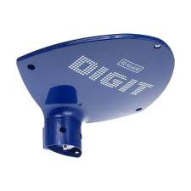

On 1 January 1993, after the dissolution of the Federation, Czech Television was established.
In the 1990s, the first private TV company was launched (NOVA and others).
In 2000, the Czech Republic was preparing for the transition to digital TV broadcasting in the digital terrestrial (formerly terrestrial) platform DVB-T
The DVB-T platform should replace analogue terrestrial broadcasting.
Technically, the Czech Republic has been very well prepared - the experimental digital television broadcasts have already been successful in the three largest cities.

Slide 10
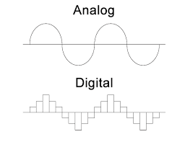

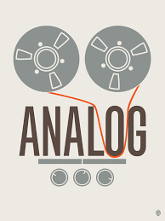
Analog x digital
The difference between analogue and digital transmissions can be likened to sending money by a coach or by bank transfer.
If we send the money to a shoemaker, the recipient will receive our money physically as we sent it, provided that the coach does not declare that the courier is not lost anywhere, etc. While we send them by bank transfer, the recipient receives physically other money, but In any case at the same value as they were sent.
Digital transmission of information is the transmission of a value, in the form of a number. (In this case the so-called binary number).

Slide 11

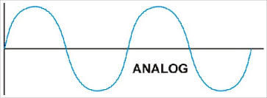
Analog broadcasting
An analogue broadcast is an outdated way of spreading television and radio signals.
Both the image and the sound are transmitted using
electromagnetic waves.
Color and sound information is generated by modulation of this continuous (analogue) signal.
Each TV or radio frequency thus bears one station signal.
Analog broadcasting is currently replaced by digital broadcasting.
In the Czech Republic, analogue broadcasting was turned off at the end of 2011, when analogue darkness occurred.

Slide 12
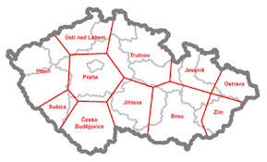
(DVB = Digital Video Broadcasting)
Digital broadcasting allows the multiplex to transmit several television programs at one frequency.
This makes it easier to use the bandwidth used for analogue TV broadcasting.
What is that when it comes to digital broadcasting
- what is DVB-T (C, S) Digital Video Broadcasting - Terrestrial (cable, satellite)
- transition from analogue to digital broadcasting
- high resistance to non-linear distortion and interference
- possibility of application of ef. Discontinuous methods in RF. Transmission of TV signals
- reception of digital signal even in moving vehicles (subject to appropriate modulation).
Computerization of virtually all kinds of distortions of video signals generated in the
production and distribution part of the TV transmission

