Slide 1




Information and communication technologies:
10. Auditive media, their history, present and future.
Methodological Concept for Effectively Supporting Key Competencies Using the Foreign Language ATCZ62 - CLIL as a Learning Strategy at the College

Slide 2
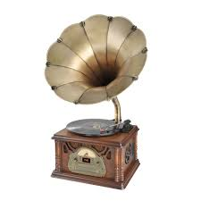
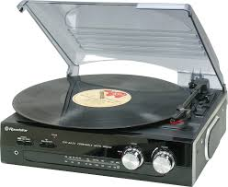

Means of audiotechnics
DT MEANS | AID (information carier)
gramophone | gramophone record
Disc tape recorder | tape
cassette recorder | Tape recorder
CD player | CD disc
Radio | broadcasting
Audiobooks | MP3

Slide 3
Audiovisual equipment
DT MEANS | AID (information carier)
Film projector | Sound movie
TV | TV broadcasting
Video recorder | Video cassette
Multimedia computers | CD ROMs wit multimedia programms
Dataprojectors | Data on computers or other sources
DVD player | DVD

Slide 4
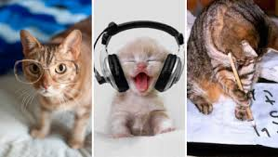
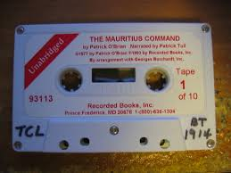
Auditive Media
Auditive = Hearing
Media = medium, between, middle
The media is an intermediary, it mediates something
Definition - it is difficult to define the term
Media, there are many definitions
They are important in the communication process
The role of media: communication, transport of information

Slide 5


Auditive Media
Examples of auditing media that fix and store data:
Tape recorders, cassettes, video cassettes, films or audio CDs
Classification by theoretical criteria:
Primary, secondary and tertiary media
Media publishing steps:
Interpersonal communication
Communication in a small group
In organization and mass communication
Dělení dle počtu užitých médií: monomedia, duální média a multimédia
Auditivní média:
Rozhlas, zvukové dokumenty
Záznamy (např. divadelních her), hudba, řeč, telefon

Slide 6
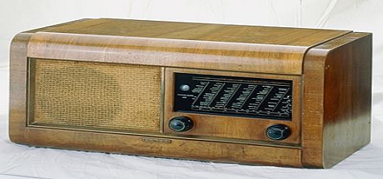
History
Inventors:
T. Edison - 1877 - phonograph
Berlineri - 1878 gramophone
Hertz - radio waves
Marconi - 1896 signal transmission between two places
Nikola Tesla - Founder of Radio Technology - 1891 - Beginning of Radiation
- World War I - US Army Radio Transmission
- KDKA in Pittsburgh - First Radio Station (1920)
- 1922 VB the first regular radio broadcast on European

Slide 7
History on our territory
1908 first attempts at radio broadcasting.
After the First World War there is a development - the need of establishing a communication network - wireless radiotelegraphy and radiotelephony.
1918 - The first radio station in Petřín in Prague - first broadcast 1919.
Regular radio broadcasting started on 18 May 1923 from the Scout tent in Prague Kbely.
Radiojournal - the first private company to operate radio broadcasting (1923)
The Golden Age in Radio History 1930-1938 - Recording System, Recording Technique, Magneto (1938).
1936 - broadcasting in the world context, broadcasts from abroad, recordings made in the Czech Republic are sent abroad.
World War II Period - Censorship, Ban on Listening to Foreign Stations, 1945 The Prague Uprising Launched by Radio Challenge.

Slide 8
In 1948, Communists take over Czechoslovak Radio - ideological propaganda, censorship, coverage over the whole territory - original intent to protect the population and mobilization (idea used in 1968)
1968-1989 - The role of informing and mapping political events, there are significant changes in broadcasting
Hvězda News Channel - Broadcast 24 hours a day, 1976, live broadcasters.
1988 Termination of foreign broadcast jammers
Velvet Revolution.
1991 - Establishment of private radio stations
September 1994 broadcasting via the Internet
1995 Free Europe starts broadcasting from Prague
There is a gradual digitization

Slide 9


Present
Auditive media - still used,
Often linked to visual →
Audiovisual media
Players - phones, tablets, computers,
TV, mp3 / 4, players, radios, radio, dictaphones, man :-)
Audiobook = sound recording of the spoken word
- emergence already in history, now boom thanks to smart phones, internet downloading

Slide 10

Future
Do we expect some future of auditive media? Yes x No
Will a TV screen or a radio be part of our home, as it is so far?
HN - Article "The future without screens is approaching, yet slow"
TV in our homes will be replaced by projectors;
New concept: projectors that need little space for display - huge image at 25cm distance, complicated installation, connection to set-top-box, computer or game console with wireless system.
Projectors for mobile phones and tablets / Lenovo, ... /.
Reducing the price of projectors will allow the replacement of TVs.

Slide 11
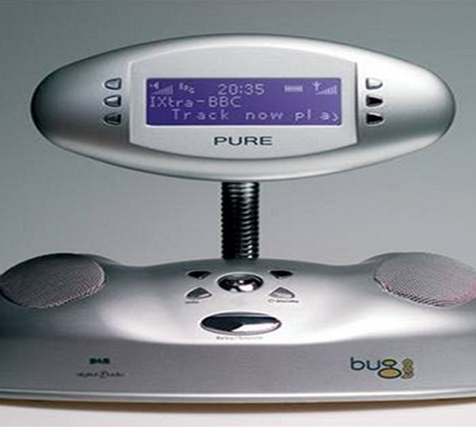
Future - Technology
.
Digital radio status
Mobile application
Smart TVs
Integrated players
Traffic news
Hybrid radio

