Slide 1




Information and communication technologies:
1. Didactic means, aids, multimedia
Methodological Concept for Effectively Supporting Key Competencies Using the Foreign Language ATCZ62 - CLIL as a Learning Strategy at the College

Slide 2
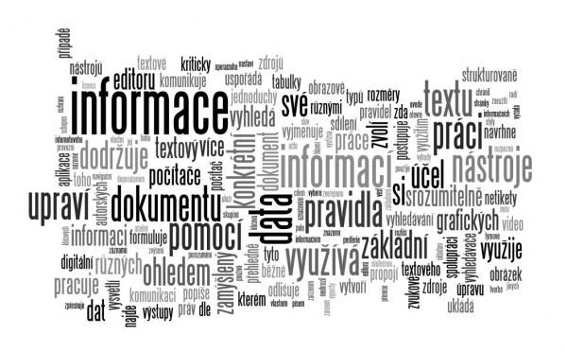

Information and communication technologies,
ICT
(Information and Communication Technologies),
In czech: IKT,
Include all information technologies used for communication and information.

Slide 3
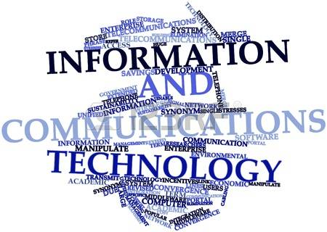
. One of the means of communication is MEDIA.
MULTIMEDIA is a material-energy information bearer, containing at least three independent information channels from each other, either to or from the learning system. Of these, at least two lead to a learning system, and at least one leads to the response of the learning system towards the educational system.
Multimedia is a subset of hypermedia.
Basic Concepts

Slide 4
Didactic means
. Non-material: methods and organizational forms, didactic principles
Material (including virtual, for some digital devices):
Tools - are directly related to the content, represent or illustrate it, in justed didactic or unadjusted form)
Methodical aids (resources bound directly or indirectly to content)
Spaces and their equipment
Didactic technique (didactic means neutral in relation to the content, usable for realization with different goals, contents, methods and organizational forms)
The choice of non-material and material didactic means must be interrelated so that the whole and its individual elements together support the achievement of the goal.

Slide 5
Didactic aids
1.Original objects and real facts
- natural products in the state of origin (minerals, plants, etc.), prepared (preparations, stuffings, cuttings, etc.)
- products and creations in the original state (instruments, works of art, etc.), modified (sets and sets of samples, cutting machines, etc.)
- phenomena and processes, physical, chemical, biological, social, etc.,
- sounds, real sounds, voice and musical expressions.
2. View and represent objects and facts
- static, functional, modular, flat, etc.,
- presentations presented directly (pictures, photographs, diagrams, etc.), presented through technical means (statically, dynamically, interactively, virtually, 3D, etc.)
- audio recordings.
3. Text aids printed or digital
- Classical, working, programmed, interactive books,
- working materials, dictionaries, spreadsheets, task collections, atlases, etc.,
- Additional and auxiliary literature and information sources.
4. Programs presented (implemented) by technical means
- programs, educational films, radio and television programs, etc.,
- programs, information, tutoring, repetitive, etc.
5. Special aids
- experimental kits, kits etc.

Slide 6
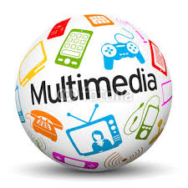
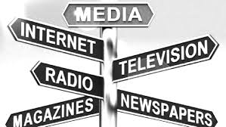
Multimedia
Are the area of information and communication technologies, which is characterized by the merging of audiovisual technical devices with computers or other devices.
- A multimedia system means a collection of technical resources (such as a personal computer, sound card, video card or graphic card, camera, CD-ROM or DVD drive, relevant service software, etc.) that is suitable for an interactive audiovisual presentation.
- Since the early 1990s, the use of multimedia apps or multimedia software has been used to combine text, image, sound, animation, or movie data.

