Slide 1

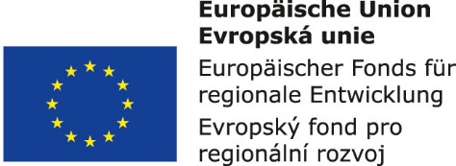


12. Chimney

Slide 2
Basic Characteristics of Chimneys
Chimneys are designed to remove flue gases from appliances to a free space outside the building where they are scattered so as not to endanger the quality of the living environment of the house's residents.
The chimney consists of:
  One or more chimney flues
  Chimney casing
  Sweep openings
  Pickup openings
  Vent connector
  Chimney heads, or extensions

Slide 3
Classification of Chimneys
According to the appliances we distinguish chimneys for:
  Solid fuel chimney x Liquid fuel chambers x Gaseous fuel chimney
According to the structure, we distinguish chimneys for:
  Single-layer chimneys x Multi-layer chimneys
According to the location of chimneys, we distinguish chimneys for:
  Fitted or built-in chimneys x Solitary chimneys
According to the ground plan shape of the chimneys we distinguish:
  Square chimneys x Rectangular chimneys (up to 1: 1.5) xCircular chimneys

Slide 4
Classification of Chimneys
According to the size of the flue to distinguish:
  Narrow chimneys (up to 40,000 mm²) x Medium chimneys (over 40,000 mm²) x Man chimney (minimum cross-section up to 10 m high is 450 x 450 mm)
According to the built-in material we distinguish chimneys for:
  Chimneys made of non-flammable or non-easy possibly flammable materials
  Chimneys made of materials with an absorption capacity not exceeding 20% of the specific weight
  Chimneys made of materials resistant to the effects of flue gases
  Chimneys made of frost-resistant materials
According to the arrangement of flues, we distinguish chimneys for:
  Continuous chimneys x Storeys chimneys x Overflow chimneys x Tree chimneys
According to continuous longitudinal axes we distinguish chimneys for:
  Direct chimneys x Moving chimneys

Slide 5
Design and Impementation of Chimneys
The chimney flue should have a constant cross-section along the height.
The chimney casing should be non-flammable, low absorptive and resistant to flue gases.
Single-layer chimneys must have a masonry chimney thickness of at least 140 mm.
Multi-layer chimneys are usually three-component. They are consisting of chimney liner, an insulating layer and a chimney casing.
The flue connector is part of the chimney, which connects the appliance and the chimney flue to which the exhaust gas.
Sweep openingsare designed for flue and liquid fuels that cannot be swept straight through the chimney head.
Pickup openings are designed at the level of the soil of the chimney flue.

