Slide 1
Structural Assessment of Historical Masonry structure
Student: Bc. Richard Šusták
Supervisor: doc. Dr. Ing. Luboš Podolka
Advisor: Ing. Carmen Amaddeo Phd.
Oponent: Ing. Robert Šinkner, MBA
6/2019

Slide 2
Outline
Motivation
Aim of thesis
Study case – Description
Study case – Analysis 1.
Study case – Analysis 2.
Analysis results
Questions

Slide 3
Motivation
Hot topic
Not well known in Czech Republic
Passion for architectural heritage
Cooperation on real project

Slide 4
Aim of thesis
The aim of this master´s thesis is to perform a seismic evaluation before and after retrofitting of an historical masonry building located in seismic zone based on Italian code NTC 2008.
The chosen historical building is the “Palizzi” Castle located in the Reggio Calabria Province, Italy. The “Palizzi” castle is composed of a ground floor, first floor and under-roof level. The structure of the castle is mostly brick masonry with poor quality materials.
The Finite Element Model (FEM) of the structure has been built using SAP2000 software (Computers and Structures, Inc.), in particular it was performed a response spectrum analysis and also pushover analysis by using Etabs software (Computers and Structures, Inc.) of the structure. Results were verified and compared.
The outcome of this thesis will be comparison of linear and non-linear analysis on existing masonry structure with and without retrofitting.

Slide 5
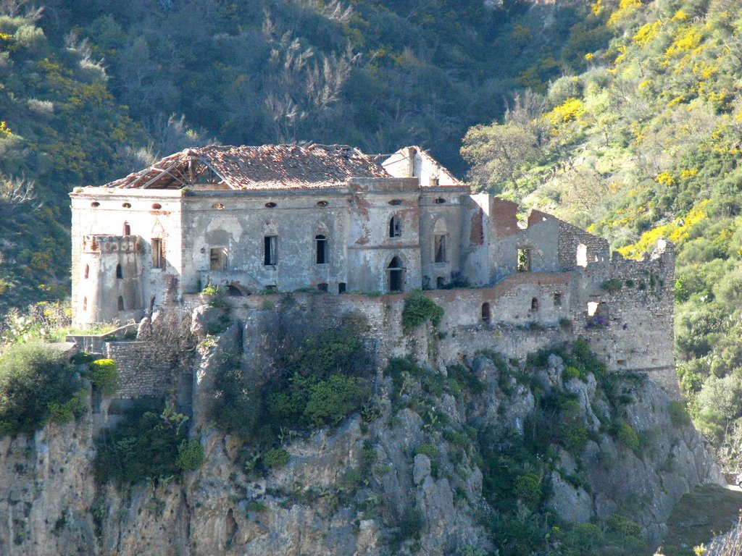
Study case – „Palizzi“ castle
Adress: Via Sant´Angelo, 14 Regio Calabria (RC) Palizzi, 89038, Italy
Name of building: „Palizzi“ castle
Permanent parcel: st. 113, 114
Building use: Historical monument
Owner: Municipality of Palizzi

Slide 6
Study case – „Palizzi“ castle
Map of Italy with location of Palizzi town
(https://www.google.cz/maps/)
Cadastral map of Palizzi municipality showing the location of the castle

Slide 7
Lay-outs:

Slide 8
Sections:

Slide 9
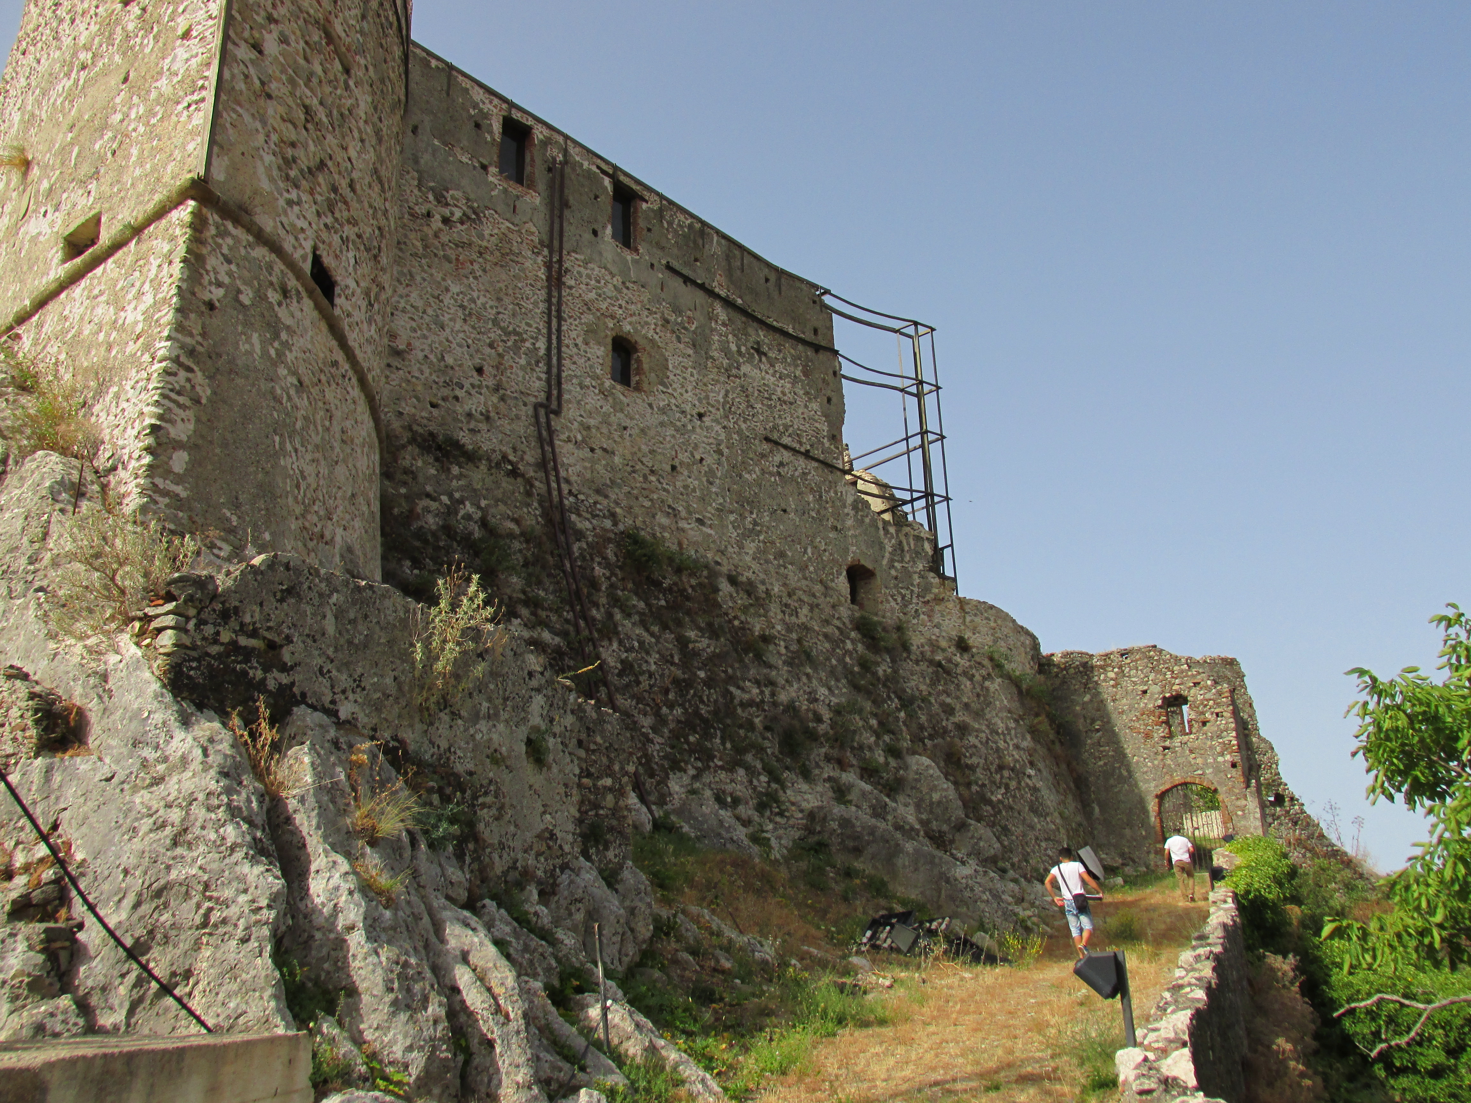
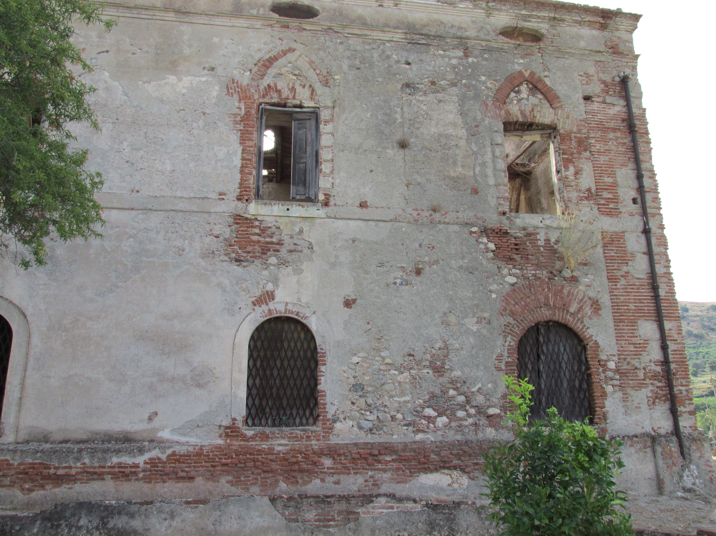
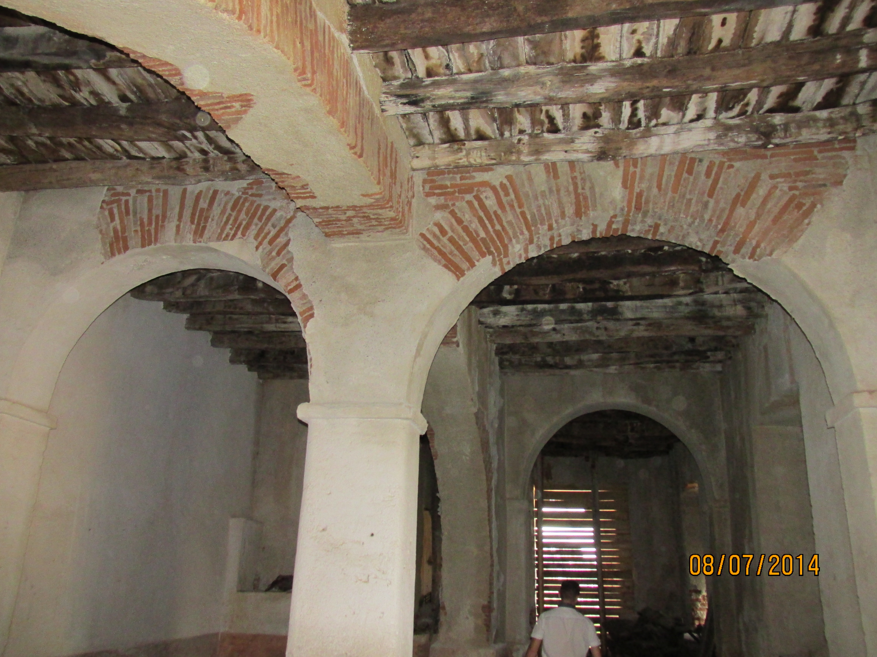
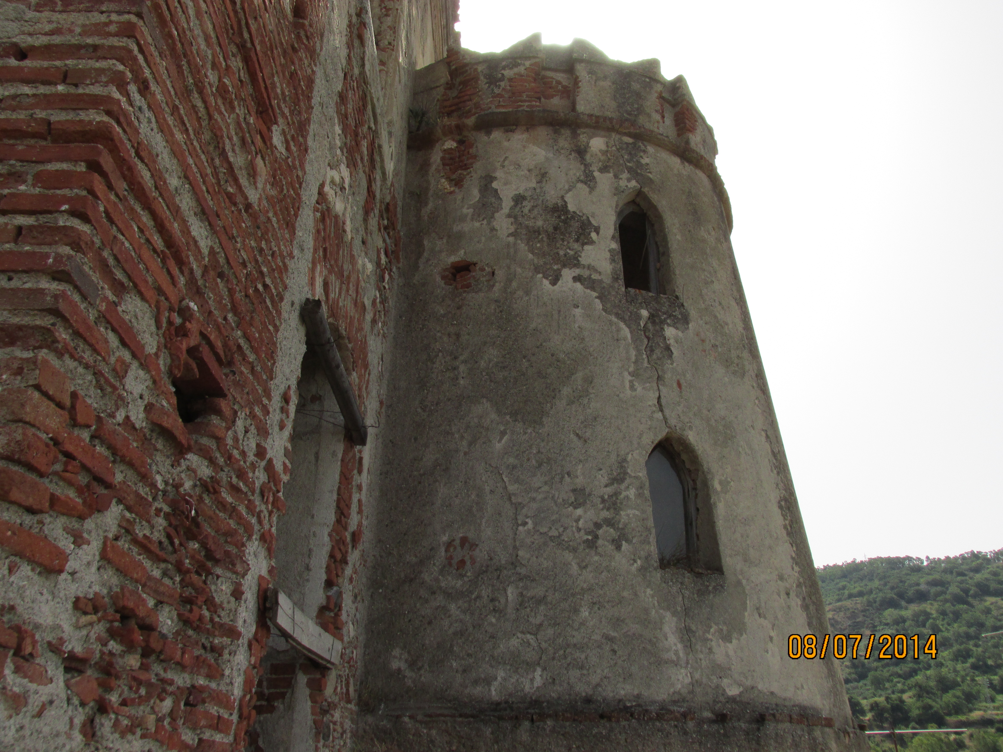
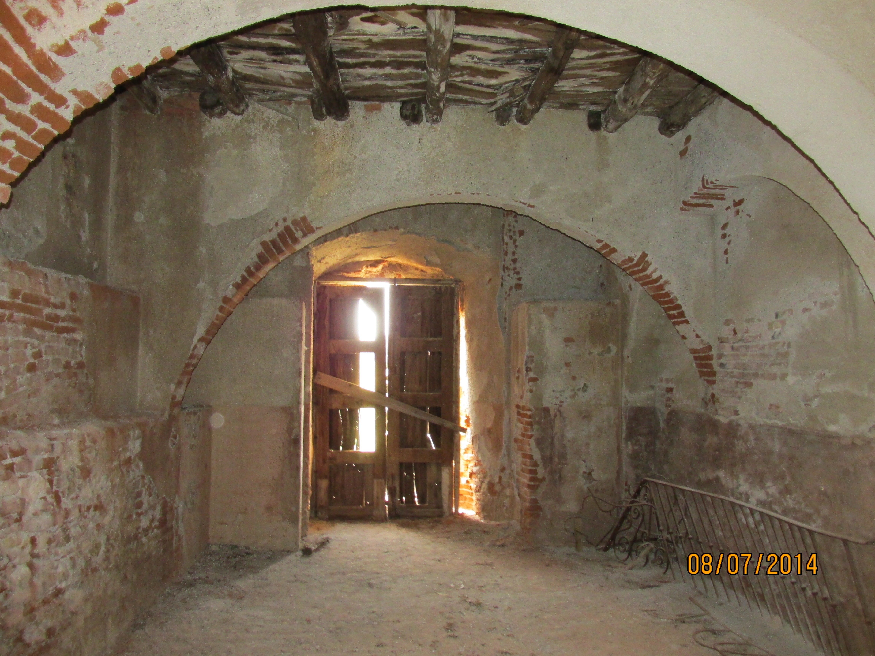
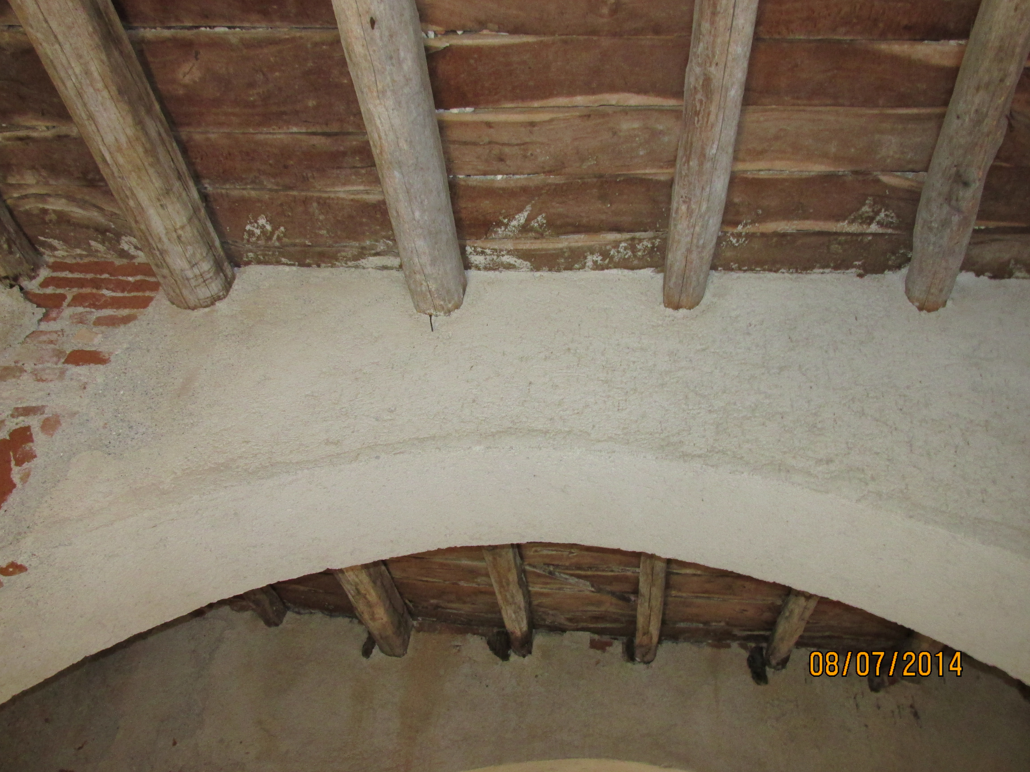
Photo-documentation

Slide 10
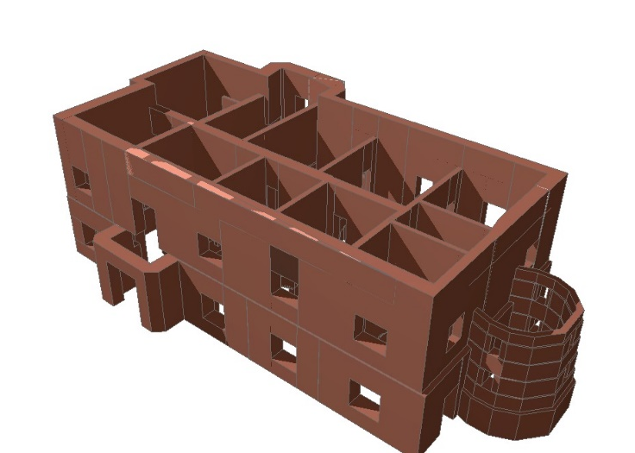
Finite Element Model (FEM)
Archicad 21.
SAP 2000 v.19.3.

Slide 11
Material Properties
Masonry typology | $$f_{m}$$ (N/mm²) | $$τ_{0}$$ (N/mm²) | E (N/mm²) | G (N/mm²) | W (kN/m³)
Brick masonry and mortar | 2,52 | 0,60 | 1654 | 394 | 18
Masonry of brick and mortar (retrofitted) | 4.91 | 1.16 | 3225 | 768 | 18
Suggested properties based on historical sources and comparison
Suggested intervention properties
Material properties based on on-site experiments and tests.
Suggested intervention properties
Masonry typology | $$f_{m}$$ (N/mm²) | $$τ_{0}$$ (N/mm²) | E (N/mm²) | G (N/mm²) | W (kN/m³)
Mixed masonry and mortar | 1,2844 | 0,0238 | 798 | 266 | 19
Masonry of brick and mortar (retrofitted) | 2,10 | 0,137 | 2497,5 | 999 | 19

Slide 12
Analysis 1.: Response spectrum
Latitude = 37,9677, Longitude = 15,9875
Limit states
Collapse prevention Limit State (SLC)
Damage Limitation State (SLD)
Operating Limit State (SLO)
Life-Saving Limit State (SLV)
Usage Class = II
Nominal Life = 100
Spectrum Type = Elastic Horizontal
Soil Type = B
Topography Category = T1
Peak Ground Acceleration, a_{g} /g - $\frac{a_{g}}{g}=0,263569$

Slide 13
Analysis 1.: Loads
12. load combinations
1. envelope
Roof and slabs – with and without
SRSS - Square Root of Sum of Squares

Slide 14
Analysis 1.: Results - URM
Model without slabs – direct stress
S22: Direct stress (force per unit area) acting on the positive and negative 2 faces in the 2-axis direction.
$f_{m}$: Tensile strength of masonry (N/mm²)
 | S22 | $$f_{m}$$
Max stress | 9,254 N/mm² | 1,28 N/mm²
Average stress | 0,587642 N/mm² | 1,28 N/mm²
Min stress | 0,007884 N/mm² | 1,28 N/mm²
Model without slabs – shearing stress
S12: Shearing stress (force per unit area) acting on the positive and negative 1 faces in the 2-axis direction and acting on the positive and negative 2 faces in the 1-axis direction.
$τ_{0}$: Shear strength of masonry (N/mm²)
 | S12 | $$τ_{0}$$
Max stress | 7,516 N/mm² | 0.0238 N/mm²
Average stress | 0,405414 N/mm² | 0.0238 N/mm²
Min stress | 0,0005604 N/mm² | 0.0238 N/mm²

Slide 15
Analysis 1.: Results - RM
Retrofitted model with slabs – direct stress
S22: Direct stress (force per unit area) acting on the positive and negative 2 faces in the 2-axis direction.
$f_{m}$: Tensile strength of masonry (N/mm²)
 | S22 | $$f_{m}$$
Max stress | 11,439 N/mm² | 2,1 N/mm²
Average stress | 0,433839 N/mm² | 2,1 N/mm²
Min stress | 0,001775 N/mm² | 2,1 N/mm²
Retrofitted model with slabs – shearing stress
S12: Shearing stress (force per unit area) acting on the positive and negative 1 faces in the 2-axis direction and acting on the positive and negative 2 faces in the 1-axis direction.
$τ_{0}$: Shear strength of masonry (N/mm²)
 | S12 | $$τ_{0}$$
Max stress | 3,557 N/mm² | 0.137 N/mm²
Average stress | 0,258344 N/mm² | 0.137 N/mm²
Min stress | 0,002053 N/mm² | 0.137 N/mm²

Slide 16
Analysis 1: Verification and conclusion

Slide 17
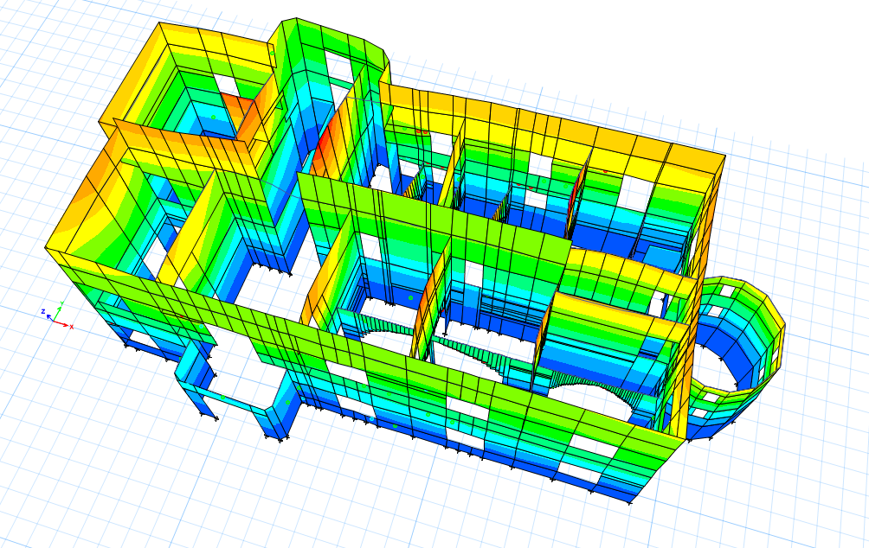
Analysis 2.: Pushover analysis
Finite element model
Hinges
Lateral load
Verification methods
- Base shear
- Target displacement

Slide 18
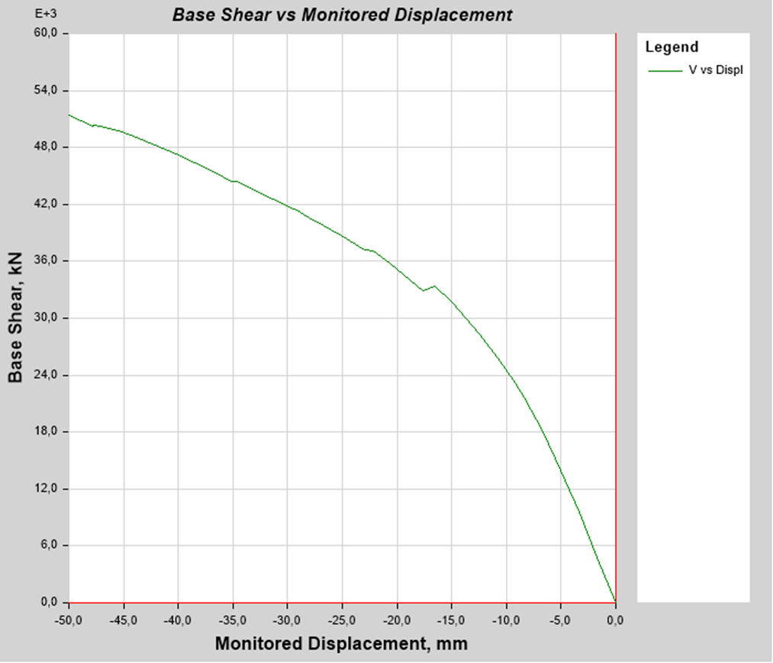
Analysis 2.: Base shear results - URM
X - DIRECTION
Y - DIRECTION

Slide 19
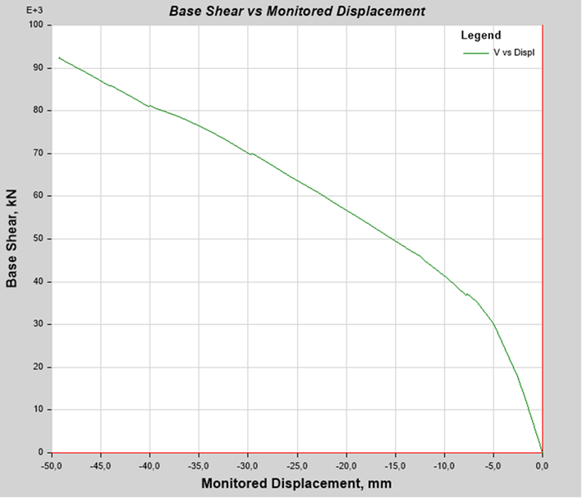
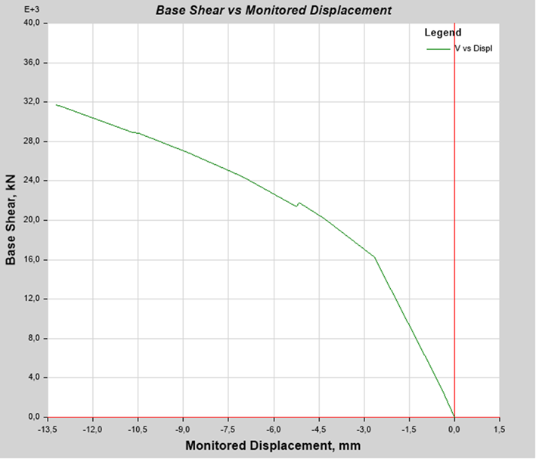
Analysis 2.: Base shear results - RM
X - DIRECTION
Y - DIRECTION

Slide 20
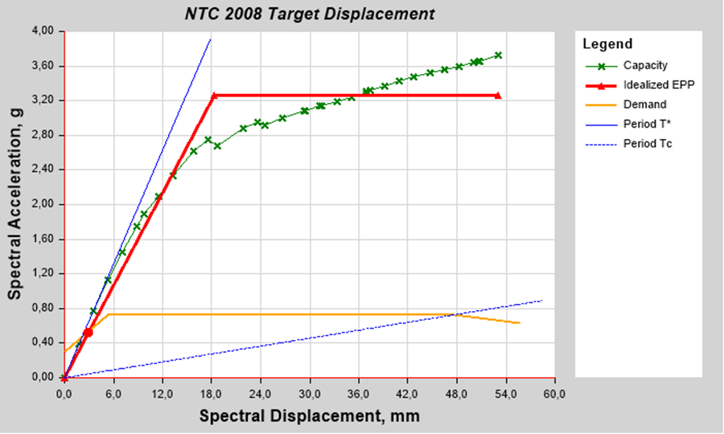
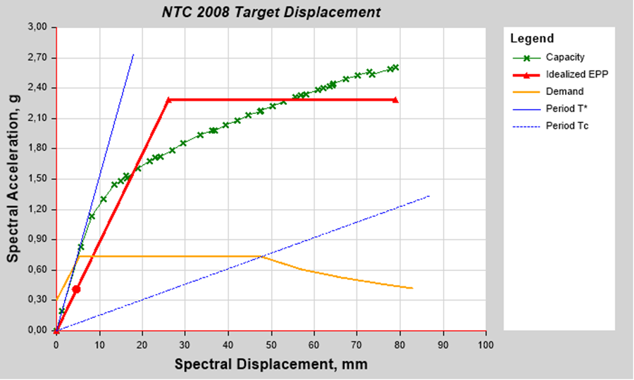
Analysis 2.: Target displacement - URM
X - DIRECTION
Y - DIRECTION

Slide 21
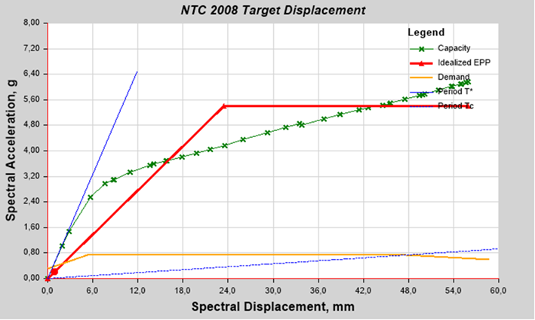
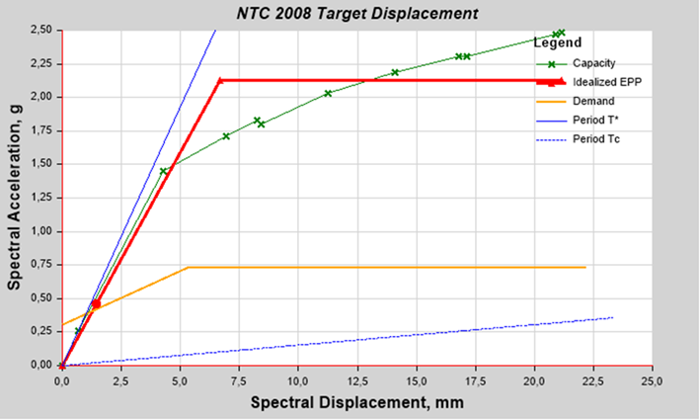
Analysis 2.: Target displacement - URM
X - DIRECTION
Y - DIRECTION

Slide 22
Analysis 2.: Verification
FE model reference | Direction | Fy* | dy* (mm) | dt* (mm)
URM | X | 3,266 | 18,307 | 2,917
 | Y | 2,283 | 26,002 | 4,67
RM | X | 5,405 | 23,436 | 4,952
 | Y | 4,706 | 32,494 | 6,141
dy*: yield displacement
Fy*: yield force
dt*: target displacement

Slide 23
Thank you for your attention!
I want to acknowledge “Studio KR e Associati” and “Studio Associato Amaddeo-Fiumanò” for providing the blueprint and the design specification of the castle.

Slide 24
Questions:
Supervisor: doc. Dr. Ing. Luboš Podolka
Jak by bylo možno počítanou historickou stavbu zabezpečit vůči účinkům zemětřesení ?
Počítá majitel objektu s ponecháním stavby ve stávajícím stavu bez střechy a s poškozenými stropními konstrukcemi, nebo bude nějakým způsobem stavba opravena ?
Oponent: Ing. Robert Šinkner, MBA.
Jakou metodou byl objekt zaměřen? Laserovým skenováním nebo klasickými geodetickými metodami?
Jak jste se dostal k takové zajímavé mezinárodní spolupráci?

Slide 25
Retrofitting methods
Bamboo-Band retrofitting technique
Reinforced plaster
Shotcrete
Fiber-Reinforced polymer (FRP)
Post-tensioning
Confinement
Center core
Injection

Slide 26
Experiment - NHERI@UCSD

