Slide 1
Numerical analysis and retrofitting of an historical masonry buildings
Student: Richard Šusták
Supervisor: doc. Dr. Ing. Luboš Podolka
Advisor: Ing. Carmen Amaddeo Phd.
Oponent: Ing. Jan Čížek
6/2017

Slide 2
Outline
Motivation
Aim of thesis
Study case
Analysis results
Conclusion

Slide 3
Motivation
Hot topic
Not so well known in Czech Republic
Passion for architectural heritage
Cooperation on real project

Slide 4
Aim of thesis
The aim of this bachelor thesis is to perform a seismic analysis of an historical masonry building located in seismic zone based on Italian code NTC 2008 and investigate the possible retrofitting techniques in order to preserve the building in case of earthquake. Elective method will be applied on chosen structure and in case of unsatisfactory results would be the structure retrofitted.

Slide 5
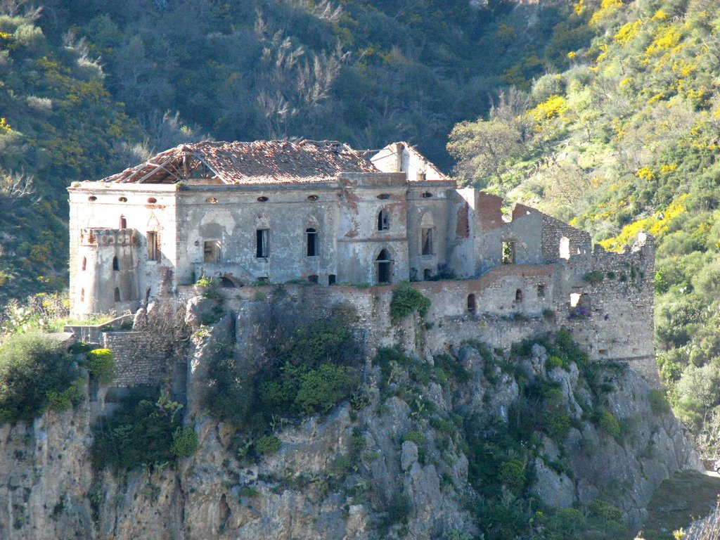
Study case – „Palizzi“ castle
Adress: Via Sant´Angelo, 14 Regio Calabria (RC) Palizzi, 89038, Italy
Name of building: „Palizzi“ castle
Permanent parcel: st. 113, 114
Building use: Historical monument
Owner: Municipality of Palizzi

Slide 6
Study case – „Palizzi“ castle
Map of Italy with location of Palizzi town
(https://www.google.cz/maps/)
Cadastral map of Palizzi municipality showing the location of the castle

Slide 7
Study case – „Palizzi“ castle

Slide 8
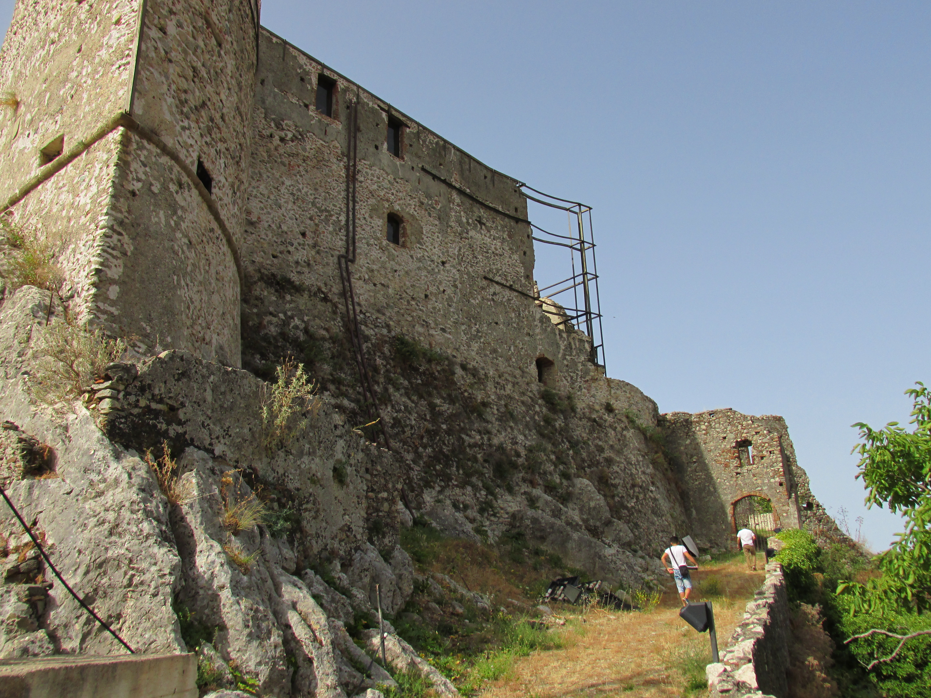
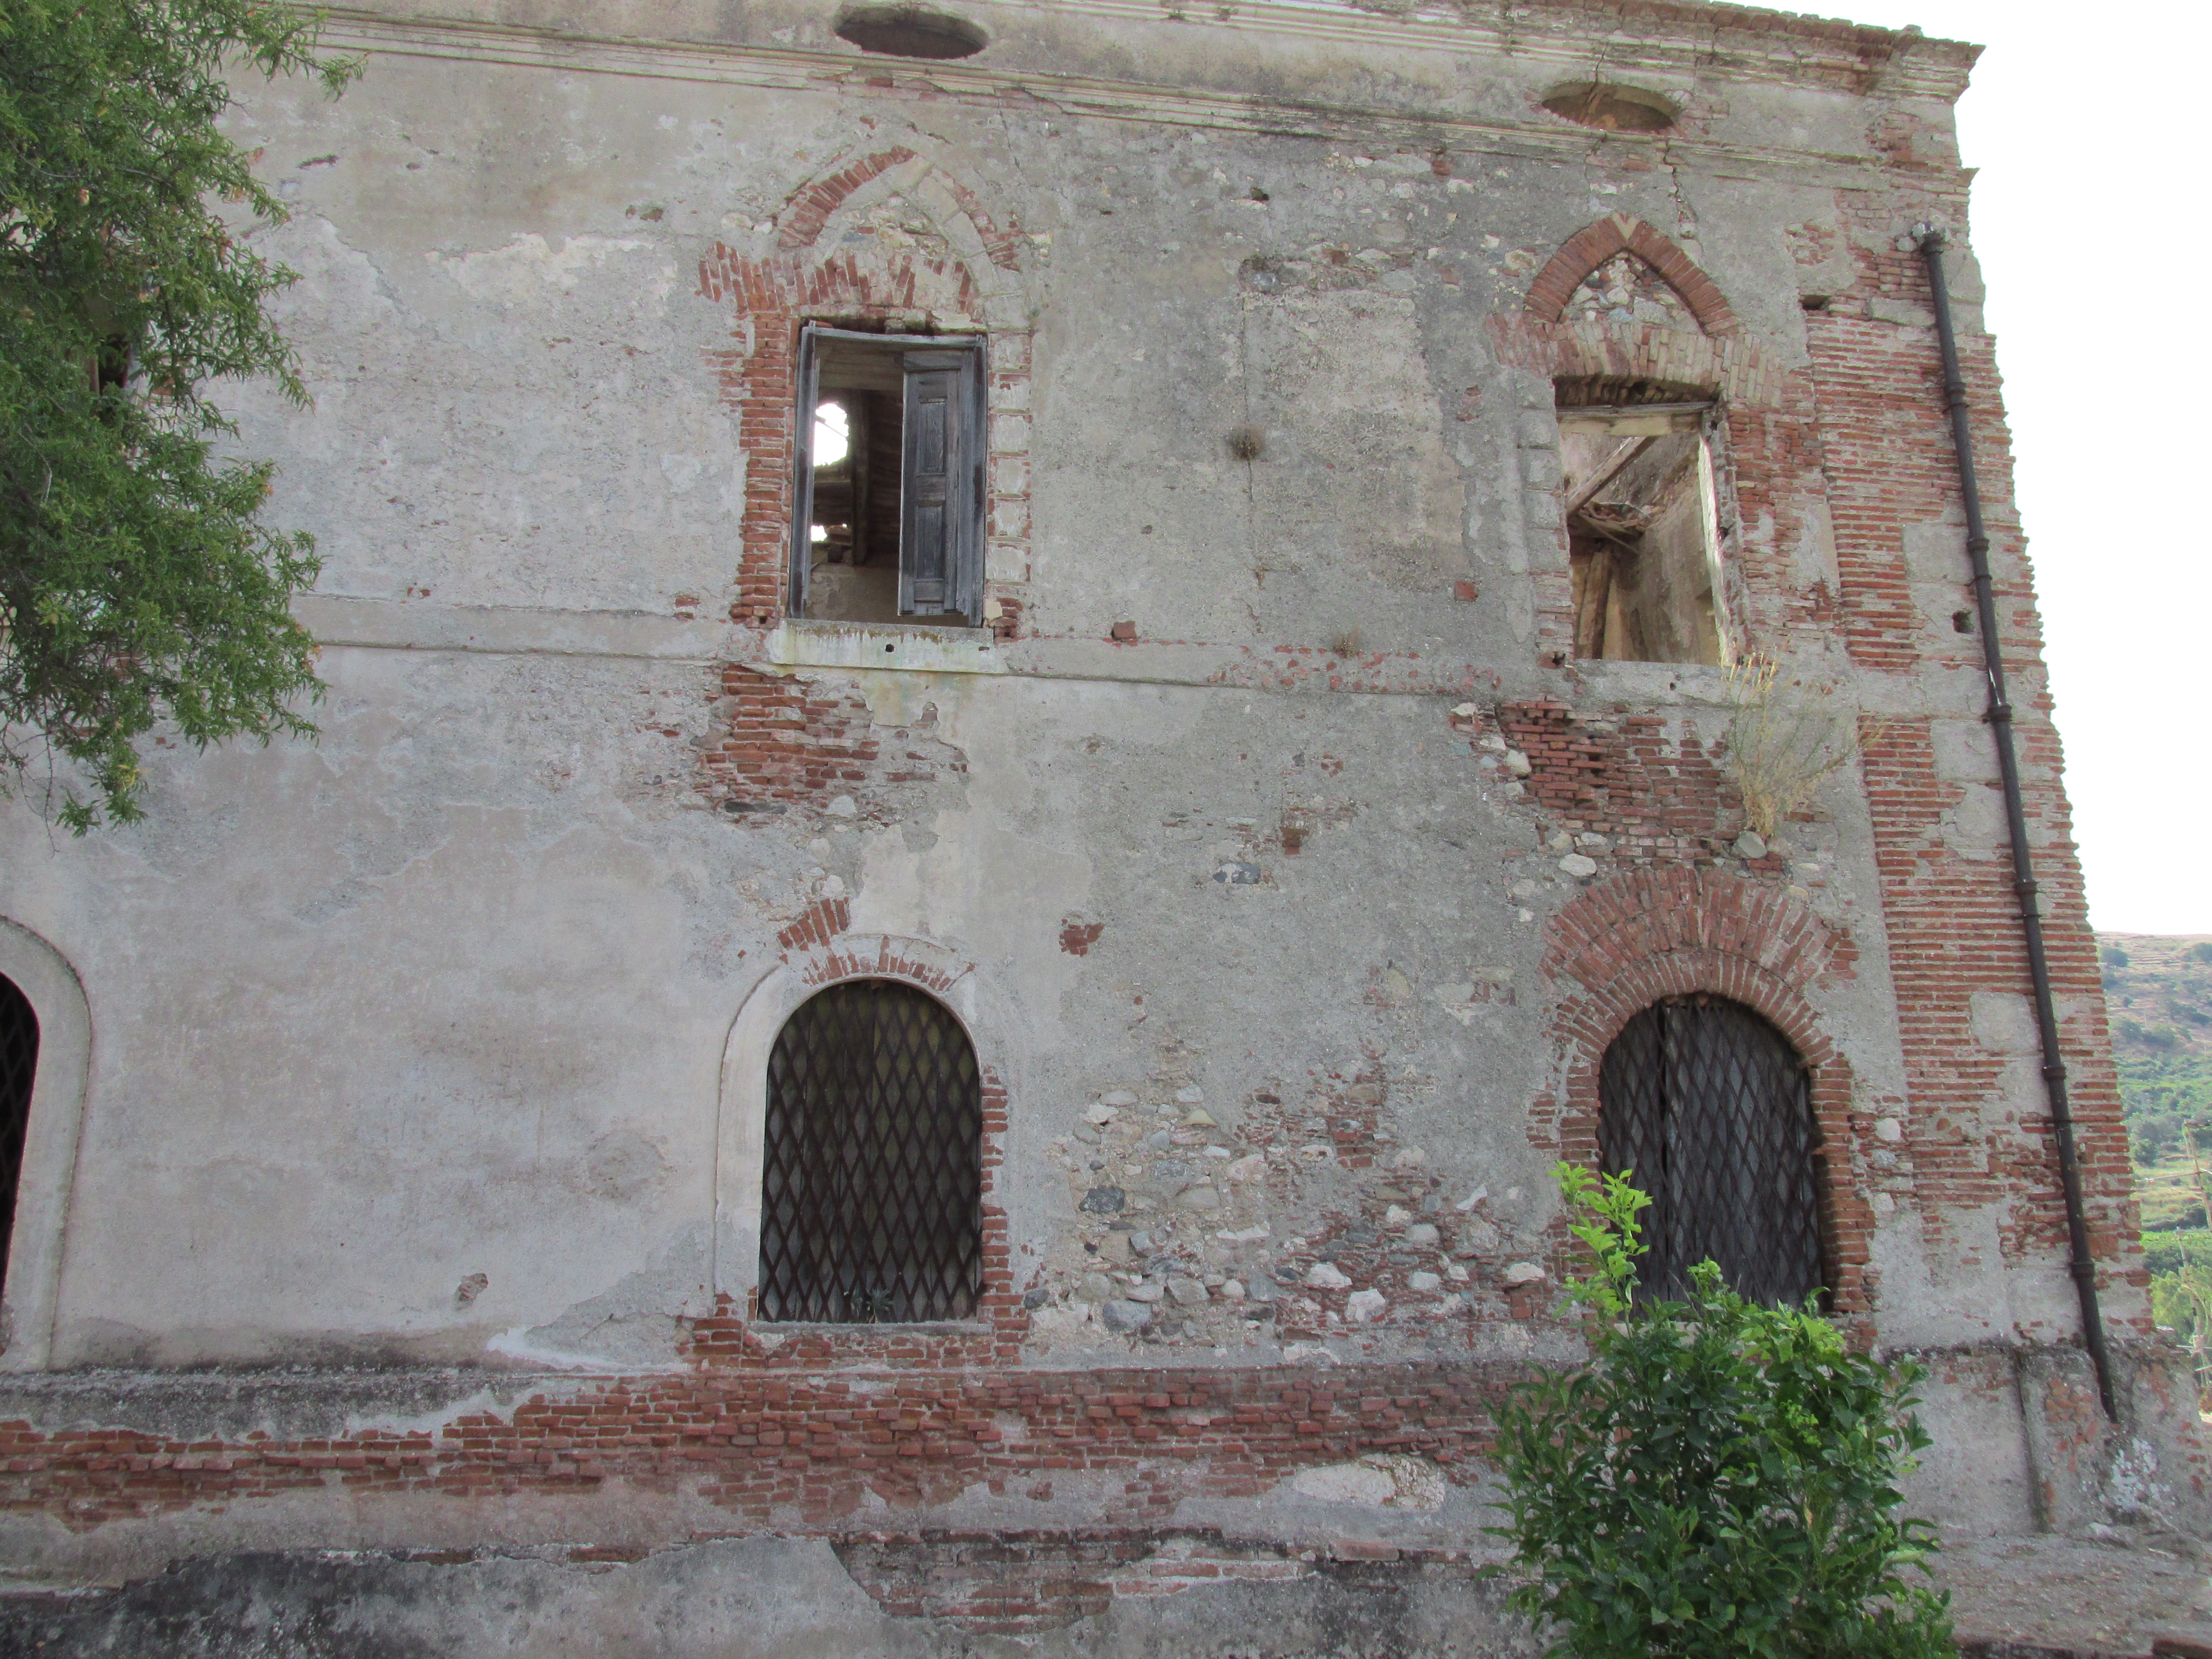
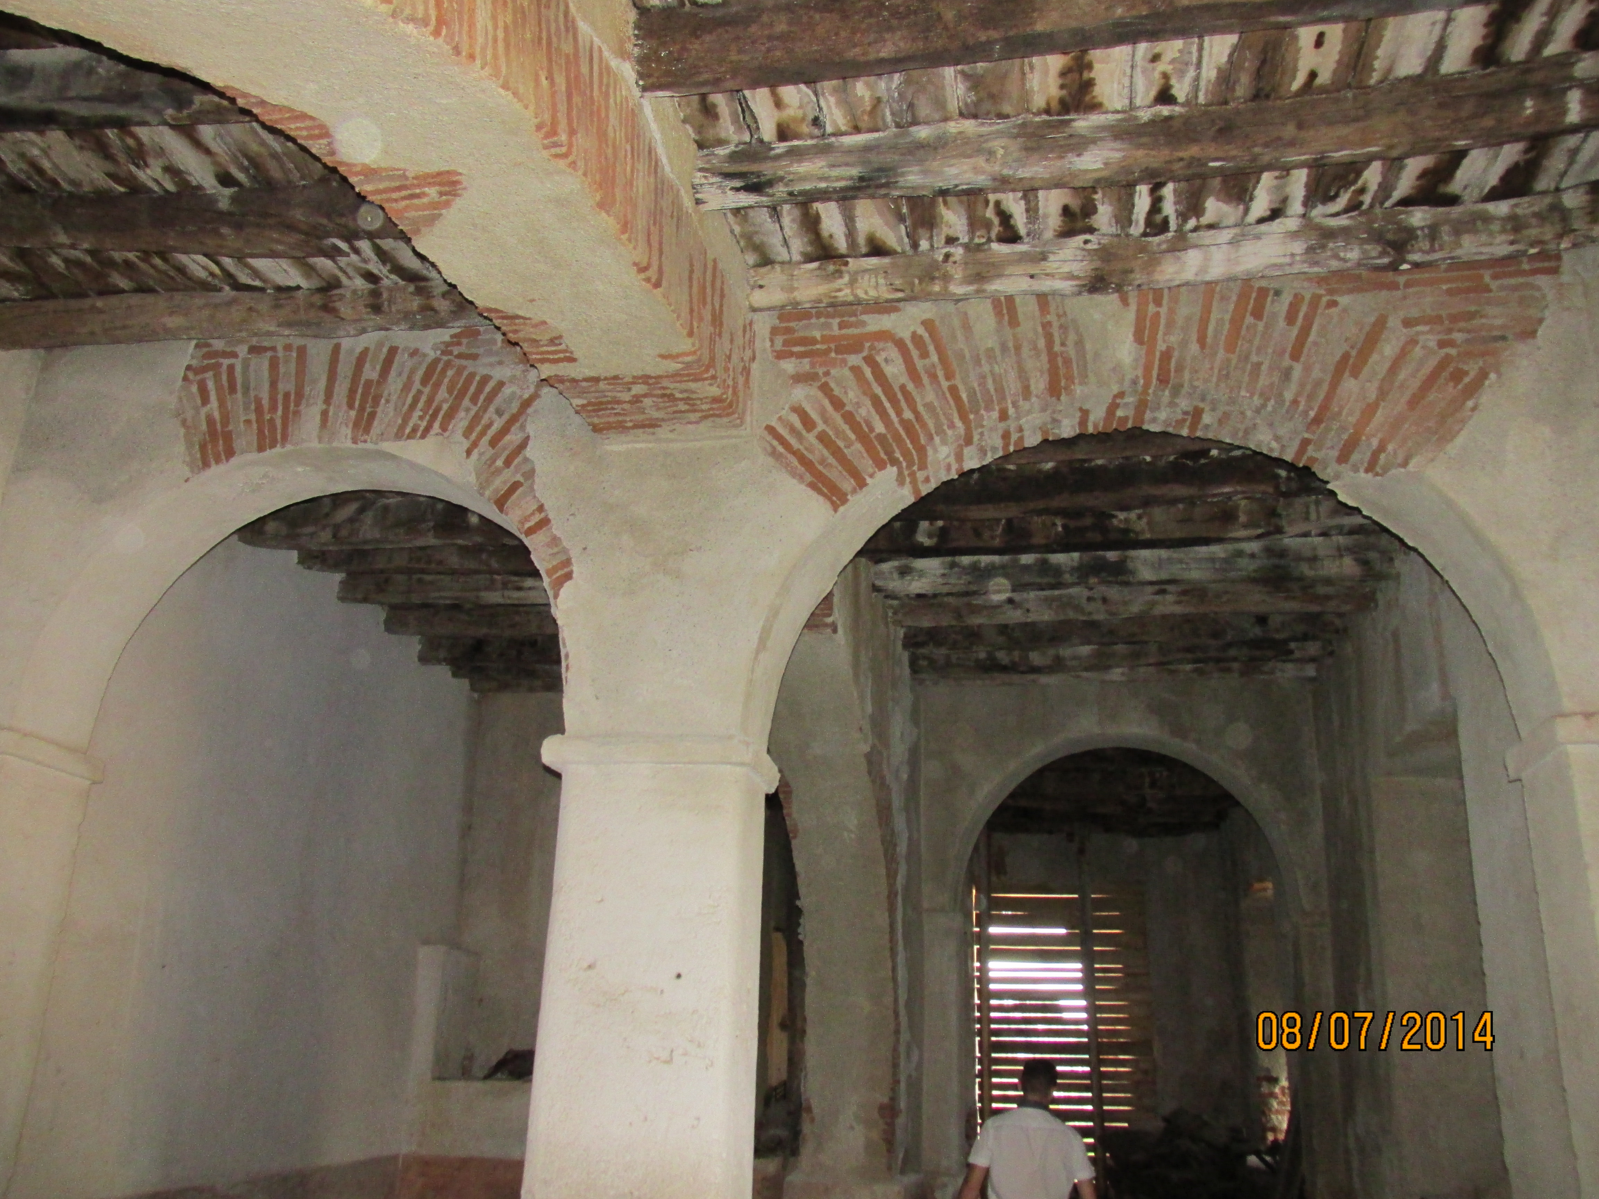
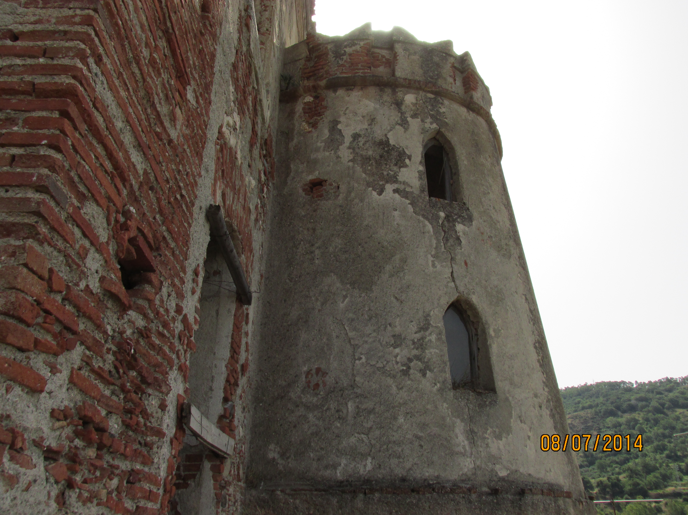
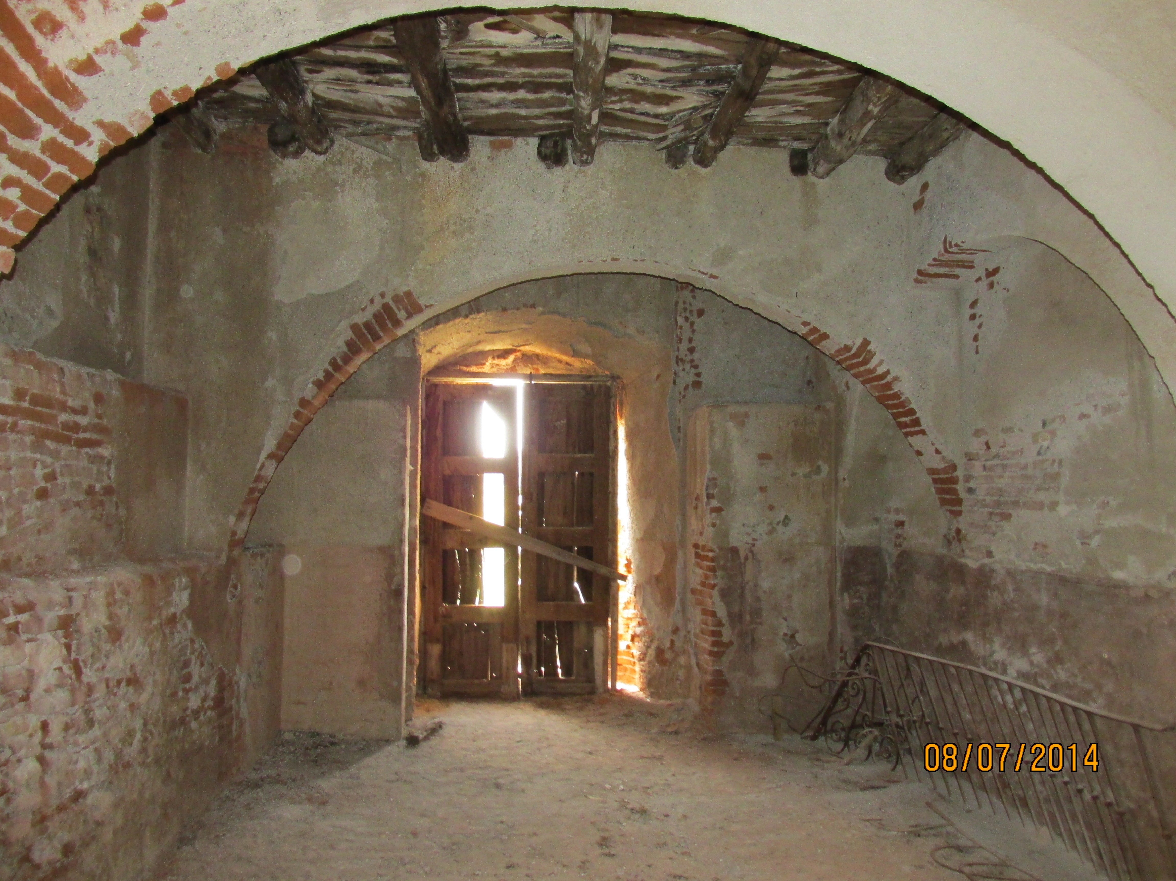
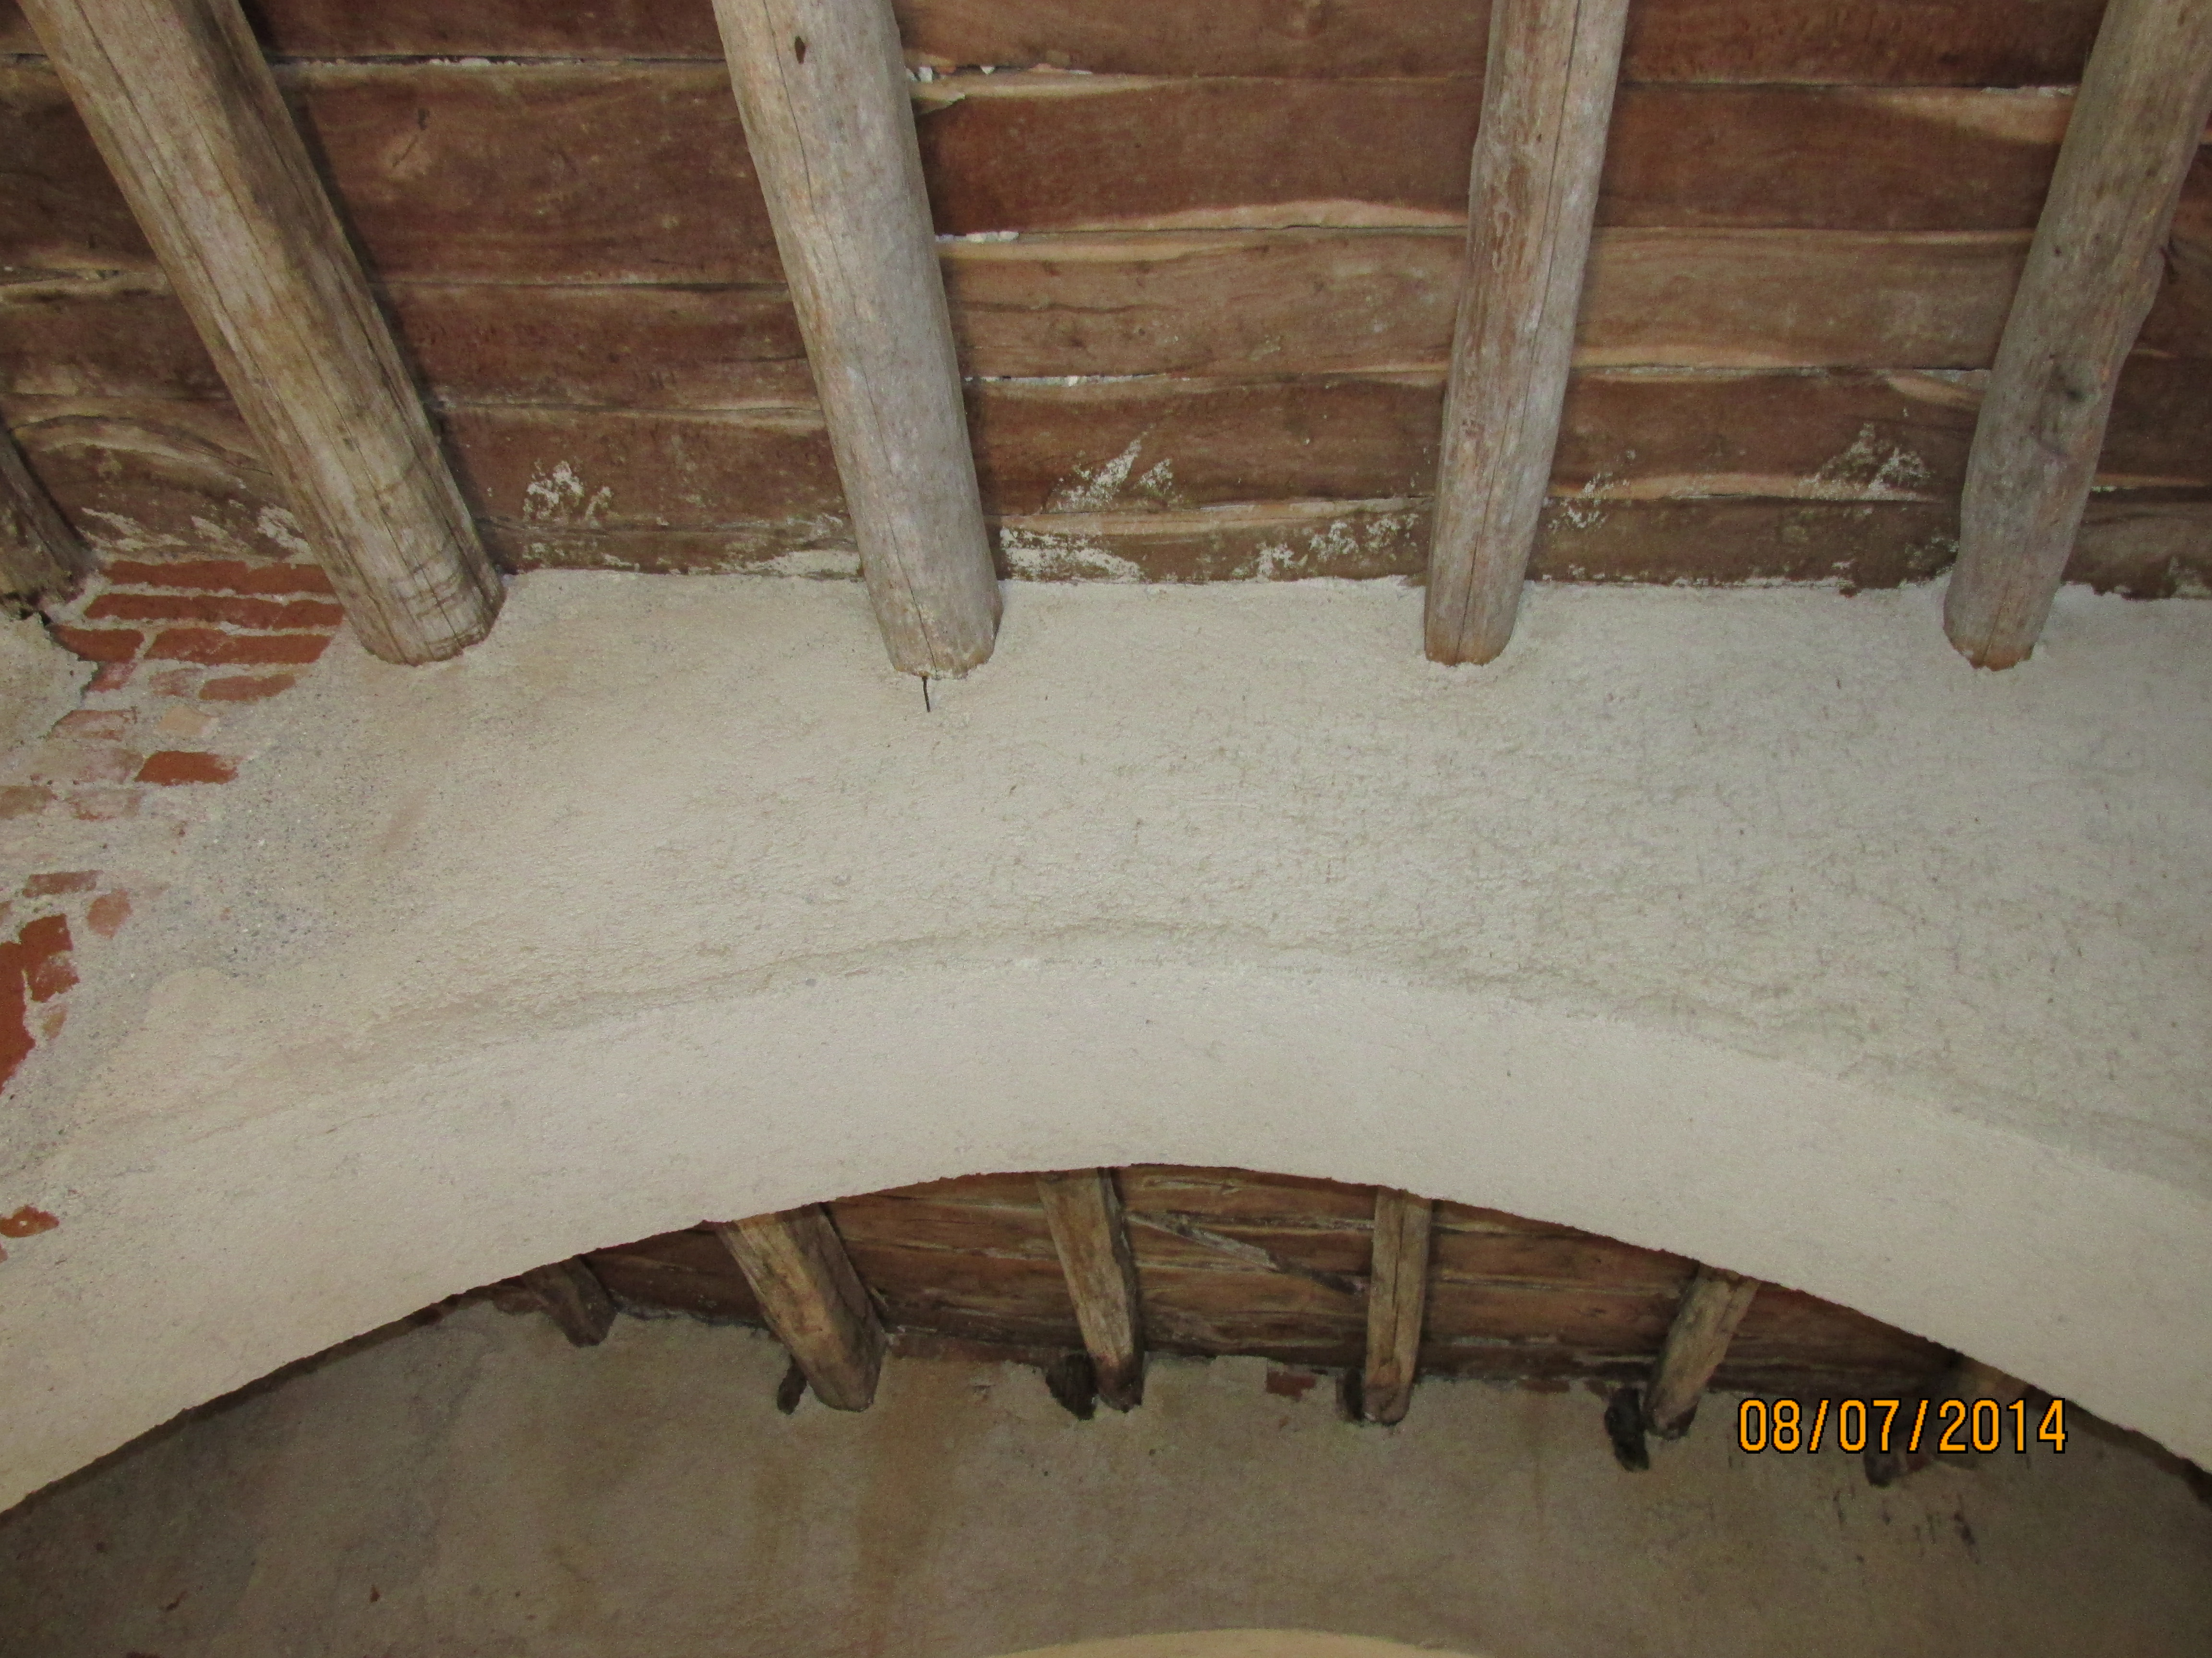
Study case – „Palizzi“ castle

Slide 9
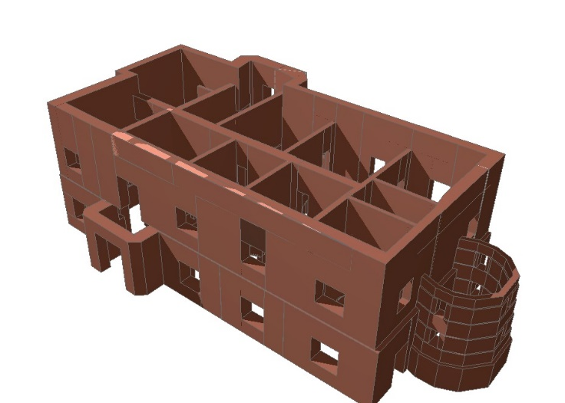
Study case – „Palizzi“ castle
Masonry typology | $$f_{m}$$ (N/mm²) | $$τ_{0}$$ (N/mm²) | E (N/mm²) | G (N/mm²) | W (kN/m³)
Brick masonry and mortar | 2,52 | 0,60 | 1654 | 394 | 18
Masonry of brick and mortar (retrofitted) | 4.91 | 1.16 | 3225 | 768 | 18

Slide 10
Study case – „Palizzi“ castle
Actual PGA is 0,175 – 0,200
Region of Calabria – 1. zone – PGA is 0,301

Slide 11
Study case – „Palizzi“ castle
Collapse prevention Limit State (SLC)
Damage Limitation State (SLD)
Operating Limit State (SLO)
Life-Saving Limit State (SLV)

Slide 12
Study case – „Palizzi“ castle
12. load combinations
1. envelope
Roof and slabs – with and without
SRSS - Square Root of Sum of Squares

Slide 13
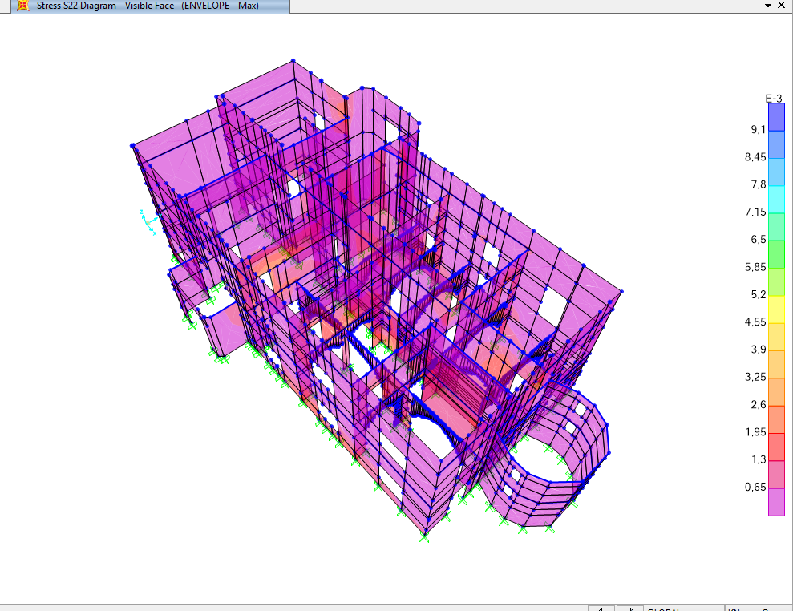
Study case – „Palizzi“ castle
Model without slabs – direct stress
S22: Direct stress (force per unit area) acting on the positive and negative 2 faces in the 2-axis direction.
$f_{m}$: Tensile strength of masonry (N/mm²)
 | S22 | $$f_{m}$$
Max stress | 9,062 N/mm² | 2.52 N/mm²
Average stress | 0,557642 N/mm² | 2.52 N/mm²
Min stress | 0,007884 N/mm² | 2.52 N/mm²

Slide 14
Study case – „Palizzi“ castle
Model without slabs – shearing stress
S12: Shearing stress (force per unit area) acting on the positive and negative 1 faces in the 2-axis direction and acting on the positive and negative 2 faces in the 1-axis direction.
$τ_{0}$: Shear strength of masonry (N/mm²)
 | S12 | $$τ_{0}$$
Max stress | 7,516 N/mm² | 0.60 N/mm²
Average stress | 0,405414 N/mm² | 0.60 N/mm²
Min stress | 0,0005604 N/mm² | 0.60 N/mm²

Slide 15
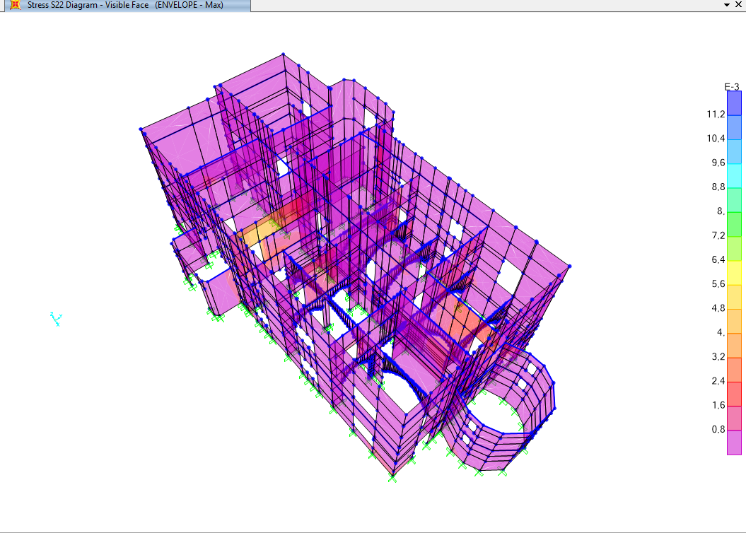
Study case – „Palizzi“ castle
Retrofitted model with slabs – direct stress
S22: Direct stress (force per unit area) acting on the positive and negative 2 faces in the 2-axis direction.
$f_{m}$: Tensile strength of masonry (N/mm²)
 | S22 | $$f_{m}$$
Max stress | 11,439 N/mm² | 4.91 N/mm²
Average stress | 0,433839 N/mm² | 4.91 N/mm²
Min stress | 0,001775 N/mm² | 4.91 N/mm²

Slide 16
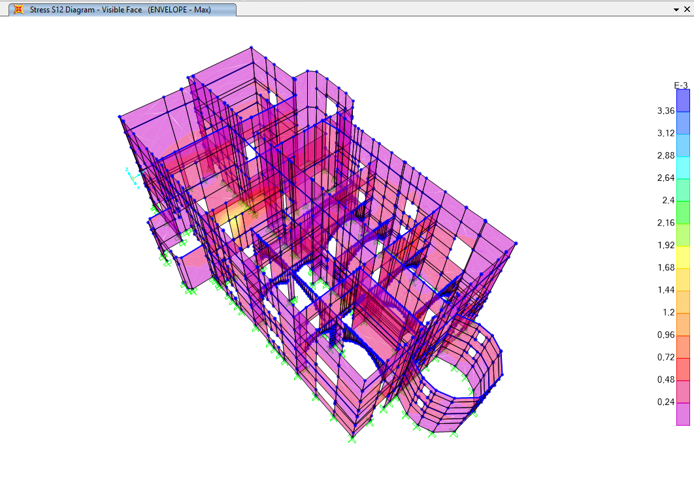
Study case – „Palizzi“ castle
Retrofitted model with slabs – shearing stress
S12: Shearing stress (force per unit area) acting on the positive and negative 1 faces in the 2-axis direction and acting on the positive and negative 2 faces in the 1-axis direction.
$τ_{0}$: Shear strength of masonry (N/mm²)
 | S12 | $$τ_{0}$$
Max stress | 3,557 N/mm² | 1.16 N/mm²
Average stress | 0,258344 N/mm² | 1.16 N/mm²
Min stress | 0,002053 N/mm² | 1.16 N/mm²

Slide 17
Verification and conclusion

Slide 18
Thank you for your attention!
I want to acknowledge “Studio KR e Associati” and “Studio Associato Amaddeo-Fiumanò” for providing the blueprint and the design specification of the castle.

Slide 19
Questions from supervisor and oponent
Existují i jiné možnosti úpravy historické konstrukce, tak aby vzdorovala seismickému zatížení? Uveďte příklady které znáte.
Do another retrofitting methods for historical structures exist? Please give examples.
Jaký máte názor na zpevnění zdiva injektáží? Je vhodná pro zpevnění zdiva při účincích seismického zatížení?
What is your opinion about strengthening masonry by injection method? Can the method be applied for earthquake resistance?
V jakém zdivu obecně lze injektáž aplikovat a v jakém naopak ne? Co je rozhodující parametr?
In which type of masonry could be possible to apply injection method and in which not? What is the critical parameter?

Slide 20
Retrofitting methods
Surface treatment
Bamboo-Band retrofitting technique
Reinforced plaster
Shotcrete
Fiber-Reinforced polymer (FRP)
Post-tensioning
Confinement
Center core
Injection

