Slide 1
Merkis
Strategic Business Management/ Finance Simulation Game
Riga International Business Week 2023
BA School of Business and Finance
24.04.2023. – 28.04.2023.

Slide 2
Contents
Introduction
Background
Gameplay
Results
Application
Additional Information

Slide 3
Introduction
ABOUT BUSINESS WEEK 2023
AUDIENCE
    30-60 Business Week participants from business
    schools from different EU countries
TIMING
24.04.2023 – 28.04.2023

Slide 4
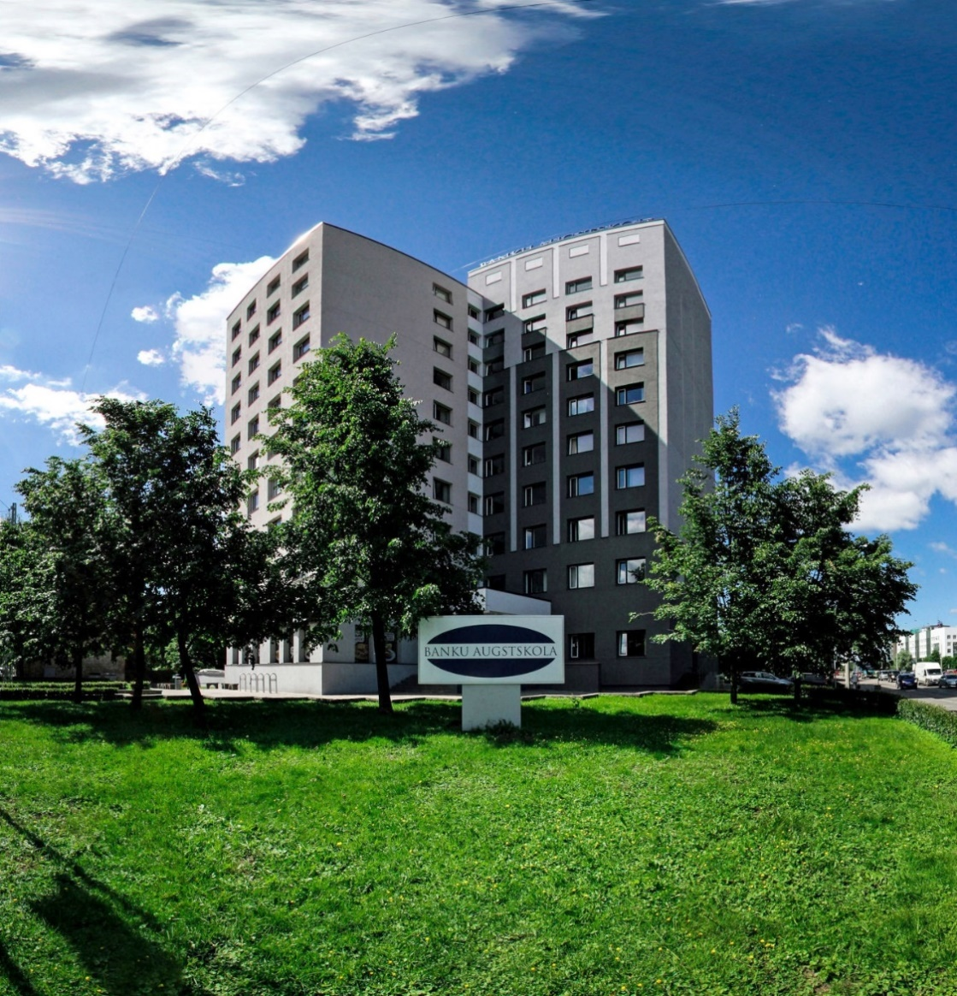


Introduction
ABOUT BA SCHOOL OF BUSINESS AND FINANCE
BA School of Business and Finance (BASBF) is one of the leading business schools in Riga and Latvia, and offers quality studies and research in business and finance. Our international cooperation, professional and creative staff, working closely with the business world, and achievements of our students and graduates earn our excellent reputation.

Slide 5
Background
What is MERKIS?
Manufacturing business simulation game
Evaluation and assessment tool
Development tool
Change management tool
Game participants, in teams, manage their companies that are modeled in physical business environment, while competing with each other.

Slide 6
Gameplay
In teams of 5-8 people
Each participant have a unique role, which changes during the game
CEO
Director of Sales and Marketing
Production Manager
Worker
Worker
Director of Finance
Chief of Engineering
Engineer

Slide 7

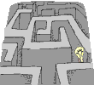


Gameplay
Several participants play the outside world.
They have strategic goals.
And compete with team-run companies for profit.
Game Companies
IRS
Bank
Customer

Slide 8
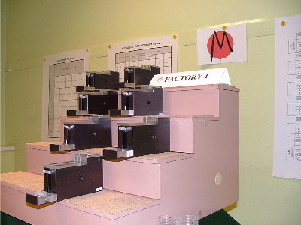
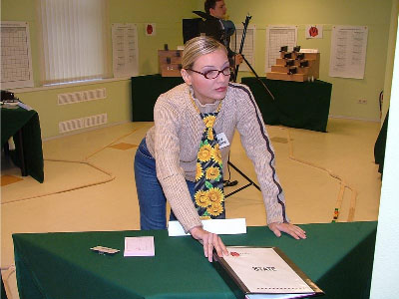
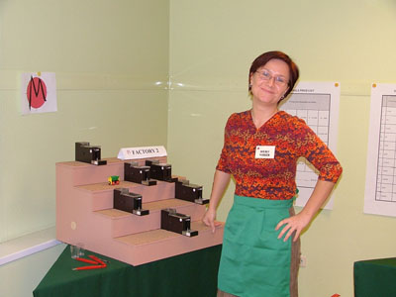
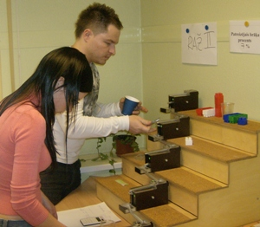
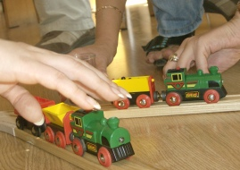
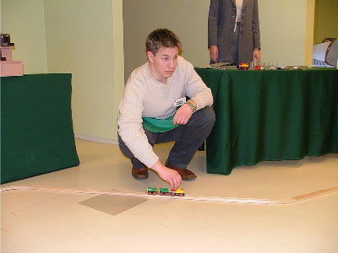
Gameplay
Physical production and logistics

Slide 9
Gameplay
Enterprise
  Enterprise is modeled in the training room physically
  We use custom built little production equipment
  Wooden railroad system with electric trains
  The game takes place in real time. 1 game year is equal to 60 minutes
  During one real-time hour players must buy materials, deliver them to factory by train, produce (physically move ball bearing from one production machine to another), deliver ready-made production to the customer, receive payments, produce financial reports, install new production equipment etc.
  The game covers 6-7 years of a real company’s life.
  Results of strategic decisions made in one year are seen in the next.
Time

Slide 10
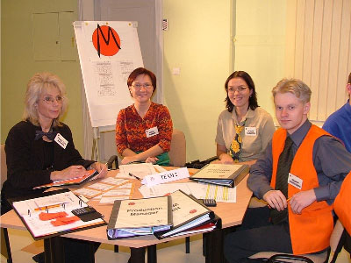
Gameplay
MERKIS training structure
One game round (year) (4 hours)
  Decision making round (30 min)
  The game itself (70 min)
  Retreat in teams (20 min)
  Self analysis (15 min)
  Trainer’s feedback (30min)
  New theory and exercises(30-60 min)

Slide 11
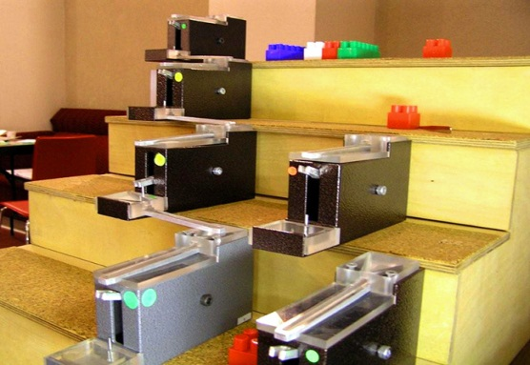
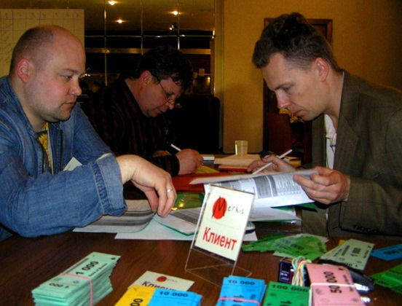
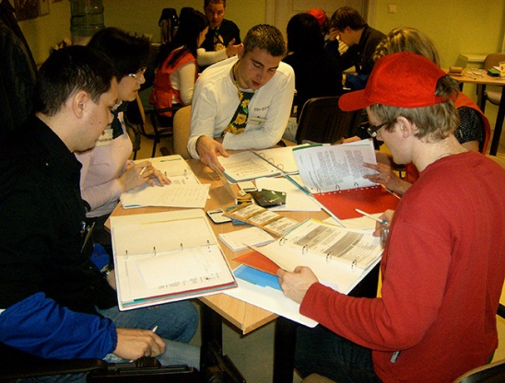
Gameplay
Critical decisions in the game
Sales
  How to increase sales?
  How to act while bidding for contracts?
  To compete or cooperate?
Finance
  How to decrease variable costs?
  How to decrease fixed costs?
  To invest in equipment or not?
Production and Logistics
  What equipment to buy?
  What equipment can be invented?
  How to optimize production?
  How to optimize logistics?
Team
  How to assign responsibilities among team members?
  How to allocate time?
How to cooperate with the Government?

Slide 12
Results
Main Results
Proactivity
Change of collective mind towards Outcome Frame thinking
Positive thinking
“Out of the box” thinking
Helicopter view on the whole enterprise
Understanding the importance of other functions
Development of specific competences
Development of specific skills
Feedback

Slide 13
Results
Skills that are trained
Leadership
Setting and achieving business goals
Tactical management and planning
Company’s finances, management accounting and budgeting
Introducing work procedures
Problem-solving in production and logistics
Negotiation skills with external parties
Cross-departmental communication
Effective cooperation in a team
Decision making in uncertainty
Creative thinking

Slide 14


Application
Who can apply?
Students will be enrolled in Blended Intensive Program (BIP). To join BIP your higher education has to be in Erasmus+ BIP program
Any bachelor and master study program students
BIP Participation fee: 260,- Eur (accommodation student hostel, +HB,)
Participation fee for others: 260,- Eur

Slide 15


Additional information
Good afternoon! ↔ Labdien!
Good morning! ↔ Labrīt!
Sorry! ↔ Atvainojos!
Thank you! ↔ Paldies!
Yes ↔ Jā
No ↔ Nē

