Slide 1

International Marketing Week Künzelsau
March 2019
Joachim Link

Slide 2
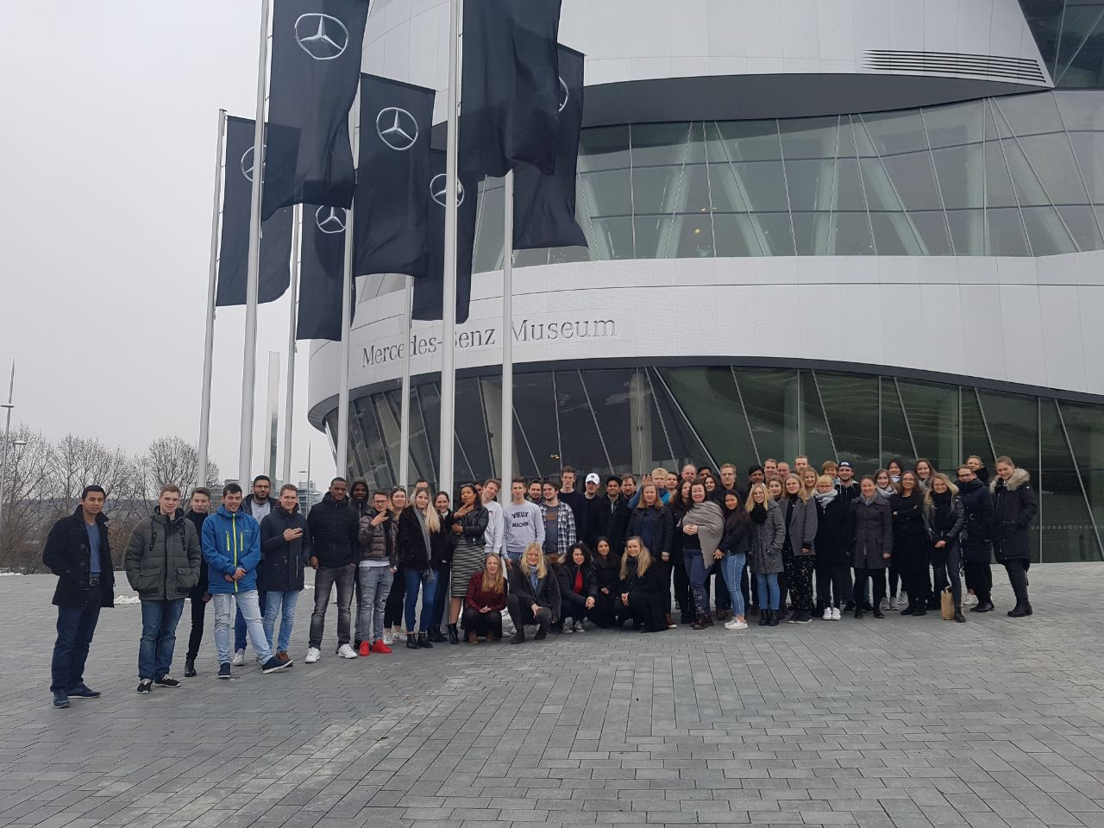

Slide 3
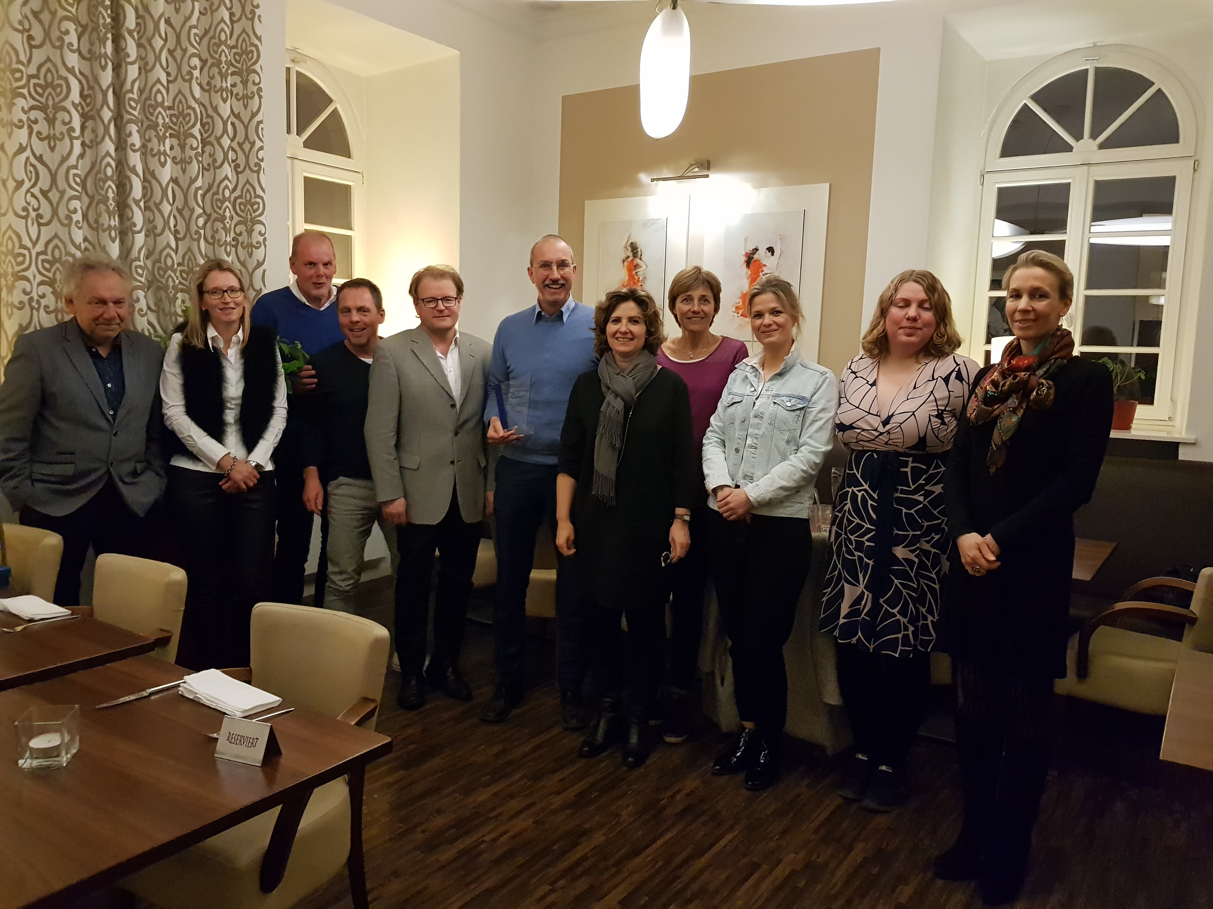

Slide 4
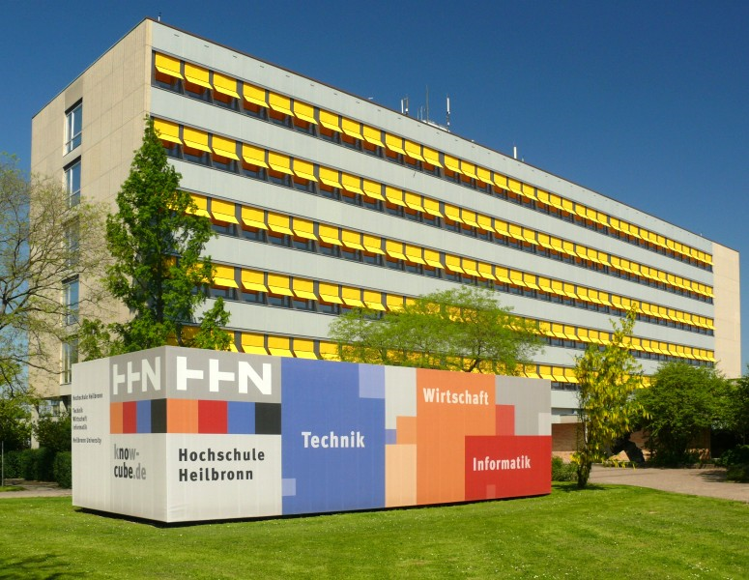
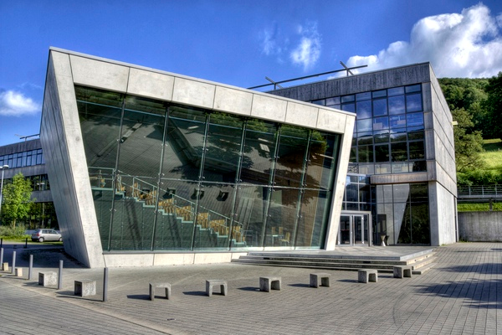
The University
Heilbronn University
Foundation in 1961
42 Bachelor- and Master-Degree courses in
- Engineering / Technology
- Business Administration
- Informatics
8,000 full time academic students
Reinhold-Würth-University
Second campus of Heilbronn University since 1988
1,500 full time academic students

Slide 5
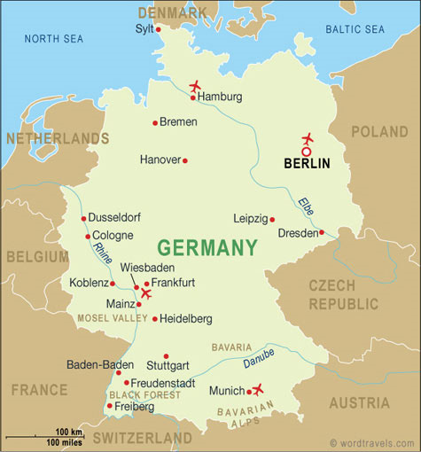
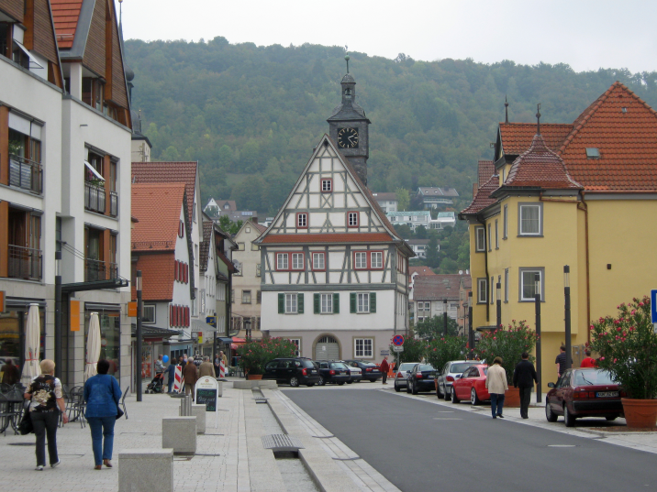
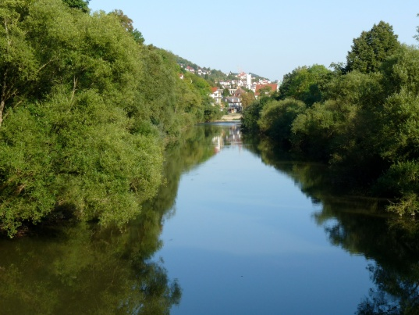
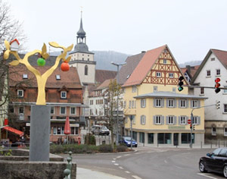
Location: Reinhold-Würth-University Künzelsau

Slide 6
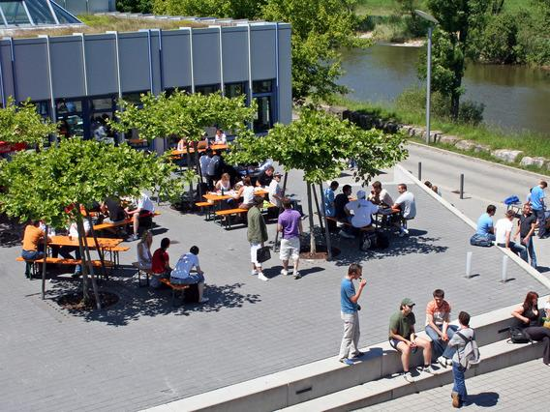
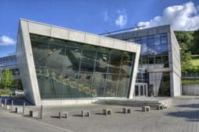
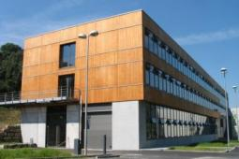
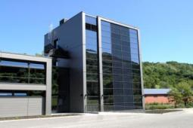
Our Campus –
small but beautiful!

Slide 7

Facts and Figures
Date: March 24 to March 29, 2019
Number of Participants: 5 students per partner university
10 German students
Theme: Brand Project in cooperation with Mercedes-Benz
Price: 200 Euros per student (including accommodation, transport, all meals as mentioned in the program,
social activities)
Registration deadline: December 21, 2018

Slide 8
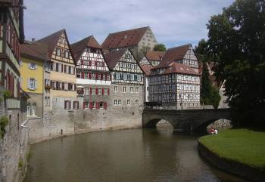
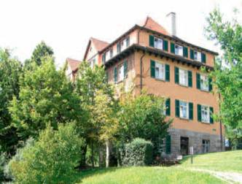
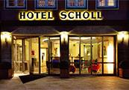
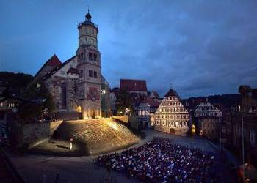
Facts and Figures
Accommodation: located in Schwäbisch Hall
(20 kilometres from Künzelsau)
  students: Youth Hostel Schwäbisch Hall
  tutors: Hotel Scholl (recommended)
Transport: daily bus shuttle from Schwäbisch Hall to
Künzelsau
Notes:
8

Slide 9
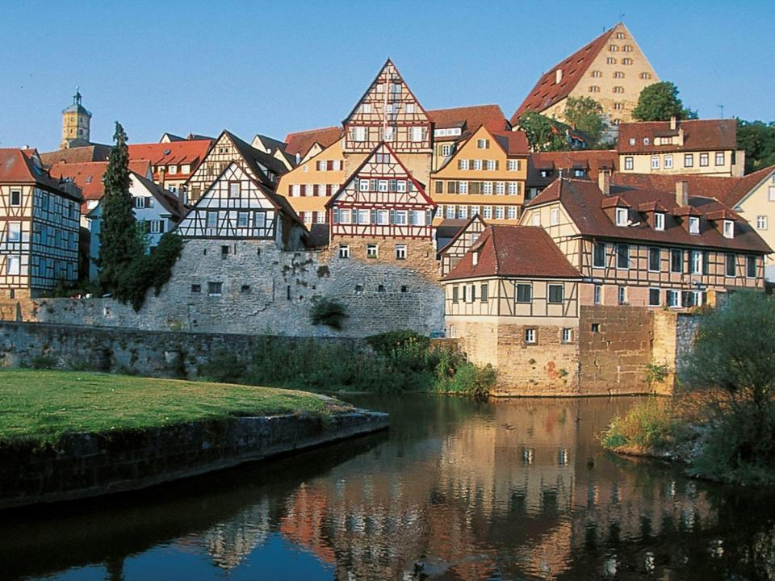

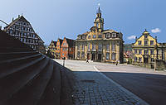
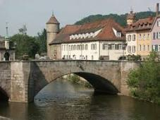
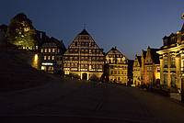
Accommodation in
Beautiful city with medieval flair
53 km to the east of Heilbronn
37,000 inhabitants
A couple of nice pubs

Slide 10
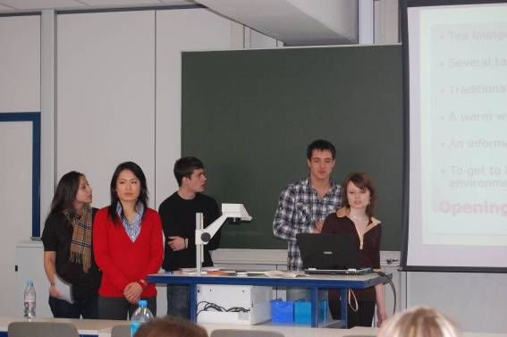
What we expect
Pre-Assignment: In order to familiarize
themselves with the topic,
the students will
get a pre-assignment task
about the topic of the week
(task will be sent by February 2019
submission deadline: March 25, 2019).
Presentation: The students have to present
their final solution at the
end of the week
(20 minutes per group).
Notes:
10

Slide 11
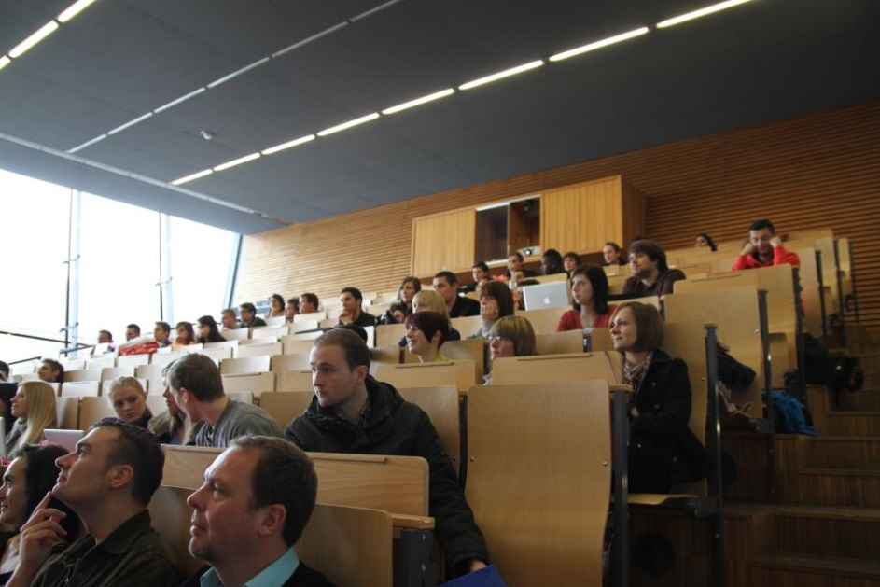
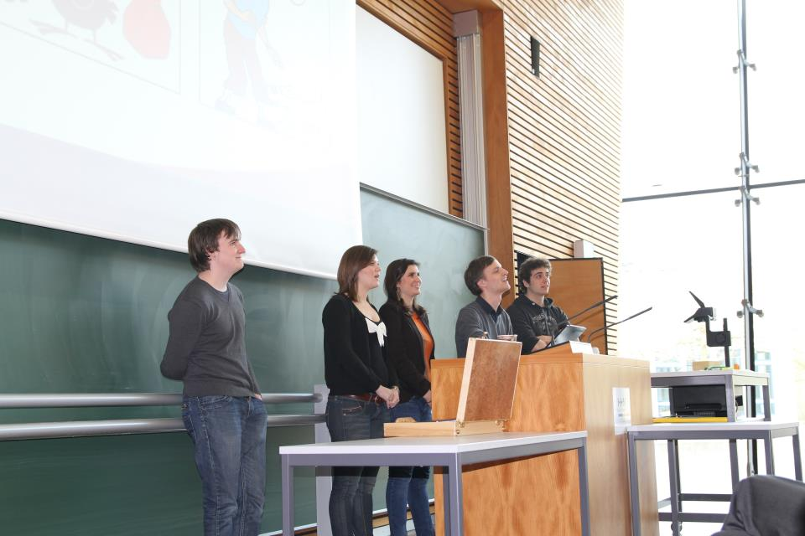
Program – Introduction on Monday
University presentations
Forming of the international teams
Mercedes-Benz Briefing / First Team Session

Slide 12
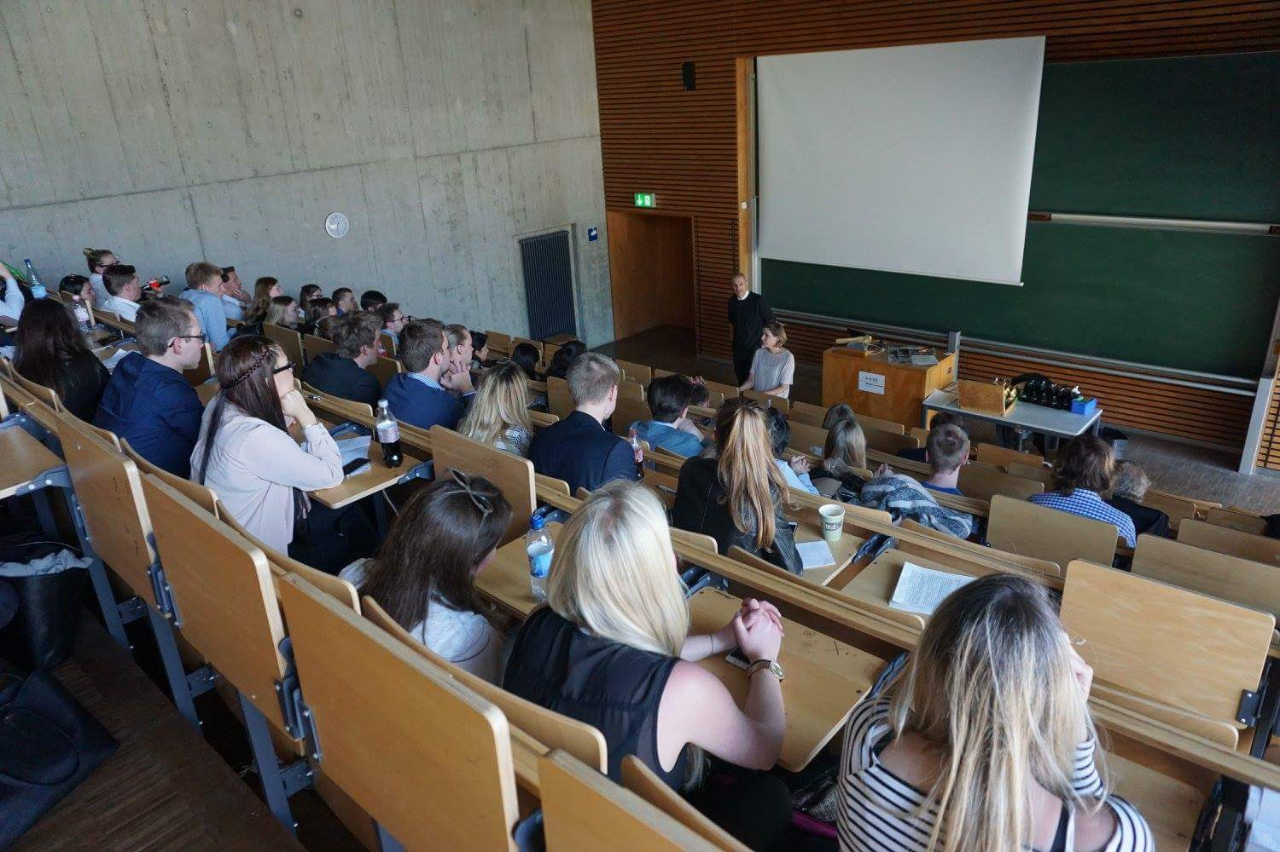

Slide 13
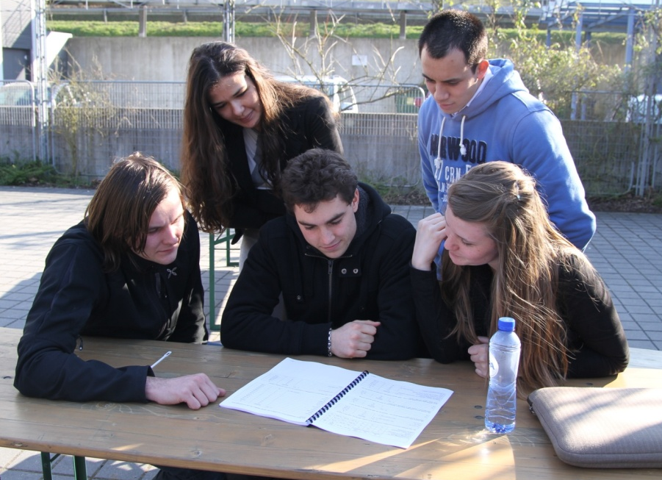
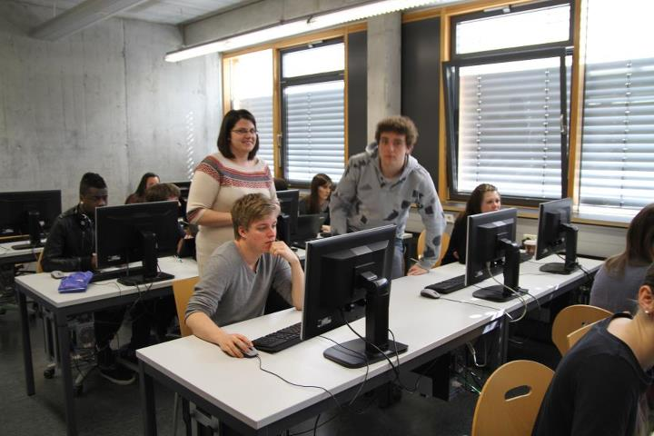
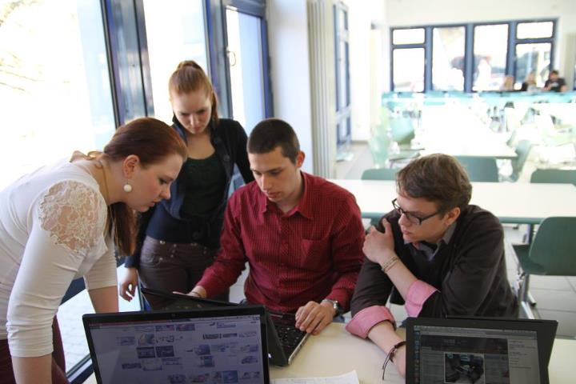
Program – Team Sessions
Work in international teams
Perceive and consider cultural differences
Develop successful and creative ideas for Mercedes-Benz

Slide 14
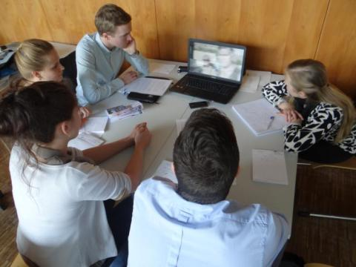
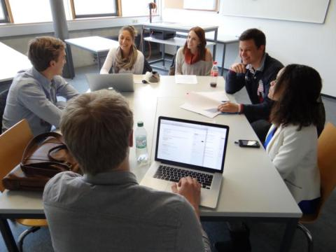
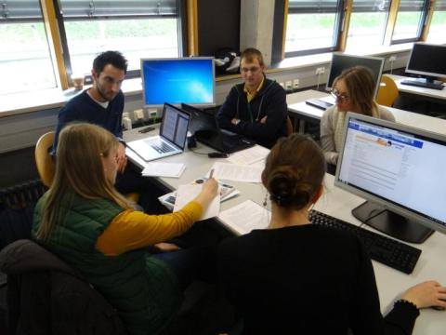
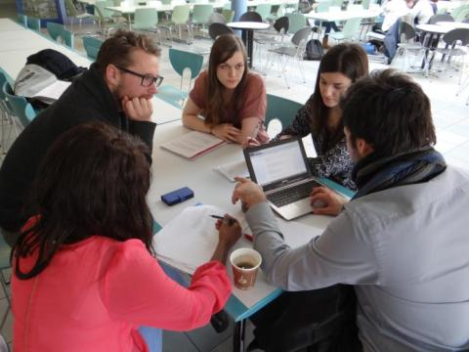

Slide 15
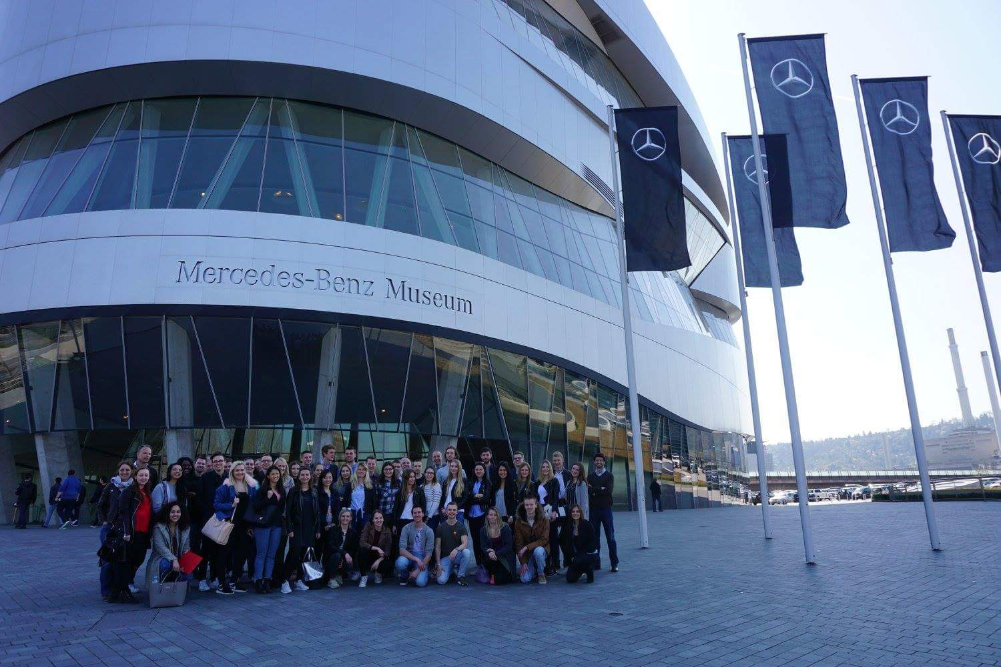
Program – field trip to Stuttgart

Slide 16
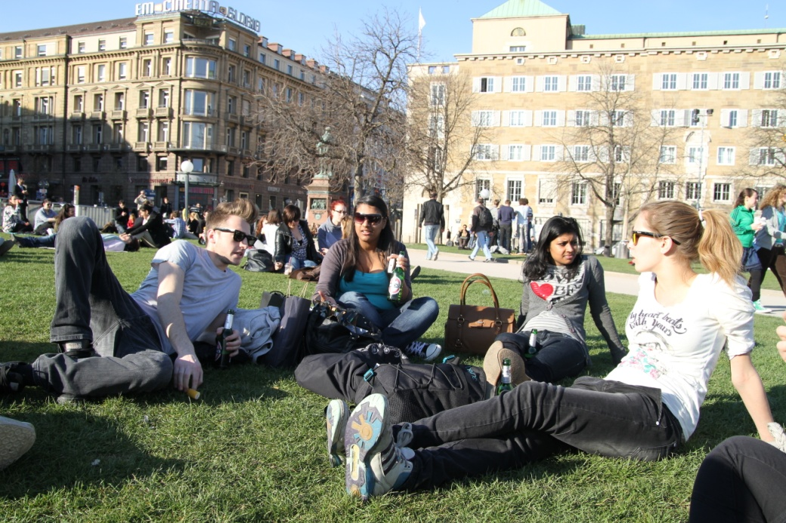
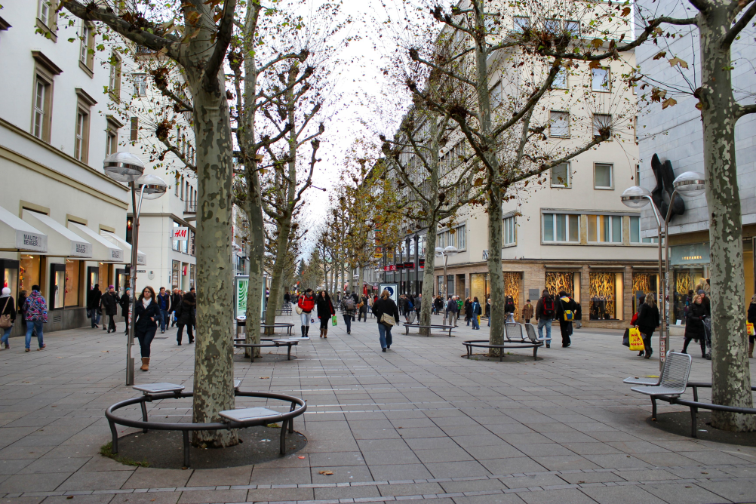
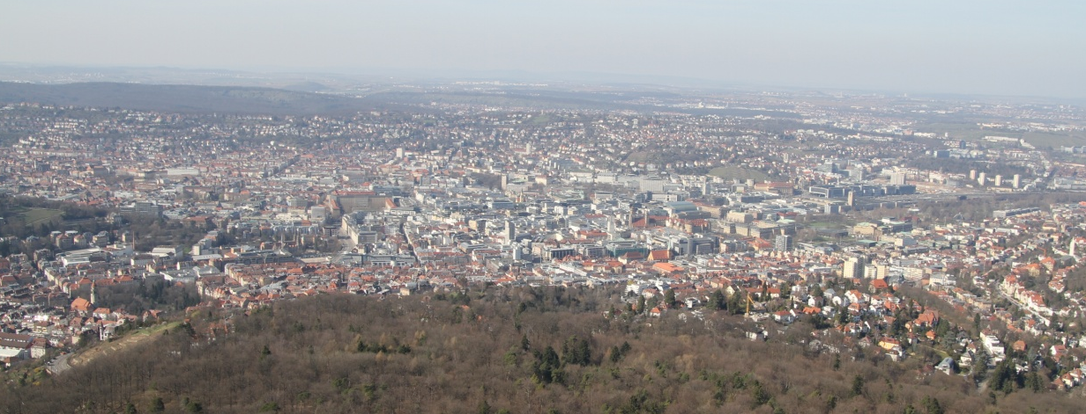
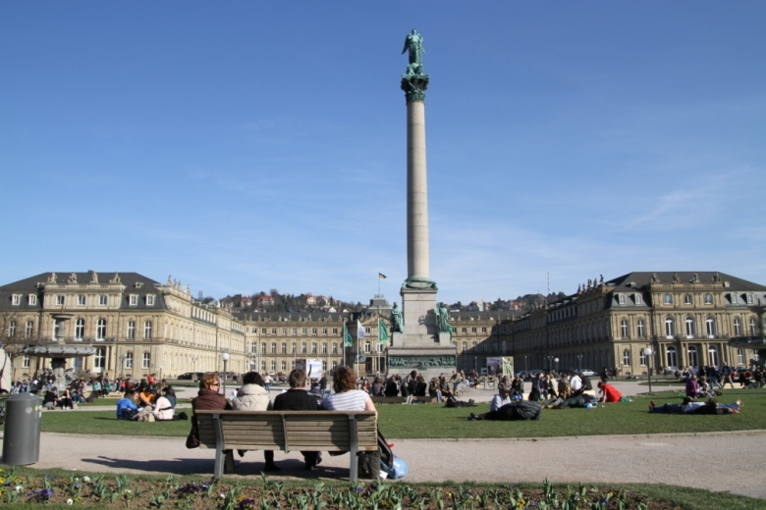
Program – field trip to Stuttgart
Shopping
Relaxing
Sightseeing

Slide 17
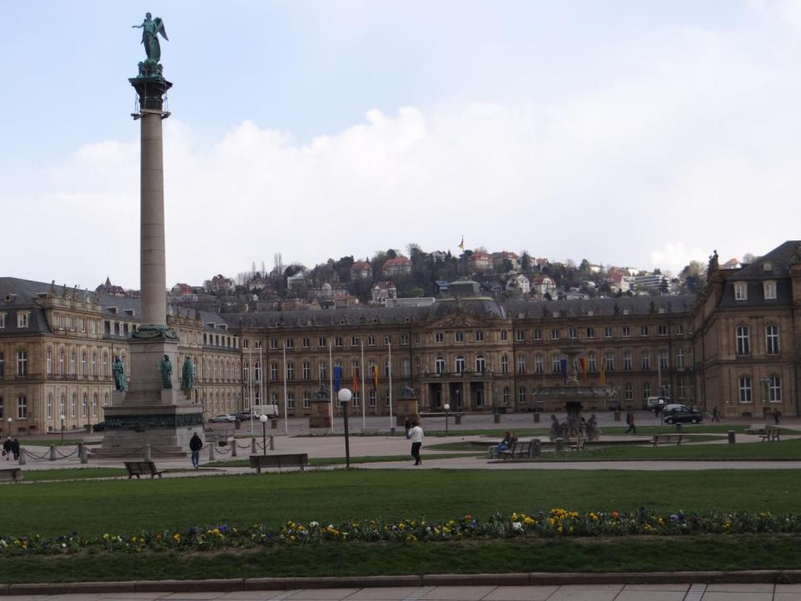
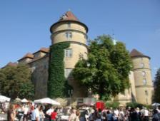
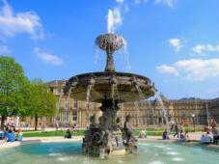

Slide 18
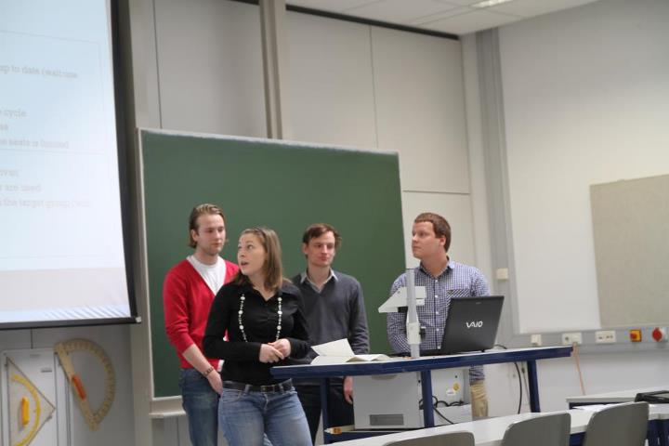
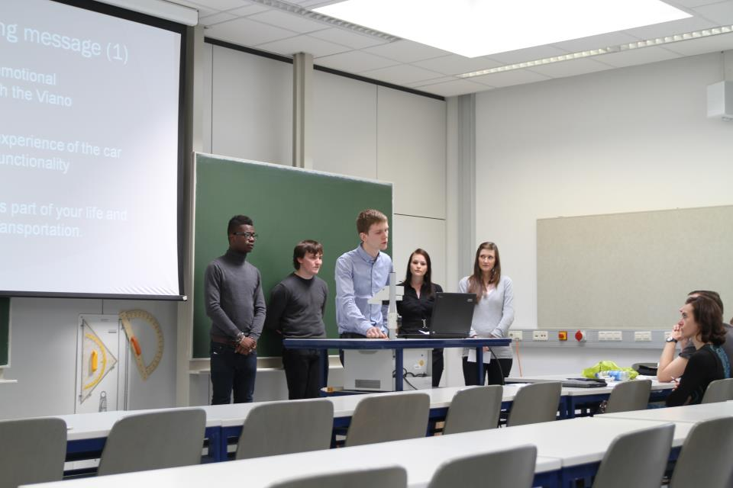
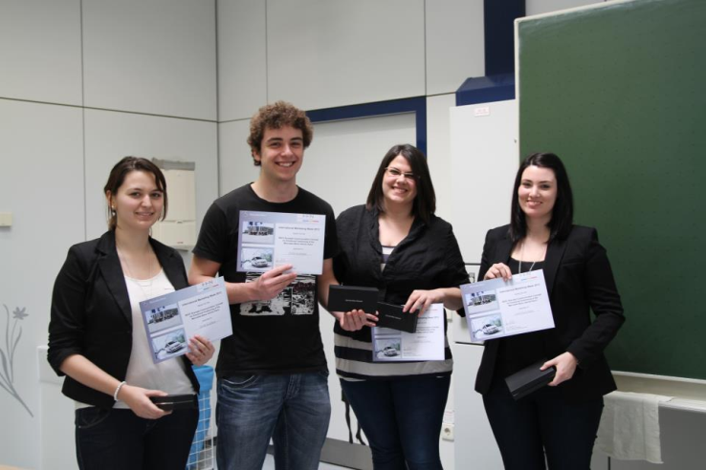
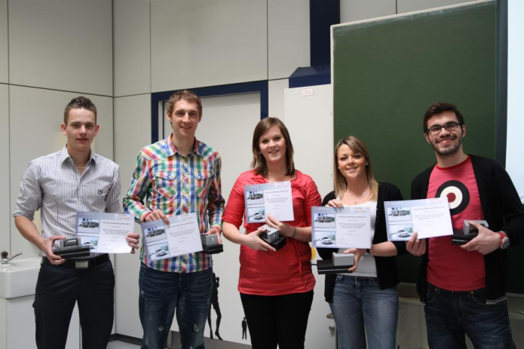
Program – Milestone and Final Presentation
Milestone Presentation
Presentation of the first ideas, discussion and coaching
Final Presentation
The teams will have to present their concept in front of an International Jury

Slide 19
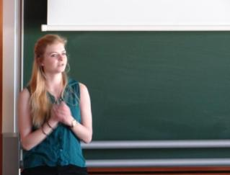
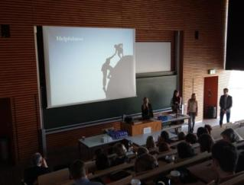
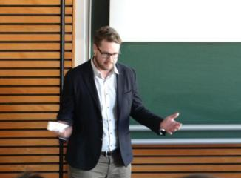
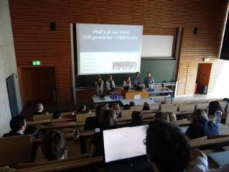
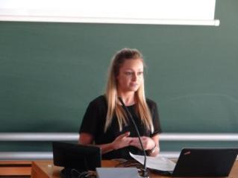
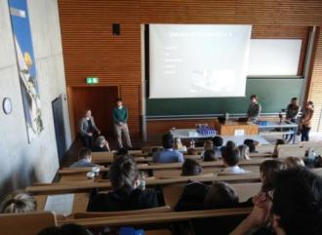
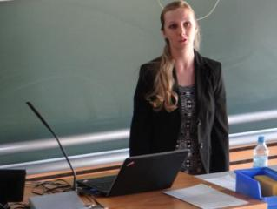



Slide 20



Slide 21



Leisure Program – International Evening
International desserts
and sweeties
Typical Swabian dinner:
„Maultaschen“
Get to know each other

Slide 22





Slide 23


Slide 24


Slide 25


Leisure Program – beyerdynamic soccer cup
human table soccer
tournament
TEAMWORK
FUN
SPORTS EVENT
COMPETITION

Slide 26





Slide 27


Slide 28


Slide 29



Leisure Program – Welcome beer in Schwäbisch Hall
Experience a couple of nice pubs in Schwäbisch Hall.

Slide 30




Weitere Bilder

Slide 31


Leisure Program – Club Night
Meet other international marketing students
…and have fun!

Slide 32

Statements of Former Participants
“…enjoyed the trip to Stuttgart
and the international diner…”
“…I appreciated
almost every
moment …”
“…occasion to exchange
with foreign students…”
“Great organization!”
“…the social time
and work has been
perfectly melted …”
“…it was perfect!”
“…would love to come back
to Künzelsau…”
“…not too much work,
good mood and
good organization …”
“…honour to work for Mercedes-Benz…”

Slide 33

An experience you´ll never forget

Slide 34


So: welcome to the International Marketing Week 2019 in Germany.
Notes:
34

Slide 35

Thank you for your attention!
Contact:
Prof Dr Joachim Link
Business Administration, Marketing and Media Management
Daimlerstr. 35, 74653 Künzelsau, Germany
Telefon: +49(0)7940 13 06 241
Fax: +49(0)7940 13 06 62311
E-Mail: joachim.link@hs-heilbronn.de

