Slide 1
International Marketing Week
17th edition
31 March – 5 April 2019

Slide 2
Our University College

Slide 3

UC Leuven-Limburg
Moving Minds,
always in movement,
open in a complex world,
ready for strong-minded students
who want to move toward the future together.

Slide 4
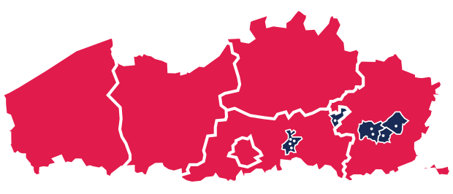
UC Leuven-Limburg
Flanders’ second largest university college
30 higher-education, profession-oriented study programmes
15 000 students
10 campuses in the provinces of Flemish-Brabant and Limburg

Slide 5
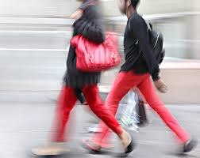
UC Leuven-Limburg
Professional bachelor programmes
in 5 faculties:
  Management
  Technology
  Teacher Education
  Health
  Welfare

Slide 6
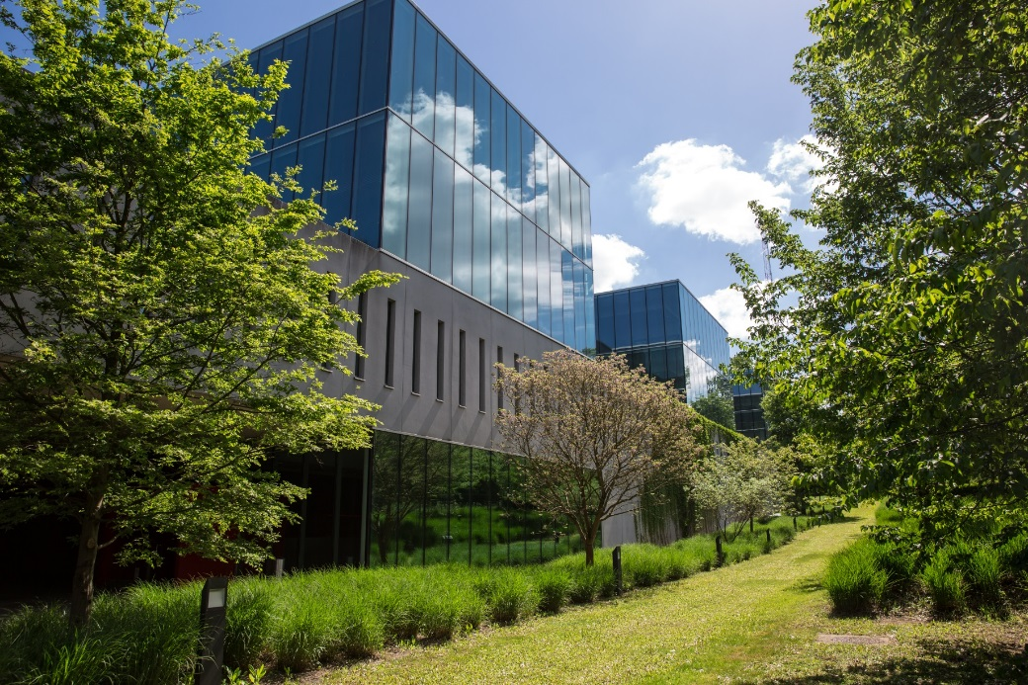
Management
Campus Proximus - Leuven
Bachelor of Business Management
Accountancy and Taxation
Finance and Insurance
Marketing
Law
Small Business Management
Bachelor of Office Management

Slide 7
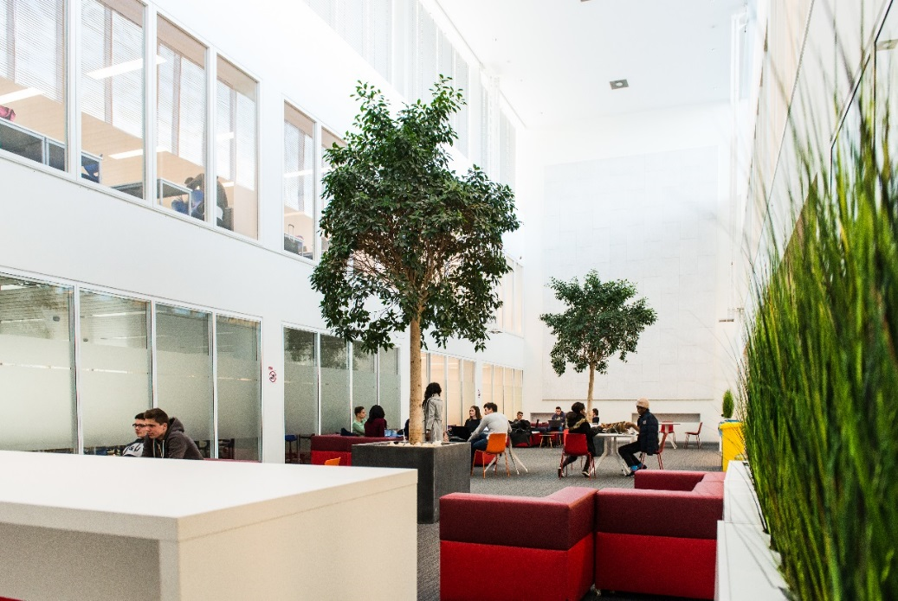
Management
Campus Proximus - Leuven
Post-initial Bachelor: Bachelor of Advanced Business Management
Track International Business Management (in English)
Track Management & Entrepreneurship
Track Culture Management
Track Human Resources Management
Track International Law
Track Digital Marketing & Communication
Track Sport Management
Track Supply Chain Management

Slide 8
Management
Campus Proximus - Leuven
International environment – Programmes in English
Exchange students
Bachelor in Business Management - Marketing across Europe (BME)
Bachelor Business Management Marketing (BBM)
Post-initial Bachelor International Business Management

Slide 9
Management
Campus Proximus - Leuven
Exchange students
Fall semester: wide range of marketing-oriented courses
Spring semester: wide range of courses on marketing, communication, finance and law topics
www.ucll.be/international/exchange-programmes

Slide 10
We are in Leuven, the student city

Slide 11
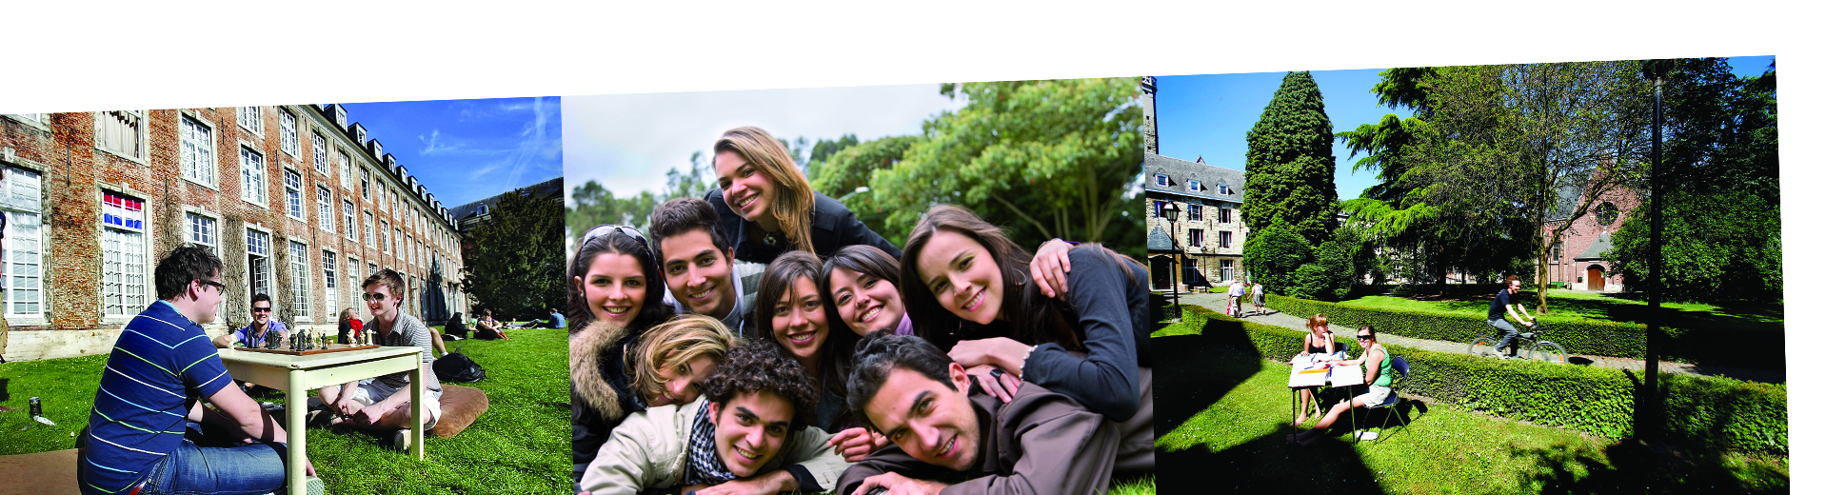
Leuven…
… the student city of Flanders
with a vibrant student life
because of the 50 000 students
together with 100 000 inhabitants

Slide 12
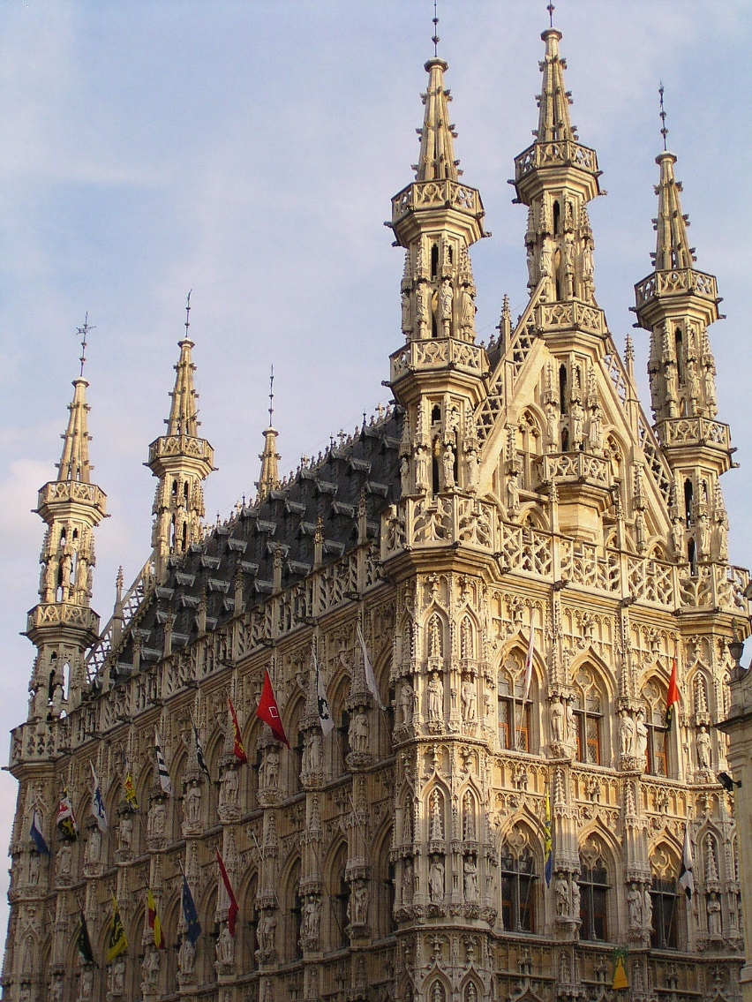
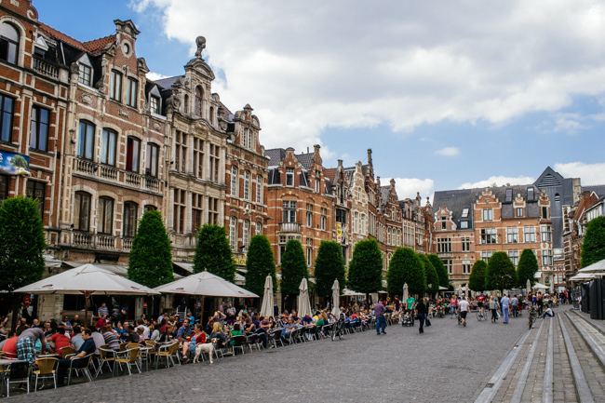
Leuven…
… a historical city center
with its Old Market Square
the longest bar in the world

Slide 13
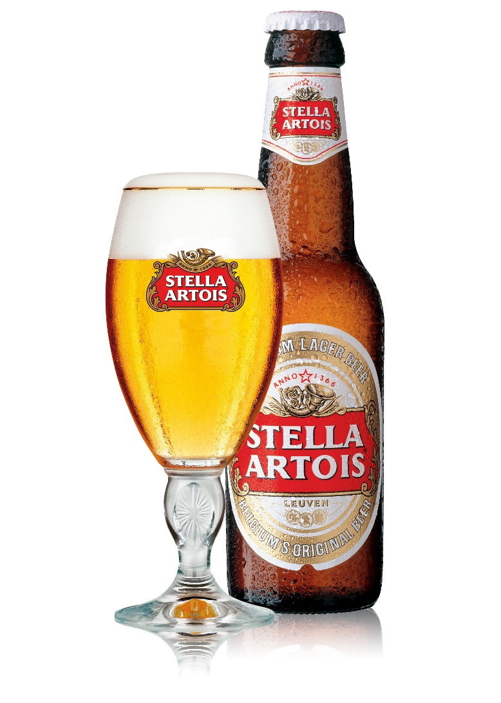

Leuven…
… a entrepreneurial city
hosting the headquarters of ABInBev
where you can taste a Stella
and enjoy your Leffe

Slide 14
Our International Marketing Week

Slide 15
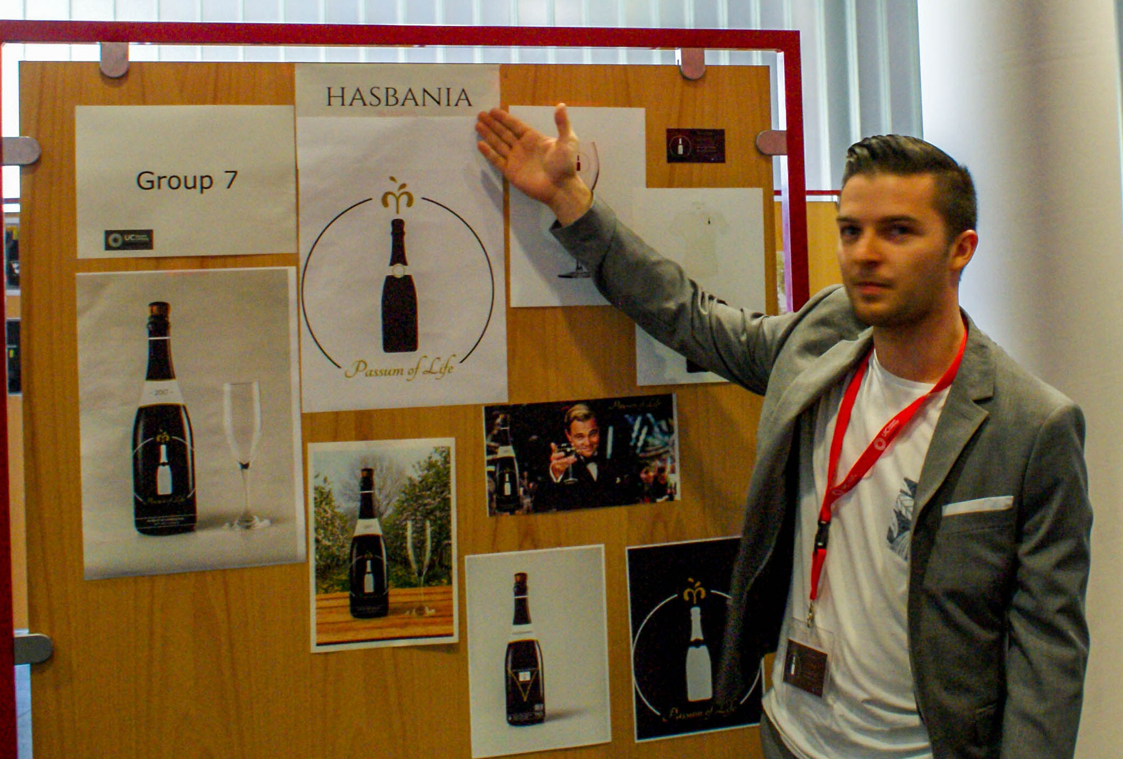
From Logo 2 Branding
A challenge for creative European marketers
Leuven – Belgium
31 March – 5 April 2019

Slide 16
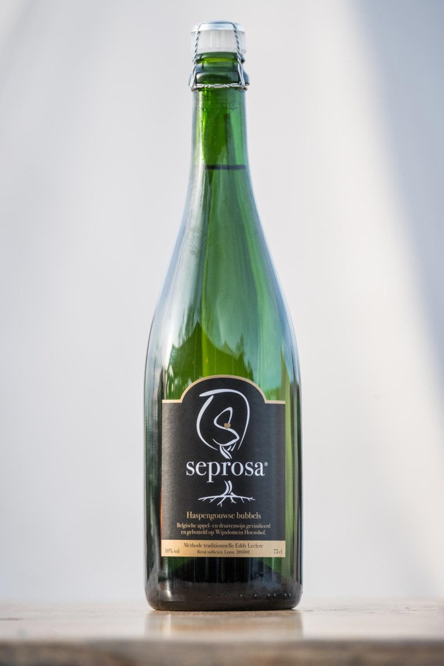
From Logo 2 Branding
A challenge for creative European marketers
The winner of 2017 in the press
Bubbles from Belgian apples
Seprosa® is a new, sparkling wine from Haspengouw. Different to a traditional sparkling wine, it is made of apples and pears.
Seprosa® is made according to the well-known méthode traditionelle , with a second fermentation in the bottle.
…
The name Seprosa® was developed during the International Marketing Week at UCLL in Leuven, participated by 150 students from different countries. It was chosen by an international jury out of 32 proposals.
Seprosa®, or 3 times prosit, is the abreviation of the Arabic ‘seha’, the Dutch ‘proost’ and the French ‘santé’.
Not only the name but also the label, logo and baseline were developed by the students.

Slide 17

From Logo 2 Branding
A challenge for creative European marketers
Modules
Market research
Marketing communication strategy
Consumer behavior
Copywriting
Graphic design
Sales techniques

Slide 18
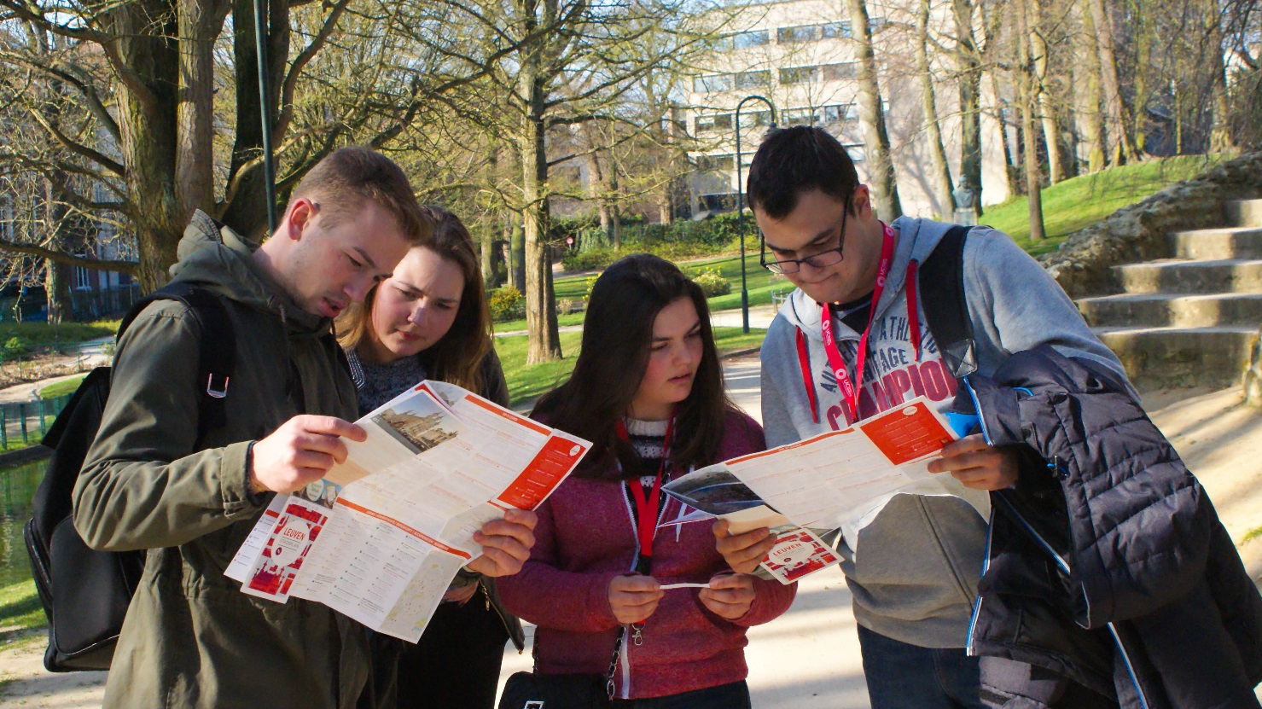
From Logo 2 Branding
A challenge for creative European marketers
If you would like to get a taste of last year's edition, have a look here

Slide 19
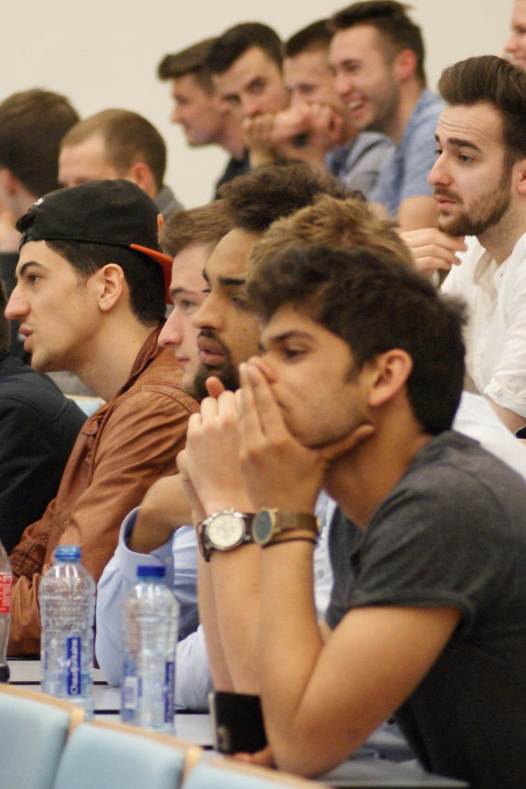
From Logo 2 Branding
A challenge for creative European marketers
The programme, all practical information and the registration procedure can be found on our website.

Slide 20
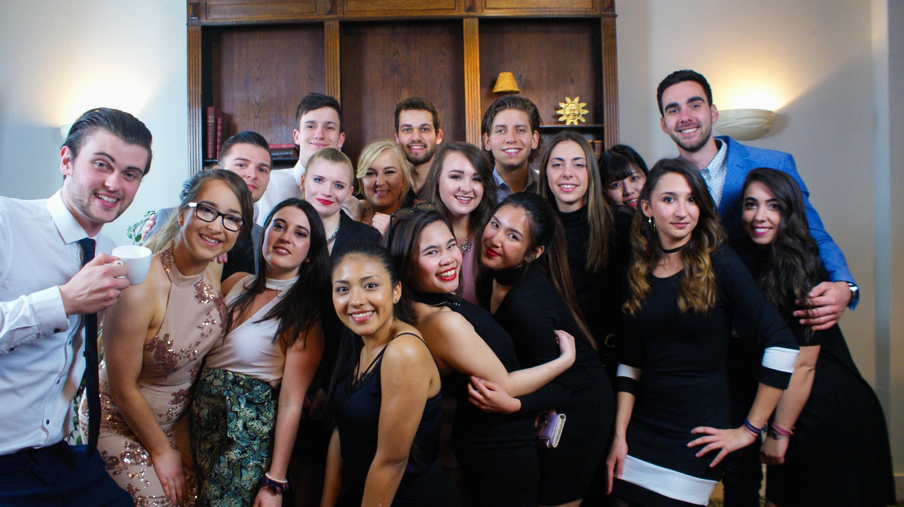
From Logo 2 Branding
A challenge for creative European marketers
mario.dewolf@ucll.be
hilde.evers@ucll.be

Slide 21
