Slide 1

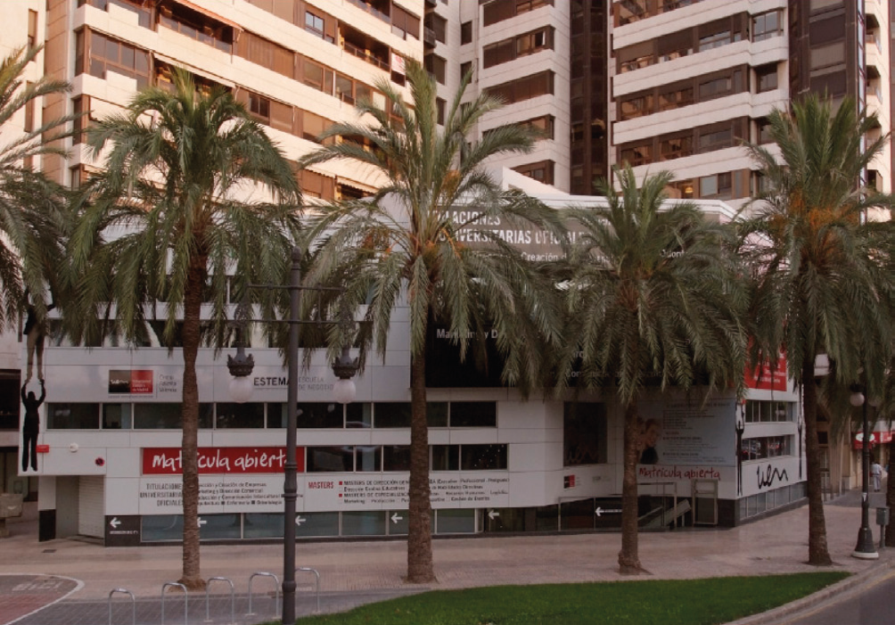
International Marketing Week in Valencia
February 24 – March 1, 2019

Slide 2



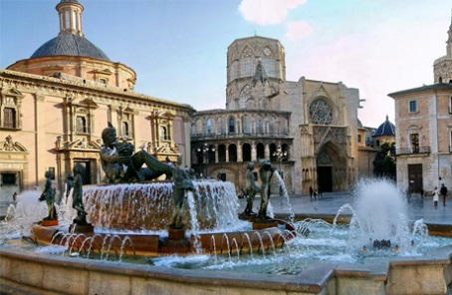


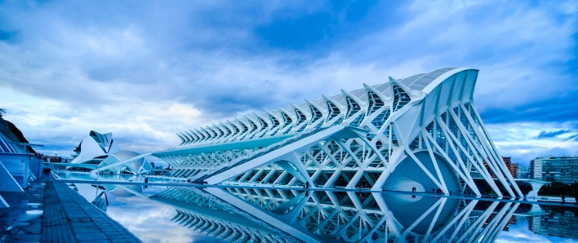
First of all…..
The beautiful city of Valencia

Slide 3

Guess what the topic is for our International Marketing Week?

Slide 4




DEVELOP A STRATEGIC MARKETING PLAN FOR A WINERY

Slide 5


Key program activity
Students may also purchase wine if they wish.
Travel by bus to the wine village of Requena (1 hour distance), in the heart of Valencia´s wine region.
Objective: students will learn and see first-hand how wine and cava are produced, how it is packaged and marketed.
Students will take a tour of one of the most famous wineries in the Valencia area, TORRE ORIA, where they will go down into the wine cellars and see the art of wine-making, visit the packaging and distribution area of the winery and have the opportunity to taste the best wines and cavas.

Slide 6

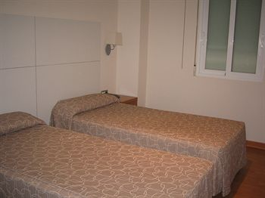
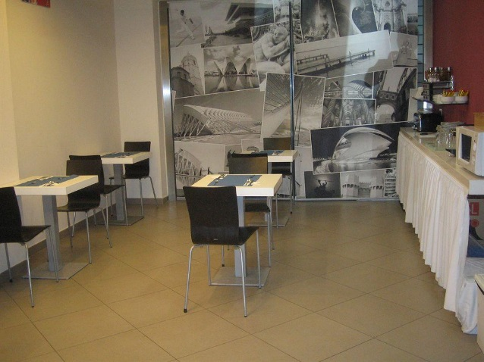
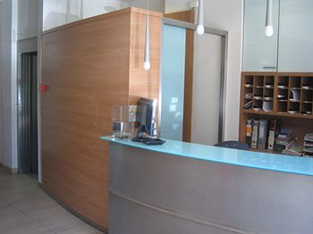
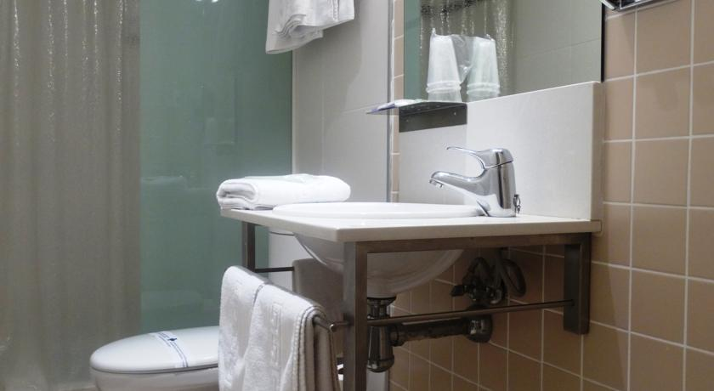
Student Accommodation: HOSTAL PENALTY

Slide 7
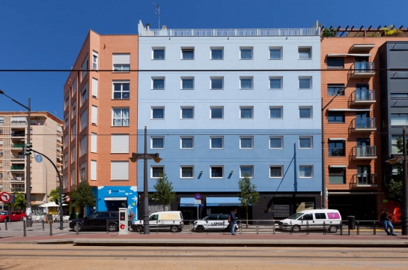
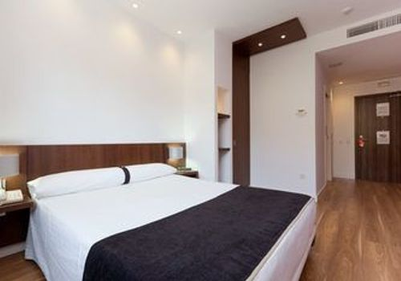
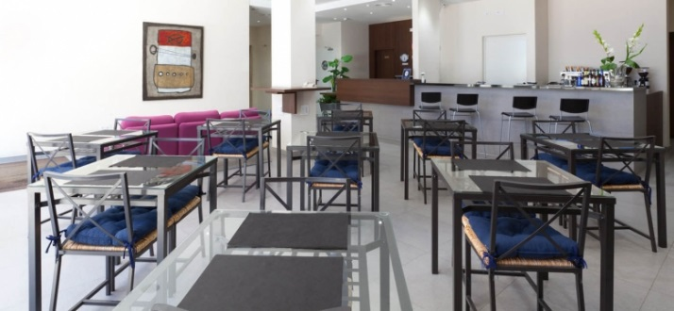
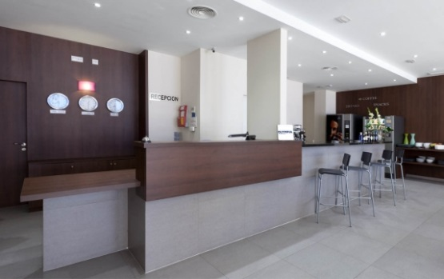
Teacher Accommodation: 2 options
HOTEL OLYMPIA UNIVERSIDADES
10 MINUTES TO THE UNIVERSITY ON FOOT
PRICES WILL BE PROVIDED AT A LATER DATE.

Slide 8
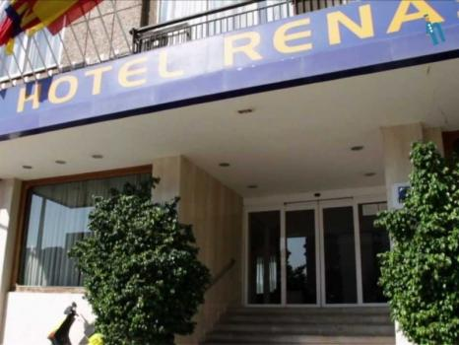
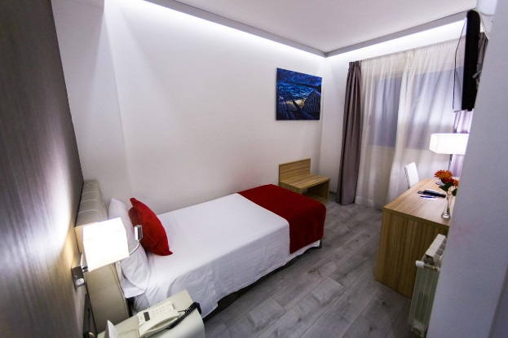
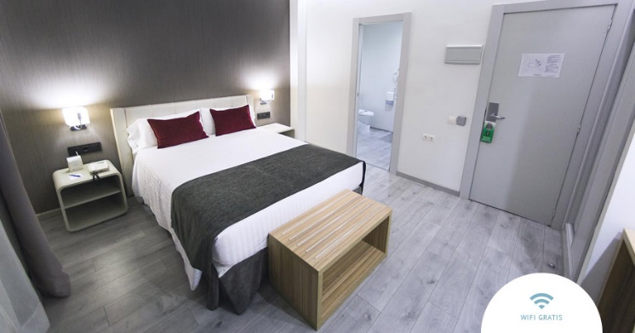
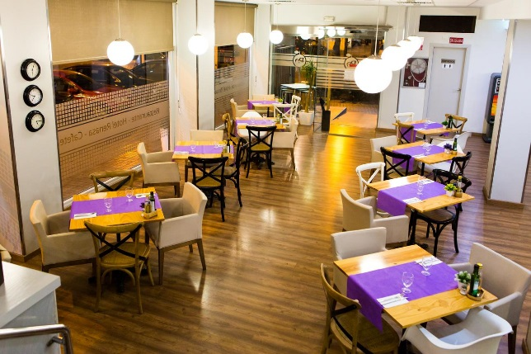
Teacher Accommodation
HOTEL RENASA
A 15 MINUTE WALK TO THE UNIVERSITY
PRICES WILL BE GIVEN LATER ON

Slide 9
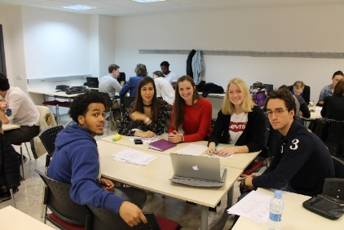
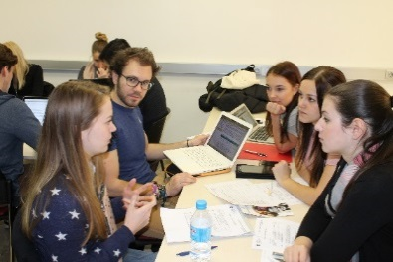
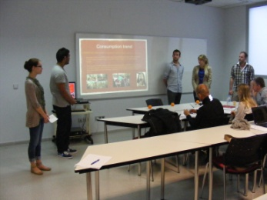
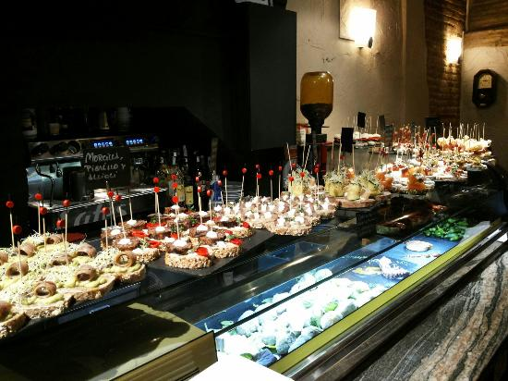

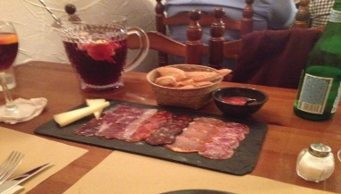
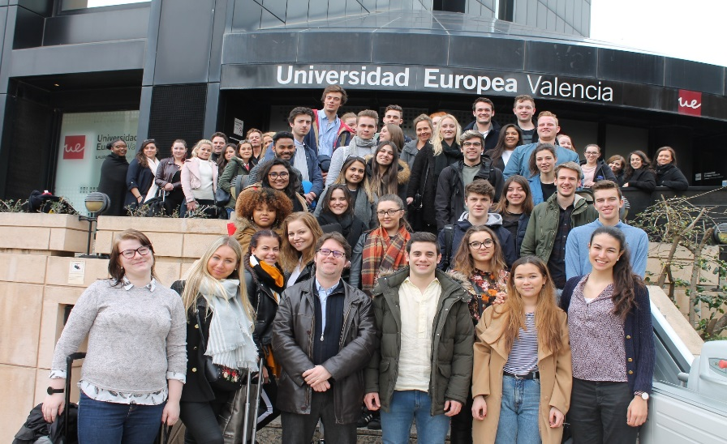
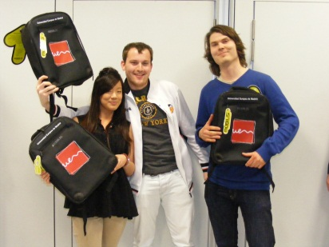
Previous International Marketing Weeks in Valencia

Slide 10
Itinerary
Pre-arrival material will be sent in advance
General assembly on the first day – students present their universities
Day trip to wine country
Daily project work in teams
Tapas dinner in the old quarter
Walking tour of old Valencia
Party night with Spanish students
Final presentations on Friday morning

Slide 11
Price and program particulars
230€
Includes:
Double or triple room in a Hostal Penalty just 10 minutes on foot from the university
Continental breakfast from Sunday to Friday
4 lunches (bocadillo, soft drink)
Field trip to wine country
Tapas dinner
Walking tour of old Valencia

Slide 12


VEGANS AND VEGETARIANS MORE THAN WELCOME!!

Slide 13
Applications
All applications are to be sent before January 15, 2019 to:
Stan.mcdaniel@universidadeuropea.es

Slide 14
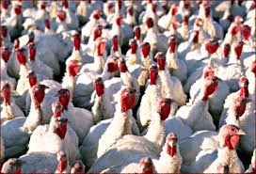
We are terribly sorry, but we have space problems. We can only accept 3 students per university. If you have a dire emergency and need to send more, just ask me☺.

Slide 15


