Slide 1
International Marketing Week 2019
Viara BreAkwell & Rozenn Ghorbanian

Slide 2
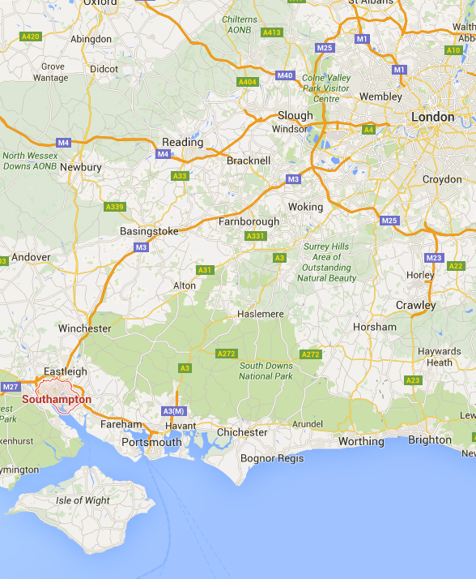
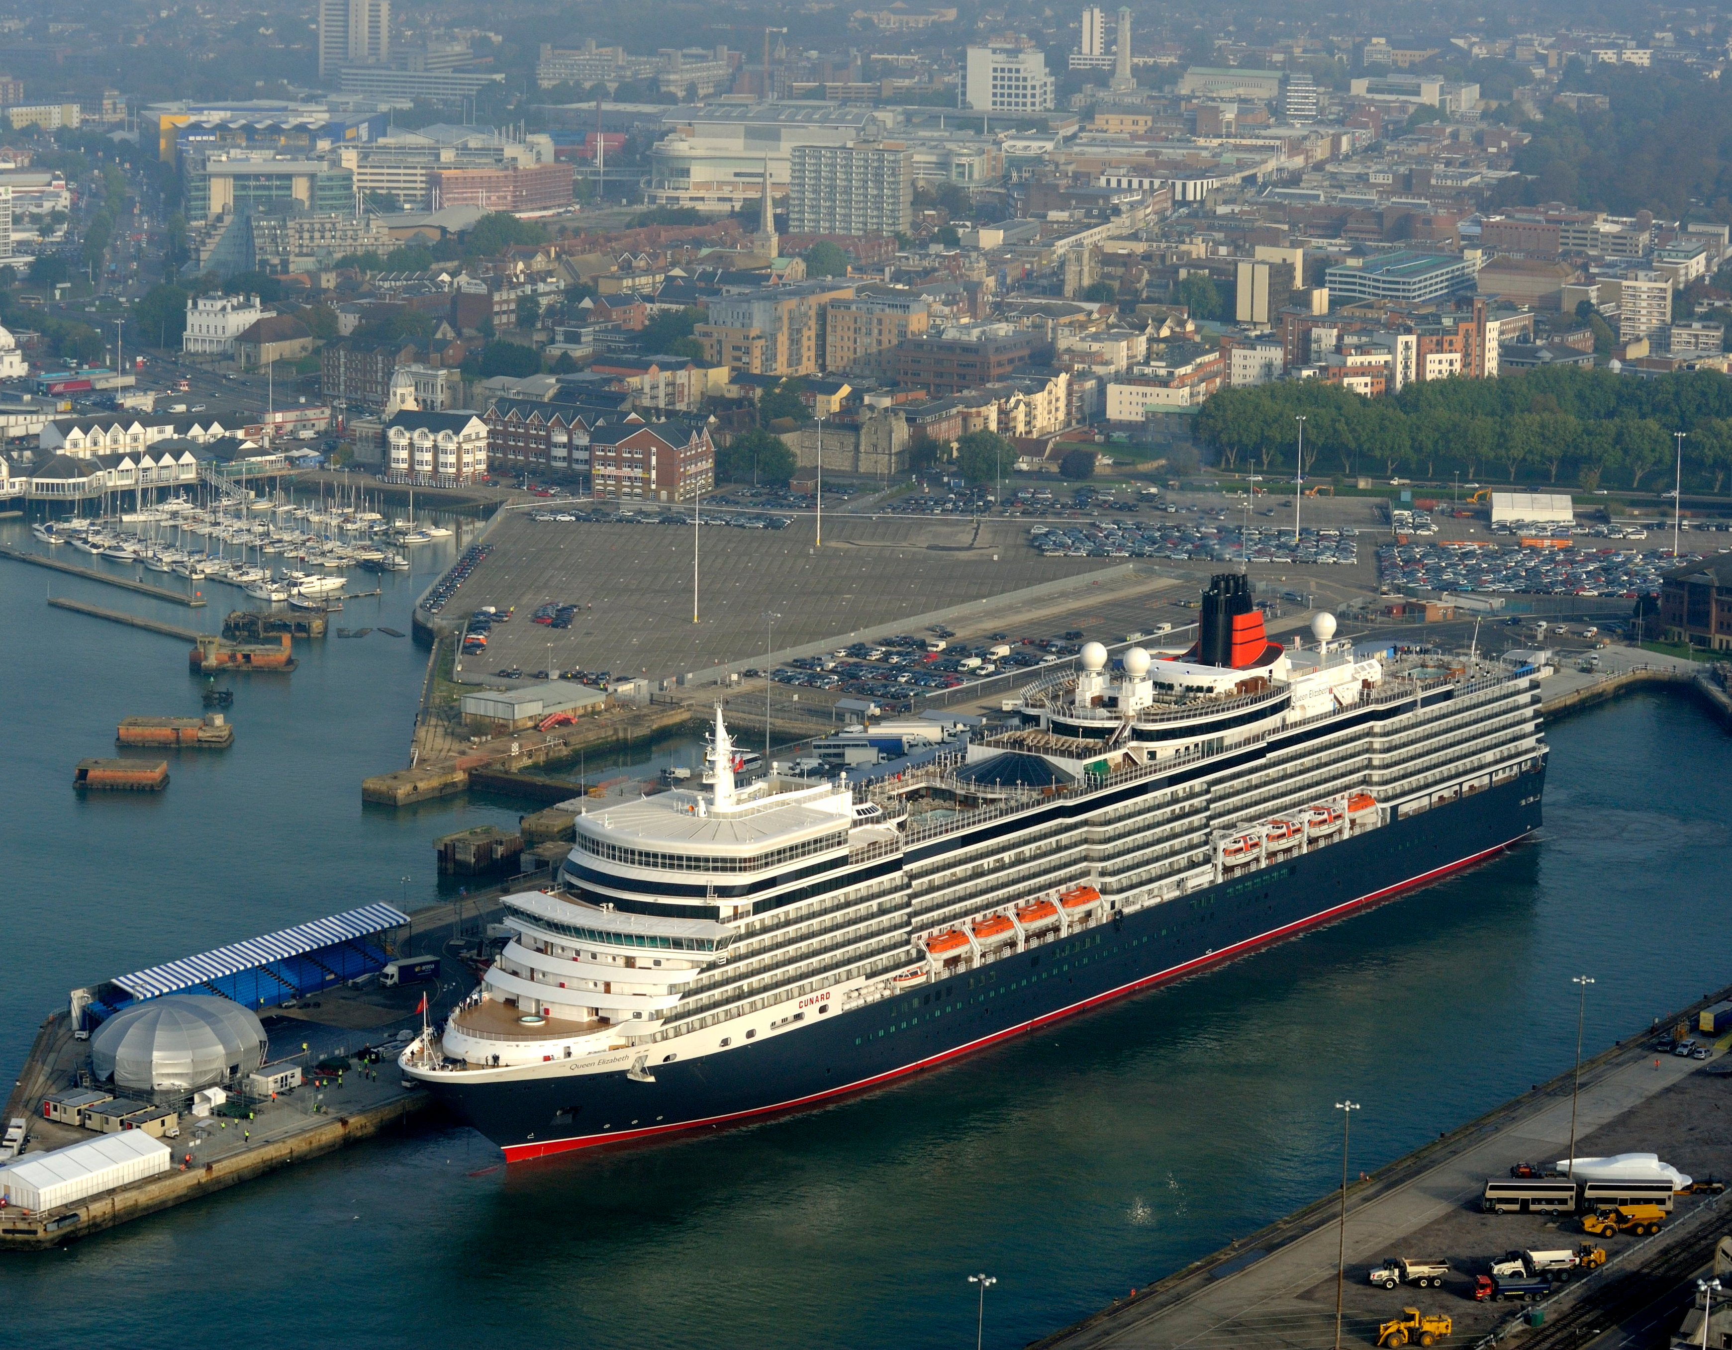
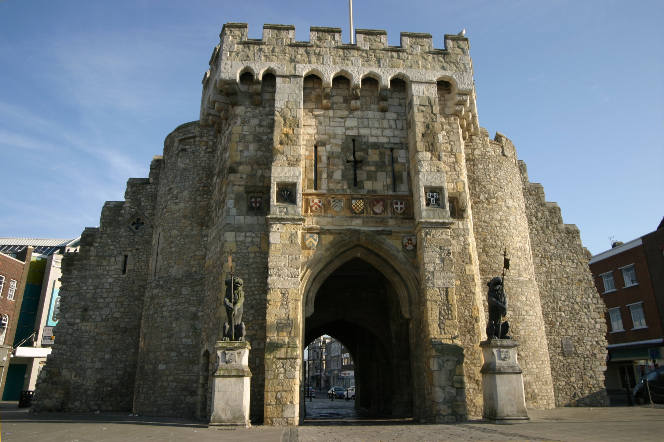
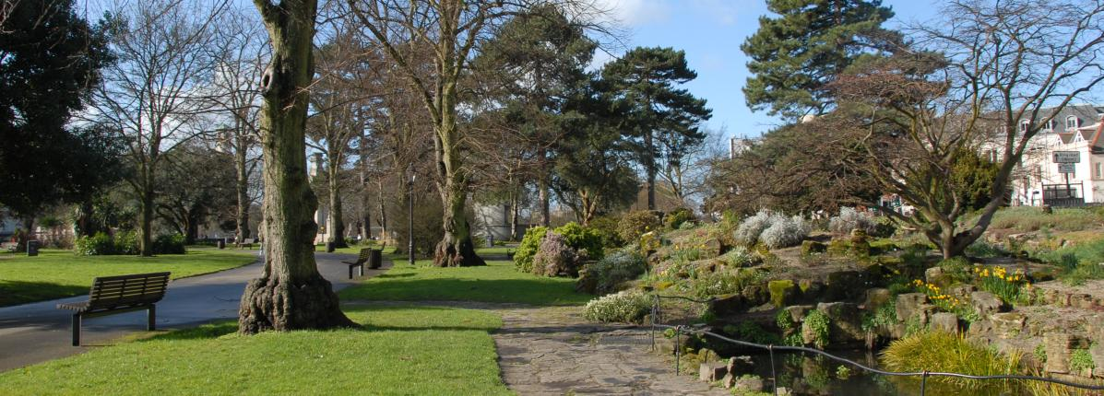
Location
Notes:
The cultural and commercial capital of the South of England
Located on the South Coast
Just over an hour from London
Short distance from Bournemouth, Portsmouth and Winchester
Easy to travel to Europe and beyond, either by ferry or from its airport
The largest city in the South-East outside of London
Population of over 230,000 people
Student population of over 40,000
20% of the population are aged 16-24

Slide 3
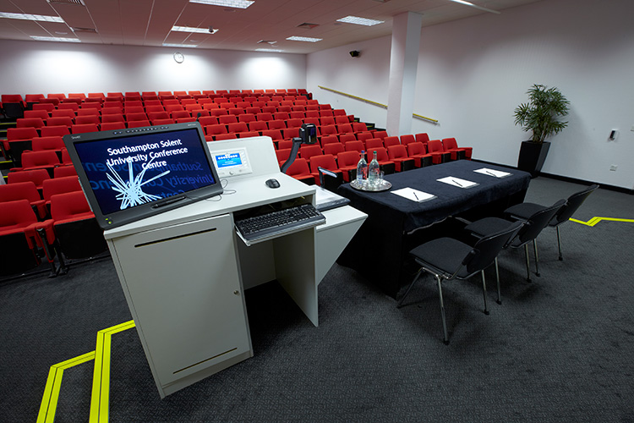
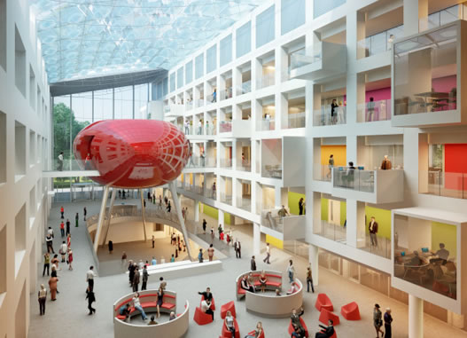
About us
Solent University is all about creating opportunities: for its students, for its staff, for its partners.
We are focused on the practical side of higher education.
Notes:
Southampton Solent University is all about creating opportunities: for its students, for its staff, for its partners. It offers expertise and experiences you couldn’t get anywhere else, opening doors and making introductions.
We’re focused on the practical side of higher understanding – giving our students the connections, experience and confidence to turn newfound knowledge into a career with real, meaningful impact. Whoever you are, whatever your goals, we want to help you make your mark.

Slide 4
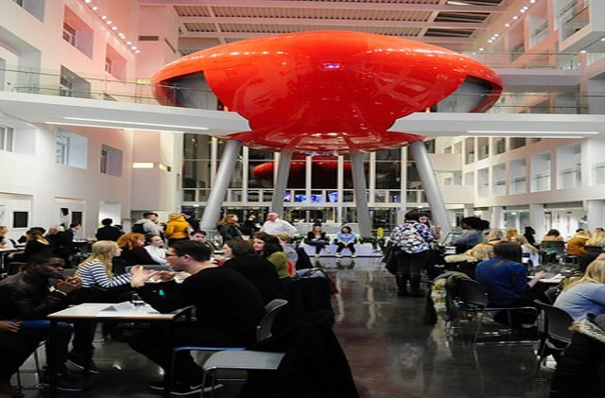
Academic Schools
Art, Design and Fashion
Business, Law and Communications
Maritime Science and Engineering
Media Arts and Technology
Sport, Health and Social Sciences

Slide 5
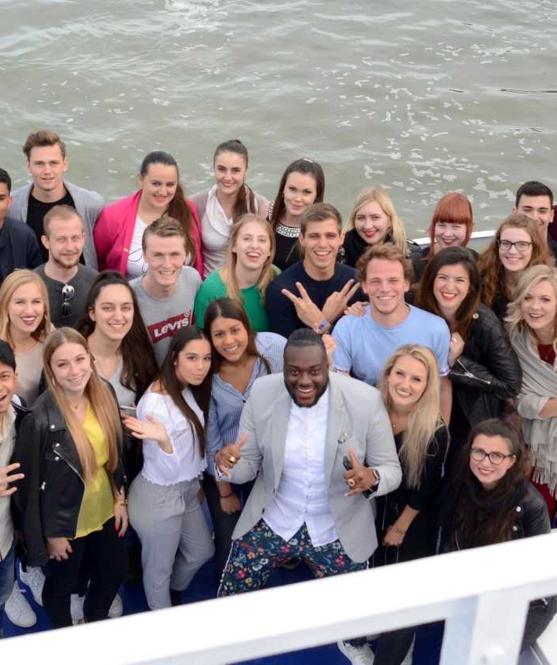
Solent IMW
Dates:
Monday 29th April – Friday 5th May 2019 (arrival Sunday)
Cost:
£300.00 Includes: Bed & Breakfast, lunch and up to 2 dinners.
Accommodation:
Shared room in hotel for students
Single staff room in separate hotel in city centre

Slide 6
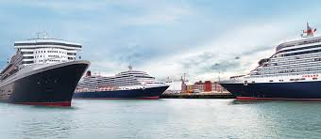

The brief – The challenge
Cunard Grill Suites
The most profitable inventory on board
Represent 13% of the fleet’s inventory
Earn 27% of ticket value
Guest may not be aware of all the benefits of booking a Cunard Grills Suite
Current massaging across international markets in inconsistent and could be clearer
Cunard have a need to grow demand for the Grills product internationally by attracting the right guest booking at full fares and not discounted rates
  Phillipa Duckworth
  Advertising and Promotions Manager

Slide 7
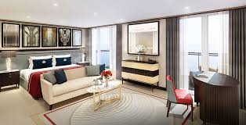
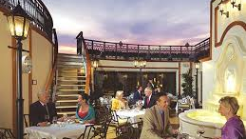
The brief – The output
  Deliver a marketing plan outlining a multi-channel campaign promoting the Cunard Grills Suites to a European market with inspirational but clear message
  Client orientated presentation pitching the proposal, plan, potential areas requiring investment, creative direction and forecasted results
  3. Detailed plan supporting an overnight launch event on board a Cunard ship in an iconic port
  4. You have a marketing budget of £250,000

Slide 8






Schedule
Sun
  Arrival
  Free day
Mon
  Briefing by client (HQ)
  Managing international teams session
  Guest lecture – tourism industry
  International dinner
Tues
  Ideation and working on creative projects session
  Working in teams on the brief
  Free evening to explore Southampton
Wed
  Working in teams on the brief
  Afternoon feedback on work so far
Thu
  Prepare final presentations
  Student party boat trip & dinner
Fri
  Feedback from client on presentations
  Afternoon depart after 2pm

Slide 9
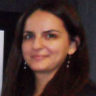
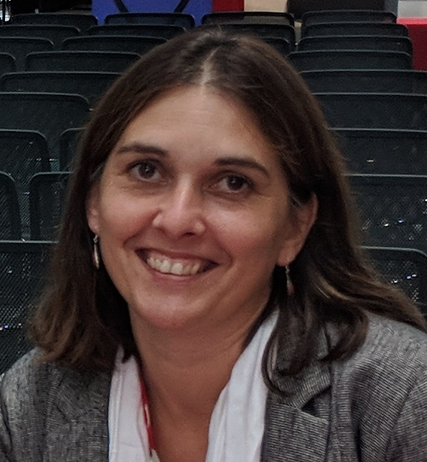

Contact us
Viara Breakwell
Course Leader Marketing
viara.breakwell@solent.ac.uk
Rozenn Ghorbanian
International Language Officer
Rozenn.ghorbanian@solent.ac.uk

Slide 10
Thank you
Any questions?

Slide 11























