Slide 1
International Marketing Week, Denmark
Theme: Micro breweries – the suvival of a niche
April 8th-12th 2019

Slide 2
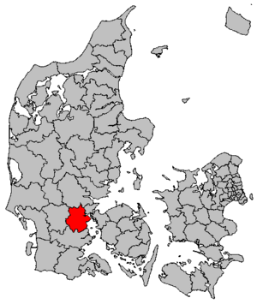
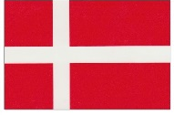
Denmark, Kolding
Denmark
More than 5 million inhabitants
Capital City – Copenhagen
Form of state – monarchy (the oldest uninterrupted European monarchy)
Kolding
7th largest city of Denmark (population 58,000)
Regional center of creativity, innovation and design
Student and tourist hub
Only 45 kilometres from the airport in Billund.

Slide 3
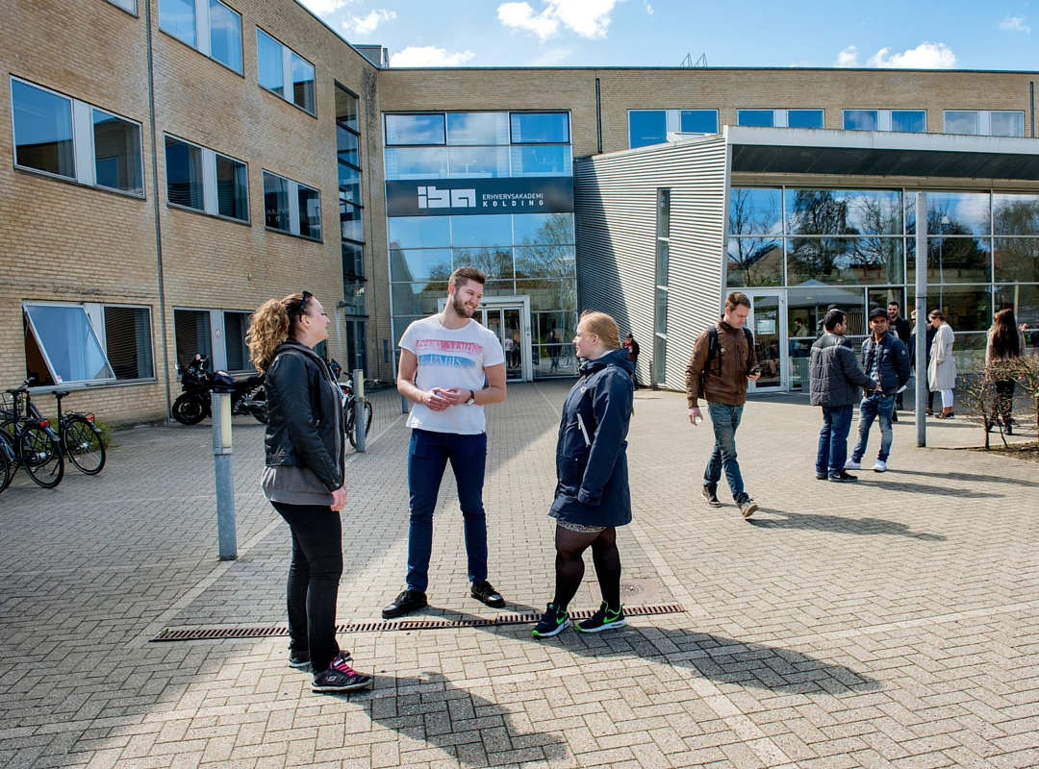
International Business Academy (IBA)
IBA's degrees cover a wide range of levels: Applied Professional, Bachelor, Master's and MBA
Students from 20 countries
1500 full time students

Slide 4
Theme outline; Survival of a industry niche
Danish micro breweries have had golden years. Over a decade the number of breweries grew rapidly from under 20 to over 120.
It has become a very competitive market and many micro breweries struggle.
How can Frejdahl micro brewery position themselves and are there international opportunities?

Slide 5
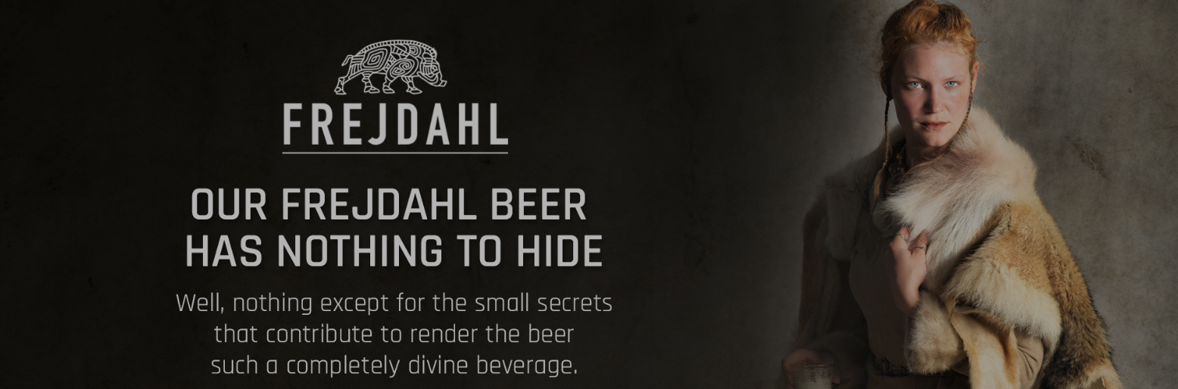
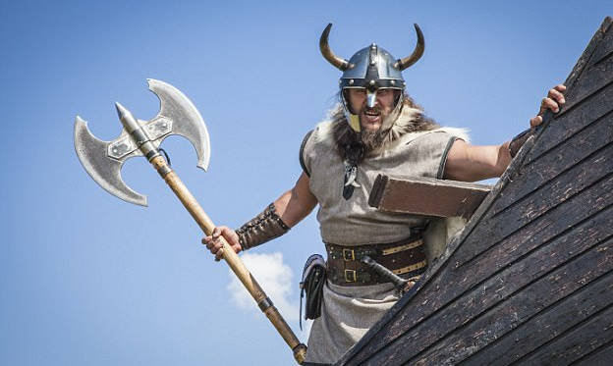
Partner; Frejdahl
Frejdahl beer is rooted in the Nordic heritage, and Vestfyen Brewery (Parrent company) has created a brand that unites taste, design and Nordic history.
Many of the raw materials and ingredients draw inspiration from the Vikings, and the names of the beer series is from Nordic Mythology – such as Valravn, Nidhug and Gudmund.

Slide 6
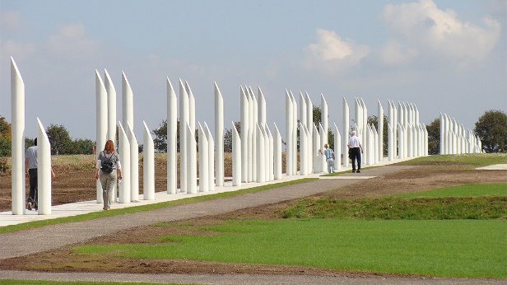
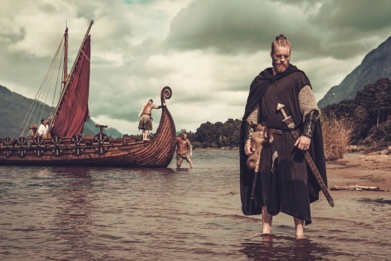
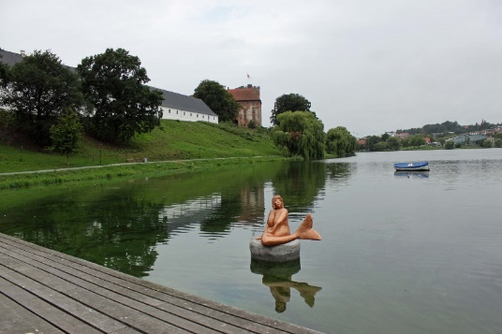
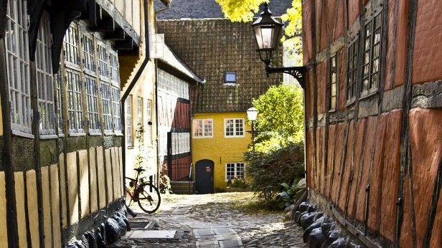
Exsperience Kolding local
brewery and learn about the
process and industry
Tuesday is our field experience day. We will visit a local brewery and learn about the brewery process and the industry.
First we will visit where it all startet at the great Viking Monument build by the first Viking King Harald Bluetooth in Jelling. The monument he build for his parents was the biggest off its time, and also contains the baptism of all Denmark.
We will also show you the 750 year old city of Kolding. Kolding is surrounded by beautiful nature and water. Even though it’s not a big city, you can still get the big city feeling. We’ll show you some cultural experiences, the rich café and bar life, student life and give you an impression of the city which lies in the mittle of it all, only 2 hours away from Hamburg or 2 hours away from Copenhagen.

Slide 7
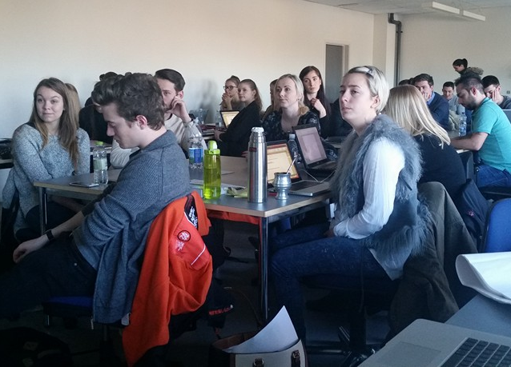
Subjects involved
Market research
Consumer behavior
Marketing Strategies
Economy

Slide 8
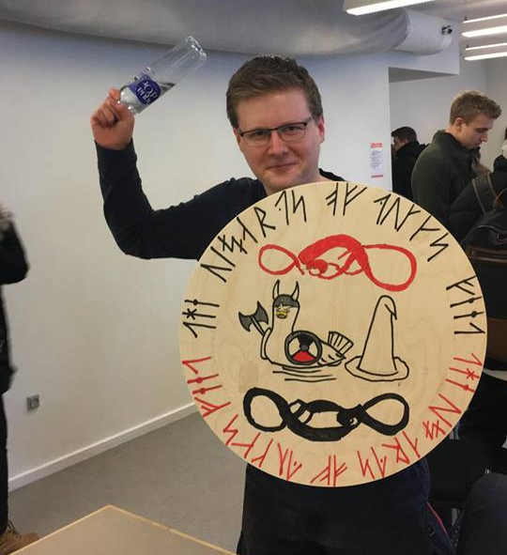
What to expect
Work on a real case together with the involved company.
Work in international teams with students from different countries
Participate in different social arrangements during the week
Team building activity

Slide 9
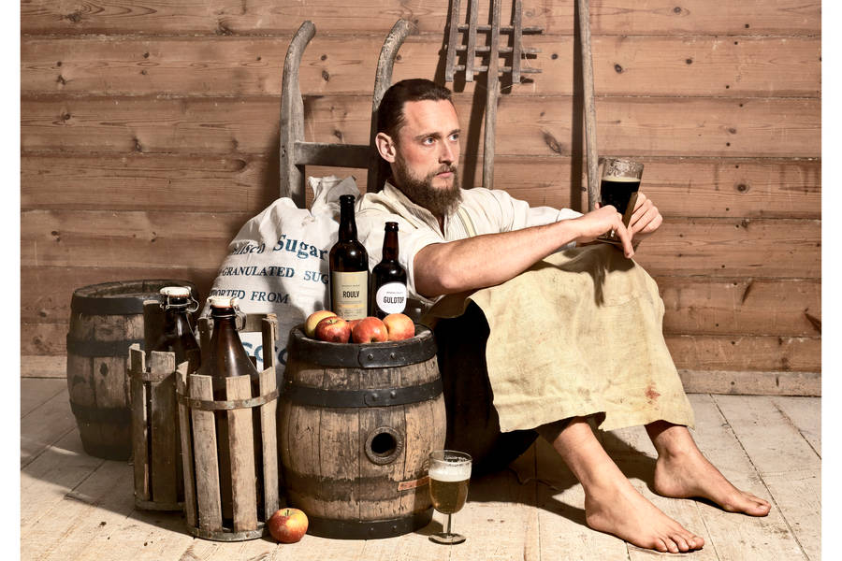
Assignment
Pre-assignment
Documentation of beer culture in your country
Assignments during IMW
Development an international marketing strategy for Frejdahl.
Develop a creative communication platform

Slide 10
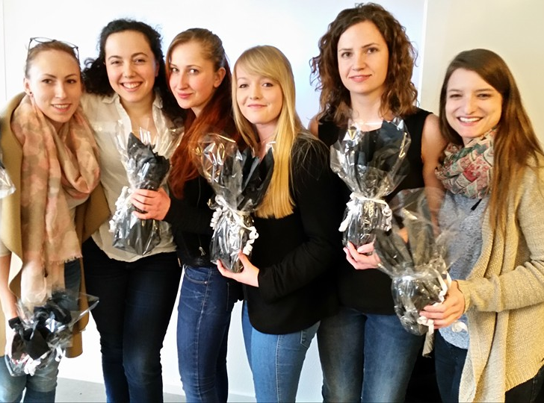
Awards
Awards are given in two categories
The overall winner (coherence between marketing plan and video)
The most innovative & creative communicative platform
Every student receives a certificate for participating in the project and a mark is given.
The IMW 2016 winners

Slide 11
The price includes
225
Euros
Social activities
Accommodation from Sunday to Friday
Breakfast and lunch every day + Two dinners
Time for party! IMW in Denmark is also about meeting new friends.

Slide 12
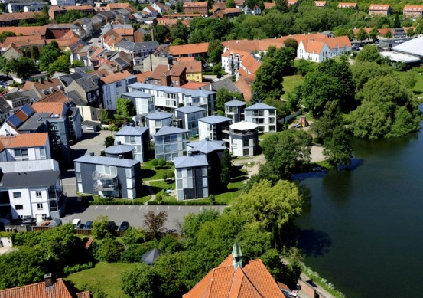
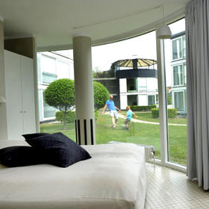
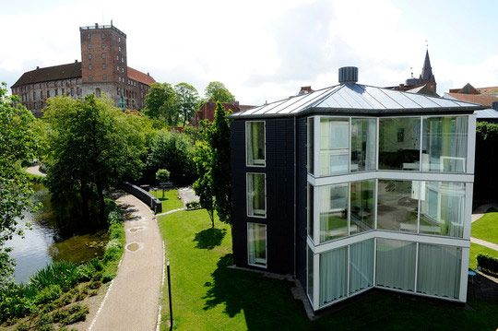
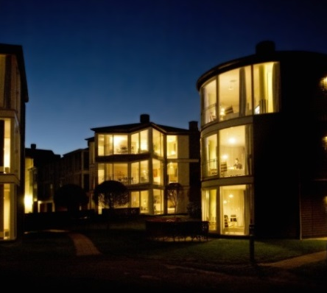
Accommodation
Kolding Hotel Apartments
In hotel apartments in the city centre
5-6 people per apartment
3 bedrooms per apartment and one bathroom
10 minutes walk from the school
Beautiful location by the lake

Slide 13
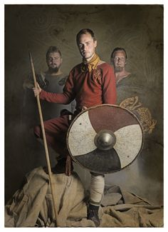
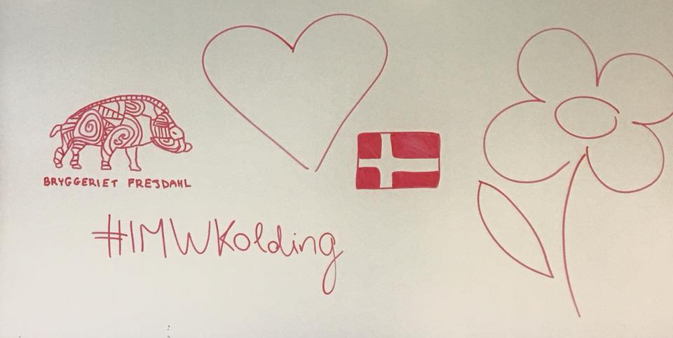
When, where, how..?
IMW in Kolding, Denmark. April 8th – 12th 2019
Price 225 euro
Up to 5 students from each university
Deadline for enrollment; January 15th 2019
Registration form enclosed
Join us in 2019
Do you accept the challenge?

Slide 14
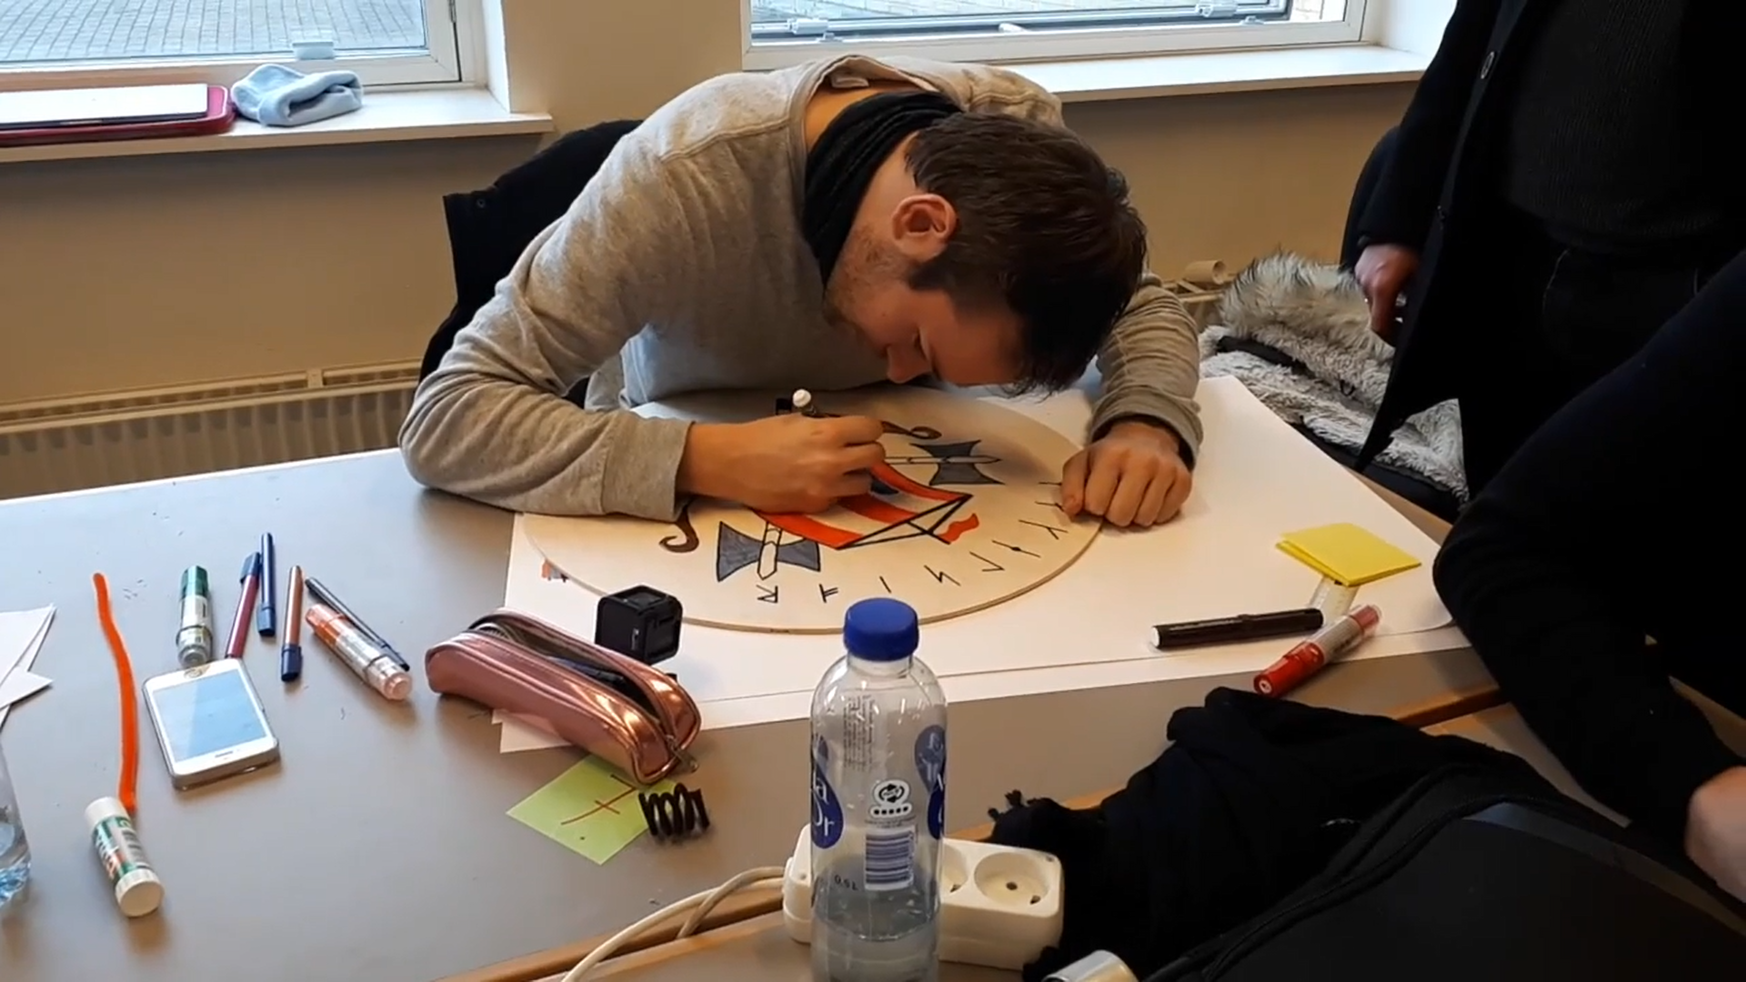
Video made by a participating student
(4:03 min)

