Slide 1






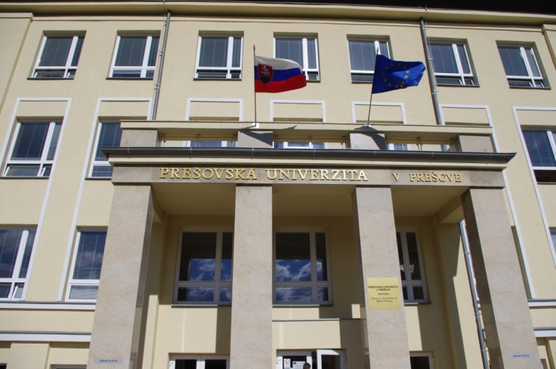
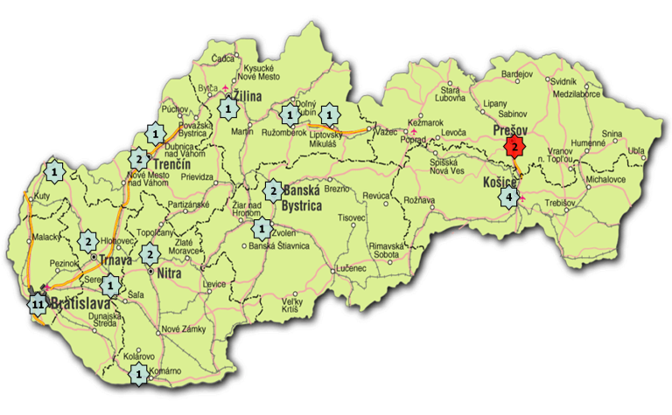




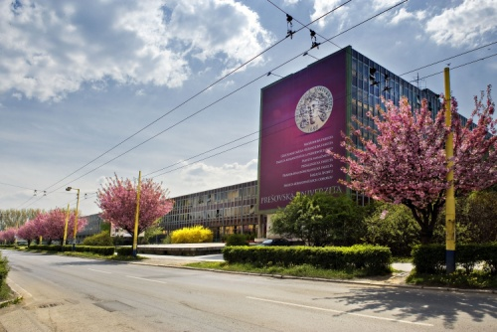

UNIVERSITY OF PRESOV
SLOVAKIA
Information for Erasmus+ students
Academic year 2019/2020
Name of the university: University of Presov
Erasmus code: SK PRESOV 01
Website: www.unipo.sk
Erasmus+ coordinator for outgoing staff:
PhDr. Ľudmila Adamová
Email: ludmila.adamova@unipo.sk
Tel: +421 51 7563 126
Erasmus+ coordinator for outgoing students:
Mgr. Veronika Tóthová
Email veronika.tothova@unipo.sk
Tel: +421 51 7563 143
Erasmus+ coordinator for outgoing students for traineeship:
Mgr. Zdenka Medoňová
Email zdenka.medonova@unipo.sk
Tel: +421 51 7563 179
Erasmus+ coordinator for incoming students and staff:
Mgr. Jana Grušková
Email: jana.gruskova@unipo.sk
Tel: +421 51 7563 147
International Relations Office:
Address: Ul. 17. novembra 15
080 01 Prešov
Slovakia
Erasmus+ Institutional Coordinator:
Doc. Ing. Ladislav Suhányi , PhD. MBA
Email: ladislav.suhanyi@unipo.sk
Tel: +421 51 7563 121
Information for Erasmus students: http://www.unipo.sk/en/en/internationa-relationships/erasmus

Slide 2

Academic calendar and application deadlines
(more information at http://www.unipo.sk/en/en/internationa-relationships/infoapplicants/calendar)
SEMESTER | Lessons begin | Lessons end | Examination period | Application deadline
Winter semester | September 16, 2019 | December 13, 2019 | December 16, 2019- February 7, 2020 | June 15, 2019
Summer semester | February 10, 2020 | May 07, 2020 | May 11, 2020- June 30, 2020 | November 15, 2019
Application procedure
Before sending the official application form, your home university has to send an email nomination.
The students selected must submit the following documents:
Application form
Learning agreement for studies
Transcript of records
English proficiency evidence
These documents are uploaded at our website: http://www.unipo.sk/en/en/internationa-relationships/infoapplicants/exchange/orgprocedures
5. Copy of passport (or ID card)
All the documents should be sent by the deadline to the following address:
Mgr. Jana Grušková
International Relations Office - Rectorate
University of Presov
Ul. 17.novembra 15
080 01 Prešov, Slovakia
Tel.: +421 51 7563 147
e-mail: jana.gruskova@unipo.sk

Slide 3

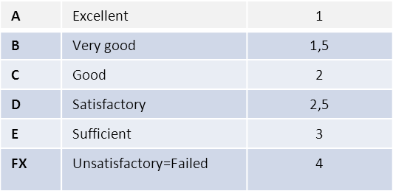
Study programmes
Selection of subjects has to be discussed with faculty/departmental coordinators. List of coordinators and information about courses and study programmes offered to foreign students are here:
http://www.unipo.sk/en/en/internationa-relationships/infoapplicants/exchange/offeredprogrammes
Courses offered to all Erasmus students
1. Slovak Language Courses
There are two courses organized by the University of Presov; they are run both in winter and summer semester as a standard study subject:
-BASIC SLOVAK (only for non-Slavic students); code: 3KLV/BASLOV1ER/11, 3 ECTS
-SLOVAK FOR FOREIGNERS (only for Slavic students-Czech, Polish,...); code: 1ISMK/SLOCU/15, 3 ECTS
2. Physical Education
All Erasmus students can add to their Learning agreements Physical education lessons (2 P.E. subjects in each semester):
- see: http://www.unipo.sk/en/en/internationa-relationships/infoapplicants/exchange/offeredprogrammes
English language requirements
Students have to meet the English language requirements for all foreign applicants stated in Erasmus+ agreements (except for those who will study in the Slovak language).
All applicants planning to study in English must present an evidence of proficiency in English at at least B1+ level of CEFR.
Following exams are acceptable: TOEFL, IESOL, IELTS, FCE, CAE.
If applicants do not have any of these, University of Presov provides them with the Language Proficiency Report form, which must be filled in by a professional English language teacher or by a coordinator in the International Relations Office)
Grading scale
ECTS credits:
1 full academic year= 60 credits
1 semester= 30 credits
1 trimester= 20 credits

Slide 4
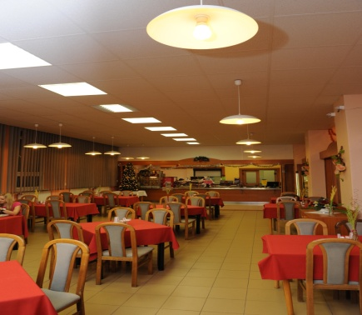
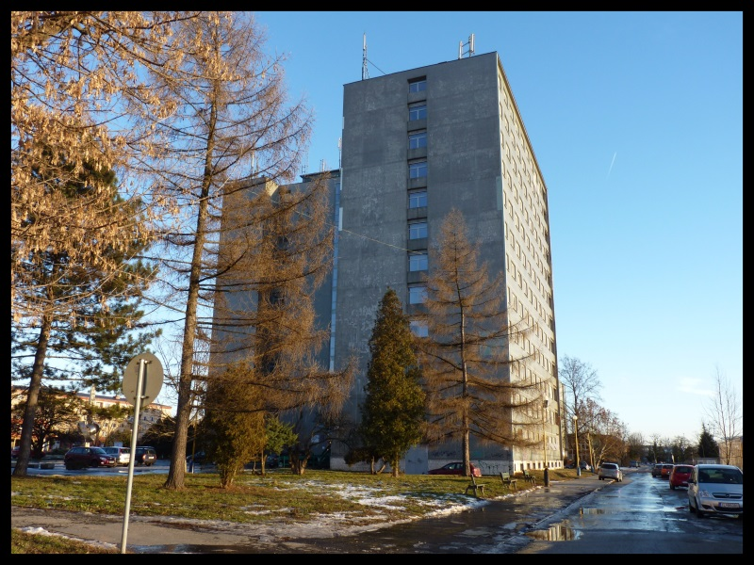
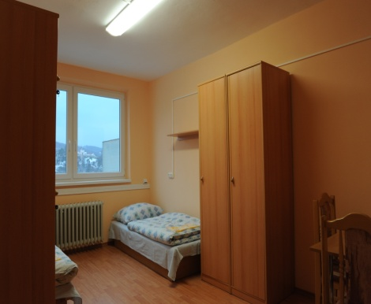
Accommodation
University of Presov offers accommodation for international students in Halls of residence, which is situated directly in the university campus. If you are interested in this accommodation, please, mark it in your Erasmus application form.
Lodging capacity for international students: 56 places
Price: 120 € / person per month
IMPORTANT: Students studying in the winter semester have to leave the Halls of Residence until February 13th.
Rooms are always rented for an entire month from the date of arrival onwards.
The monthly amount to be paid is 120 EURO.
The first payment has to be made within 3 days upon the student’s arrival. The first payment includes the monthly installment plus a deposit of 60 EURO.
50 EURO is refundable at the end of the student’s stay.
If a student wants to move out he/she must give at least one month’s notice in advance in a written form.
Whenever any payment is not made within the established deadline, the due amount will be increased with a penalty.
2 photographs 3x3,5 are needed.
Rooms are mostly double having complete bathroom facilities.
Equipment available: washing machine, TV room, oven, microwave, kettle.
The kitchen is fully equipped and can be used for light meals only.
Bed clothes are regularly changed.
Address: Študentský domov
Ul. 17. novembra 11
080 01 Prešov
Canteen
Halls of Residence
More information can be found at: http://www.unipo.sk/en/links/en-students-dormitory
Room

Slide 5

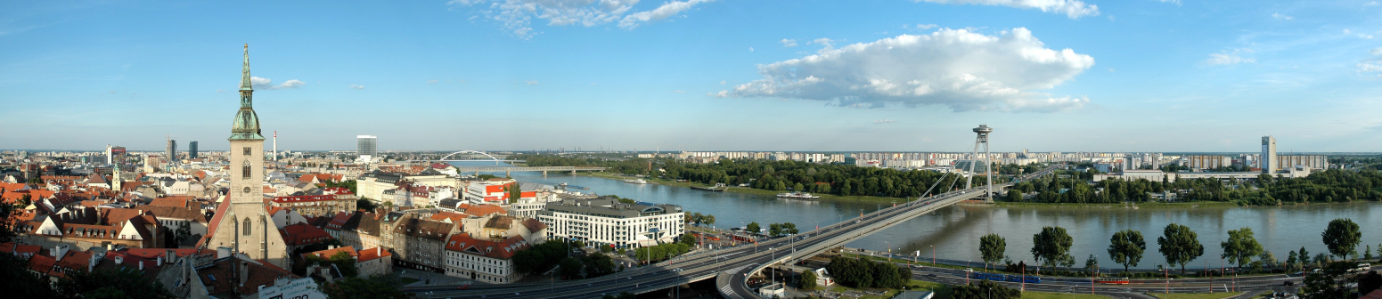

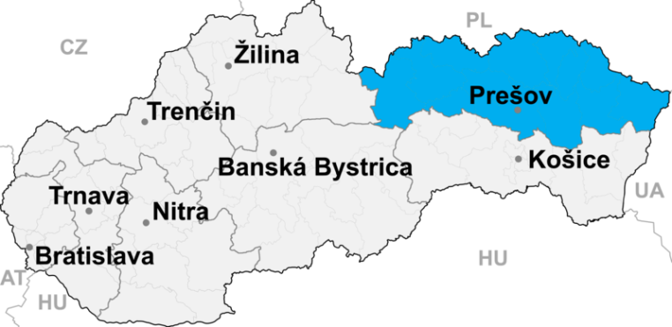

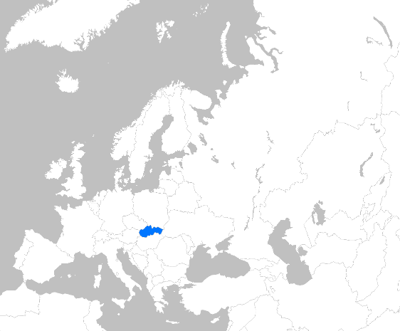
SLOVAKIA in brief
Official Name: Slovak Republic
Population: 5 410 728 inhabitants
Area: 49 035 km²
Currency: euro € (since January, 1st 2009)
Climate: continental medial climate
Government: parliamentary democracy
Member of European Union : since May1st 2004
Capital City : Bratislava
Location : Central Europe (Slovakia boarders on Hungary, Poland, Czech Republic, Austria and Ukraine)
Major Cities: Bratislava (415 589), Košice (240 000), Prešov (91 489), Banská Bystrica (80 466), Žilina (84 675), Nitra (82 661), Trnava (65 950)

Slide 6


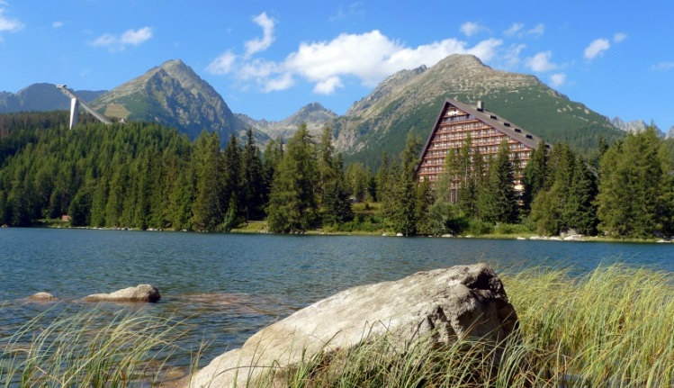
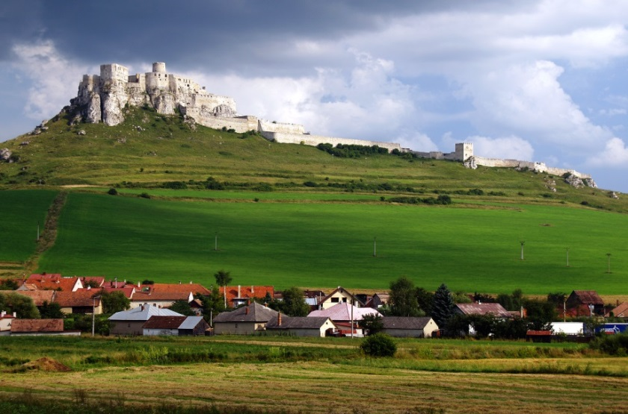
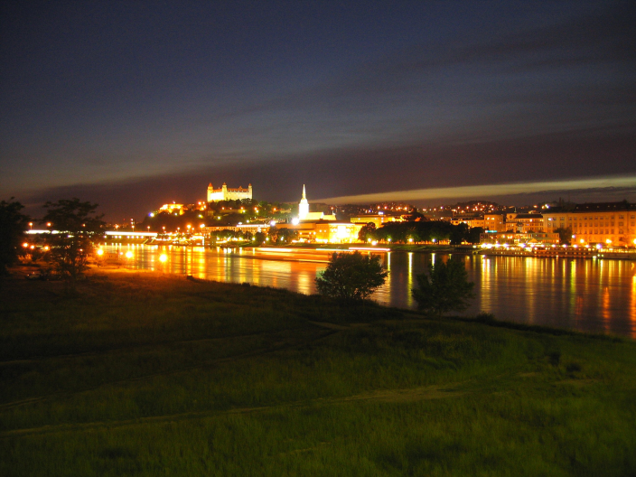
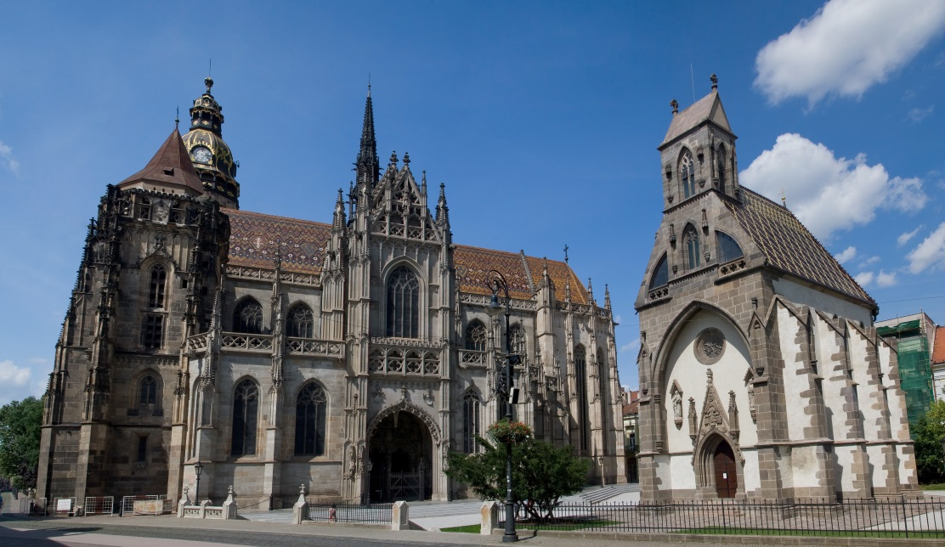
Beauty of SLOVAKIA

Slide 7
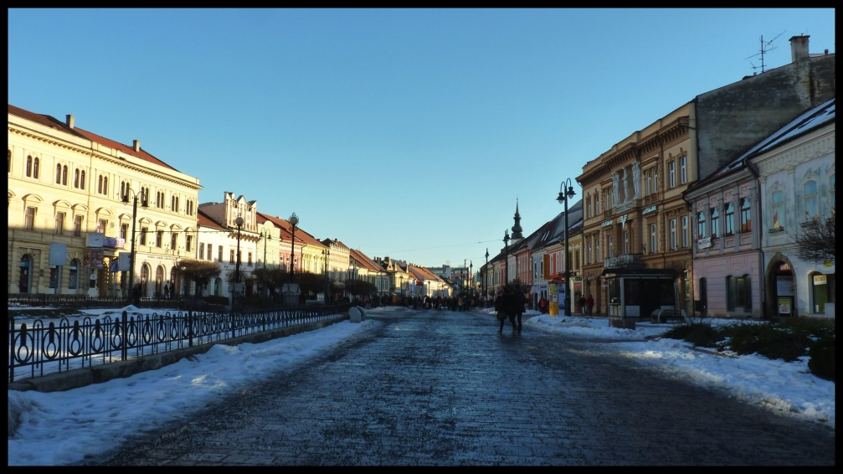

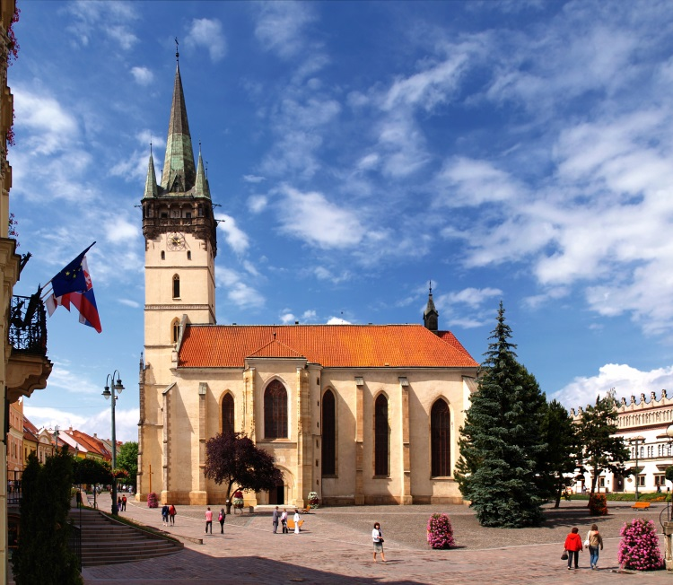
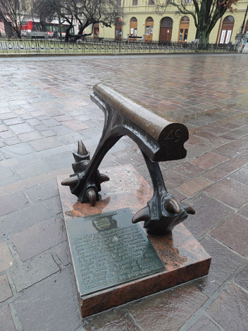
THE CITY OF PREŠOV
Prešov is a town located in the eastern Slovakia. It is the administration centre of the Prešov Region. With a population of approximately 90,000, it is the third-largest city in the country.
More information available at: http://www.unipo.sk/en/en/internationa-relations/stayinginpresov/presov
See also the International Students Guide
https://www.unipo.sk/public/media/3945/guide%20for%20students.pdf
The 49° degree latitude crosses Prešov and is marked by a monument in the city centre.

Slide 8
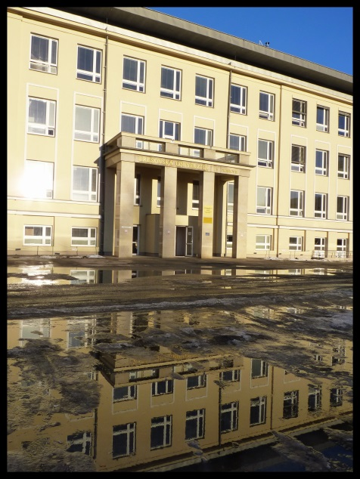
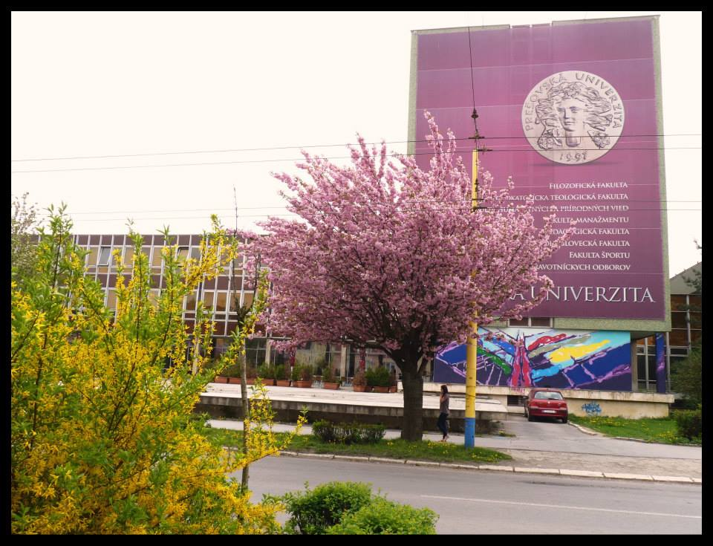

UNIVERSITY OF PRESOV
Prešov has a long-established tradition of education and academic excellence. The University of Presov is a member of national and international professional associations, organizations and working groups.
The University consists of eight faculties:
Faculty of Arts
Faculty of Humanities and Natural Sciences
Faculty of Management
Orthodox Theological Faculty
Faculty of Education
Greek-Catholic Theological Faculty
Faculty of Sports
Faculty of Health Care
The University of Presov ranks among the most reputable and distinguished universities in the Slovak Republic.
In 2013 the University of Presov was awarded a Diploma Supplement Label.

Slide 9
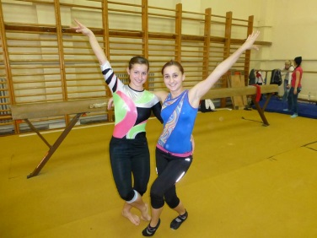
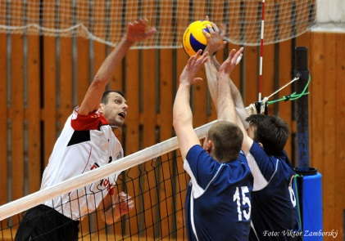

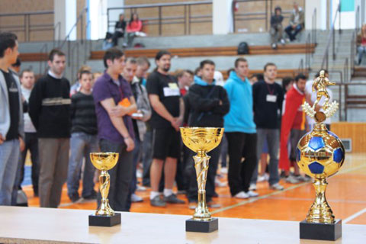
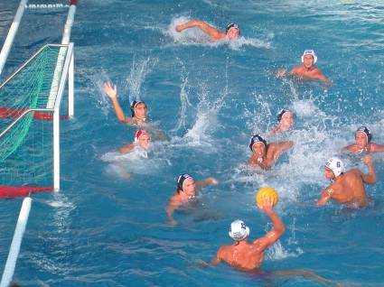
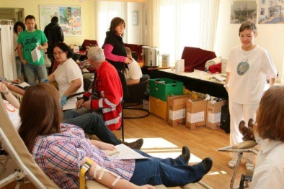

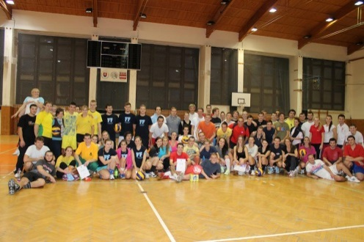
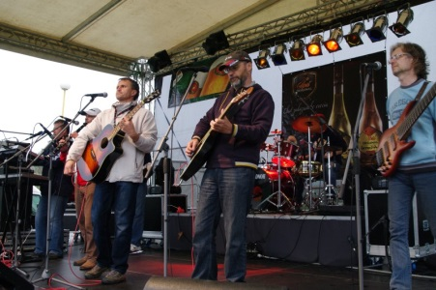
ACTIVITIES AT THE UNIVERSITY
Culturally-social and sport events
UNIPO DAY (culturally-sport day)
UNIPO FEST (music festival for student)
University of Presov ball
University open day
Student blood donation (Student drop of blood)
Artistic activities (choirs,dancing groups, student theatres etc.)
Extra curricular activities (university magazine NA PULZE, university radio PaF, student television – TV Medialka)
Sport activities (university volleyball club, university basketball club etc.)
More info at: www.unipo.sk
or https://sk-sk.facebook.com/Presovskauniverzita/

Slide 10
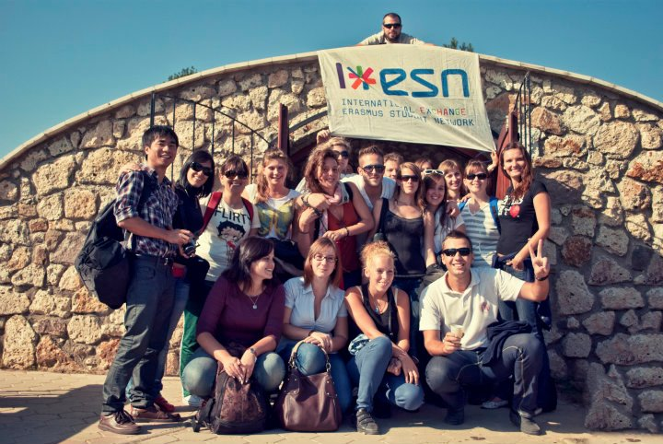

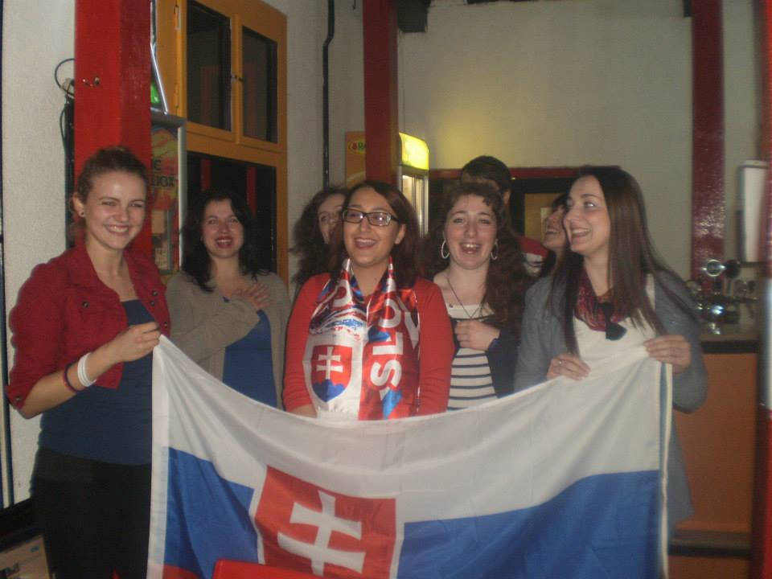
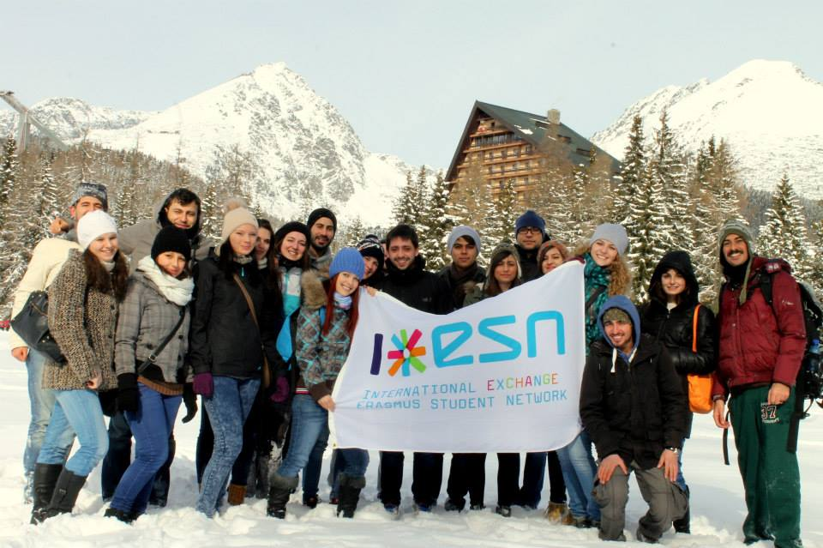
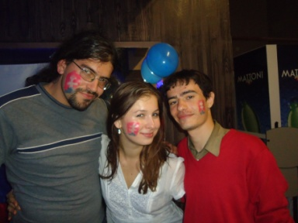
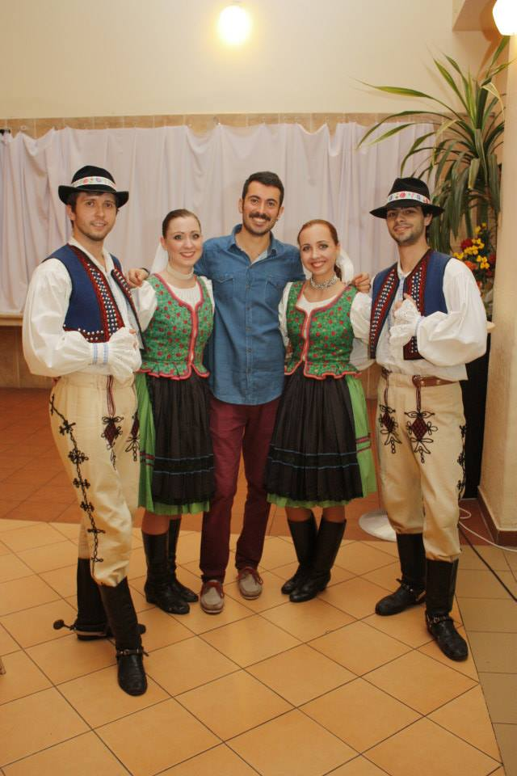

ACTIVITIES FOR FOREIGN STUDENTS
ESN UNIPO Prešov
Before your arrival to Prešov, you will be contacted by your Slovak buddy who will help you with anything you need.
During the first semester week, International Relations Office organizes Welcome meeting. ESN also prepare many events within their Welcome weeks. Throughout the whole semester you will enjoy trips, culture and sport events, Slovak and International evenings, parties and much more ☺
More info at: http://unipo.sk/en/en/internationa-relationships/erasmus/stud/services/esn or www.facebook.com/esnpresov

