Slide 1
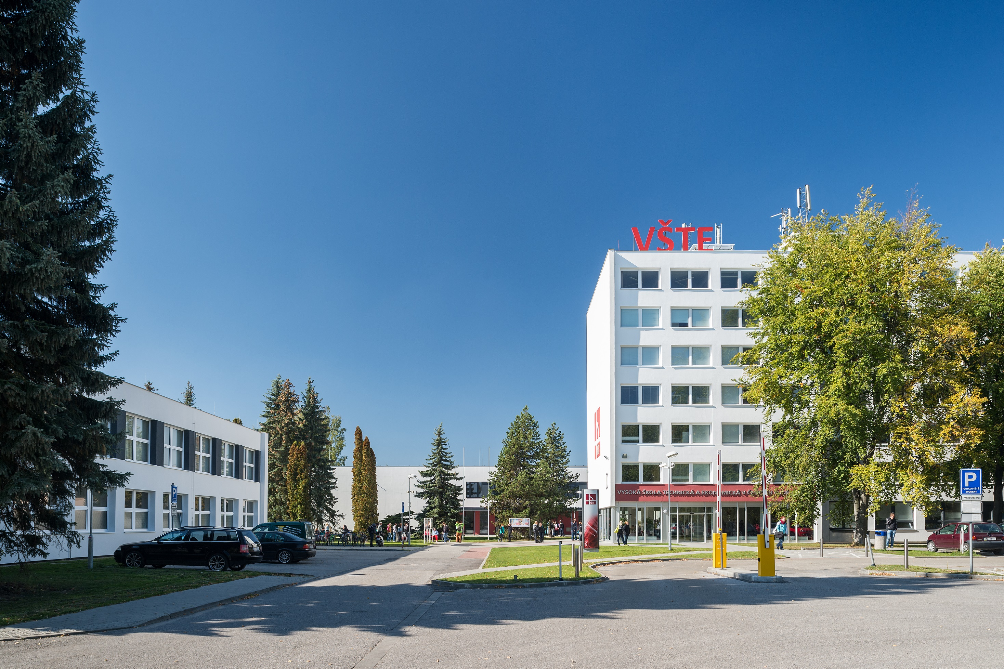

Slide 2
Institute of Technology and Business in České Budějovice
10th November 2020

Slide 3
Institute of Technology and Business (VSTE) is located in České Budějovice, in the south of the Czech Republic - a member of the European Union.
VSTE was founded in 2006, thus becoming the youngest public college (university of applied sciences) in the Czech Republic.
We are the professionally oriented technical and economic Institute with the programs focused on the applicability of knowledge rather than just theory. During the last study year all programs include one semester of professional work experience.
There is about 100 members of academic staff and more 4 000 students.

Slide 4
VSTE offers bachelor‘s and master‘s study programs in both full-time and part-time form. The programs are focused on mechanical engineering, logistics, civil engineering and economics.
VSTE offers also MBA and BBA studies with the specialization of Financial management, respectively Company valuation.
Currently the Institute consists 3 main units
Faculty of Corporate Strategy
Faculty of Technology
School of Expertness and Valuation

Slide 5
Faculty of Corporate Strategy
Ensures teaching of economic disciplines related to the field of study – Business Economics. The Faculty also guarantees master's degree program as well as the newly accredited bachelor's degree program "Human Resource Management".
Provides educational programs offered by the Lifelong Learning Centre.
The Faculty of Corporate Strategy covers the activities of 4 departments
Department of Human Resource Management
Department of Management
Department of Tourism and Marketing
Center for Language Services
The director of the Faculty is PaedDr. Mgr. Zdeněk Caha, Ph.D., MBA., MSc.

Slide 6
Faculty of Technology
Specialized in technical disciplines and guarantees related bachelor‘s and master‘s degree programs. It includes 4 departments
Department of Transport and Logistic
Department of Civil Engineering
Department of Mechanical Engineering
Department of Informatics and Natural Sciences
The Faculty supervises the construction and technical equipment of the laboratories serving for civil engineering, mechanical engeineering and logistics.
The director of the Faculty is Ing. Vojtěch Stehel, MBA, Ph.D.

Slide 7
School of Expertness and Valuation
Was established based on the decison of the Ministry of Justice and is entered in Section I of the List of Experts.
Employees court experts, academics, scholars and experts from practice.
Prepares expert reports in field of economics, mechanical engineering, civil engineering.
Cooperates with the Faculty of Corporate Strategy in ensuring the instruction in the program Business Economics.
Guarantees the study programs Bachelor and Master of Business Administration.
Organizes courses for experts.
The director of the School is Ing. Veronika Machová, MBA .

Slide 8
Research and development
Systematic improvement of quality, strengthening the cooperation with the application sector and increasing the graduates‘ employability.
Involving the students in the research activities.
Significant success in obtaining projects of the Technology Agency of the Czech Republic and the projects from the Ministry of Industry and Trade.
Important projects with relevant companies.
Organizing professional meetings, seminars and conferences.
Academic staff regularly publish in peer-reviewed journals.

Slide 9
Internship
To ensure the practical employability of its graduates, VSTE has created a semester-long (520 hours) internship as an integral part of the curricula study. Internships can be conducted both in the Czech Republic and abroad.
There are more than 1 000 companies and state organizations which enable students to get practical experience including Robert Bosch, Budvar, DM drogerie markt, GW Jihotrans and many others.
Within two months of completing their studies, more than 97% of our graduates find employment.

Slide 10
Study abroad
Our students can spend a semester abroad within Erasmus+ program or on the basis of bilateral agreements with partner universities.
The study or an internship abroad will enhance the chance of our students for job success and help them to start their career.
We offer support with visa procedure, invitation letters, recognition of the documents, registration at foreign office etc.

Slide 11
Career Centre
Place for informal meeting of students and experts from practice or HR managers with the aim to establish contacts, get inforamton and aquire more experience.
Here the students get contacts and advice for practical training, part-time jobs and their future career.
Alumni Club
Created for all VSTE graduates as a platform for maintainingand developing the relations with „alma mater“ teachers and former classmates.

Slide 12
Student life
Student union - established in 2009 represents and gathers VSTE students. Organizing student events helps to create a pleasant and friendly environment at the school.
Erasmus Student Network (ESN VSTE Budweis) helps several dozen foreign students in their everyday and student life in České Budějovice
Student Club „Céčko“ – place where the students can spend their time , meet friends and enjoy their free time togather.
VSTE Ice-hockey team BLACK DOGS
Basketball team BLACK CATS
VSTE Chess Club

Slide 13
Awards
Diploma Supplement Label by the European Commission
ECTS Label by the European Commission
Comenius’ Faculty of the Year Award

Slide 14
THANK YOU

