Slide 1


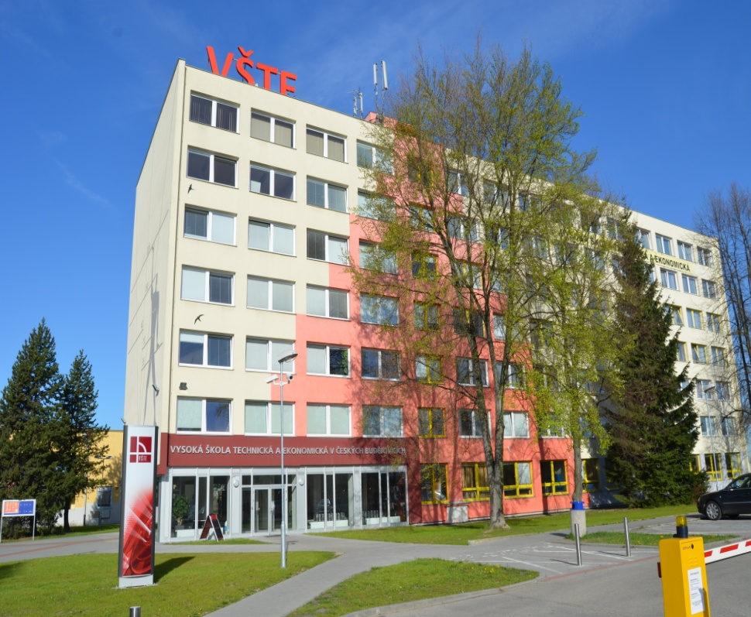

THE INSTITUTE OF TECHNOLOGY AND BUSINESS IN ČESKÉ BUDĚJOVICE
The Institute of Technology and
Business in Českých Budějovicích
Okružní 517/10,
370 01 České Budějovice
Czech Republic
© Mgr. Zdeněk Caha, PhD. a kolektiv
VŠTE v Českých Budějovicích, 2012
http://www.vstecb.cz

Slide 2
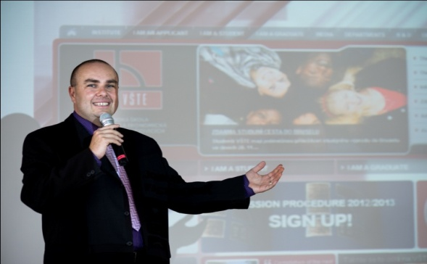
WHO ARE WE?
WE ARE …
Excellent higher educational institution which is
dynamically and professionally specialized
WHAT WE DO …
Maintain close cooperation with the local
business entities and institutions
Prepare our students for the instant start of
professional careers
Allow students to continue through to a Master’s Degree
http://www.vstecb.cz

Slide 3
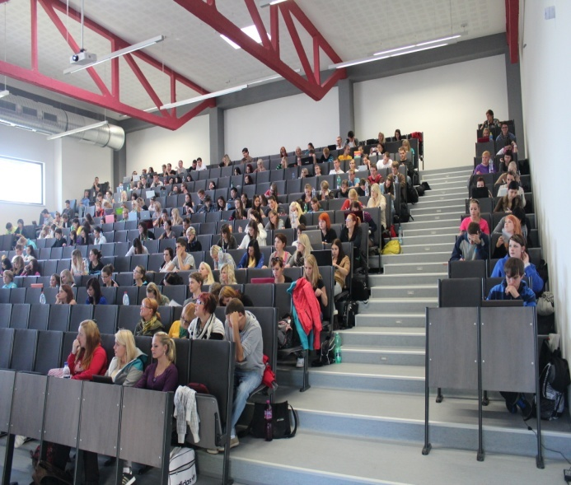
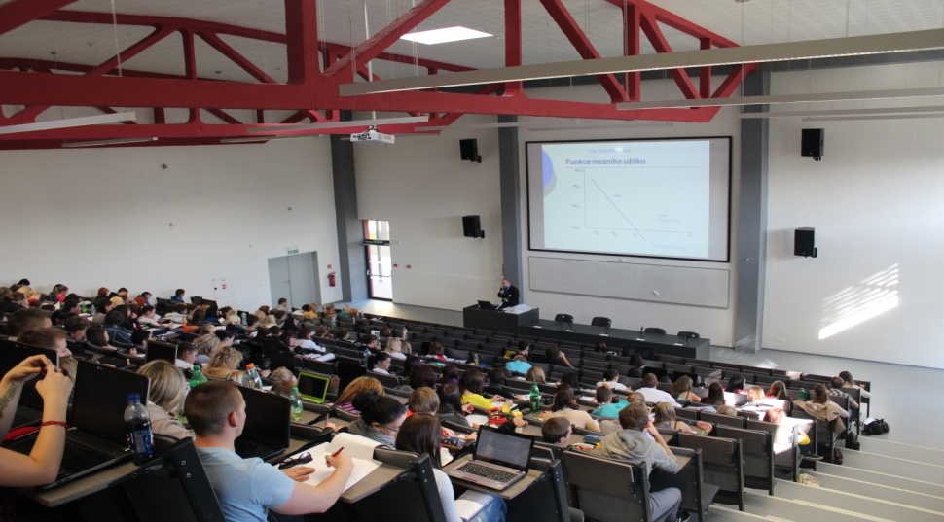
We provide teaching and practice for about 4, 000
Full-Time and Part-Time students
We also offer Study Programmes in Life-long
Education
http://www.vstecb.cz

Slide 4

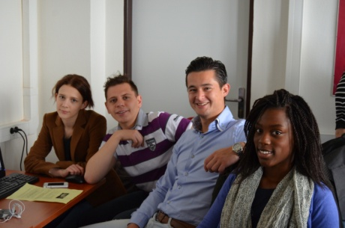
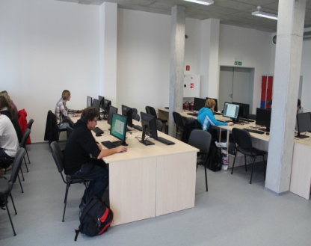
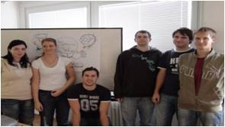
WHY ARE THE STUDY PROGRAMMES
AT VŠTE SO UNIQUE??
Teaching, practice, research and development are
interlinked
The experts with concurrent practical experience
participate in teaching
We attempt to internationalize the study programmes
Modern and effective techniques, methods, strategies
and teaching forms are being introduced
http://www.vstecb.cz

Slide 5
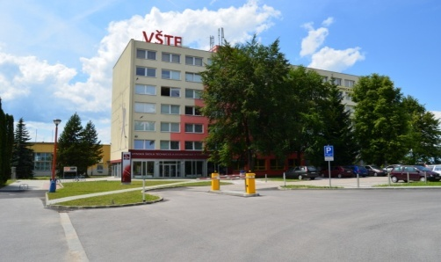
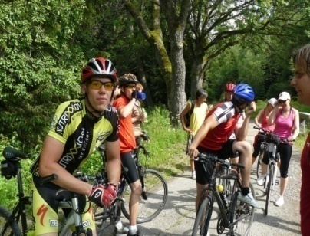
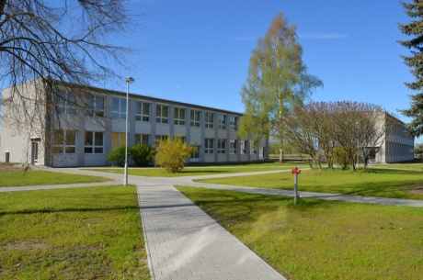
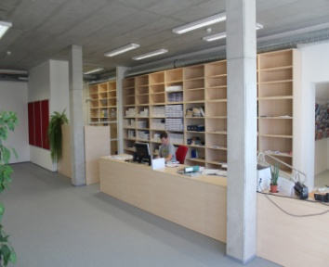
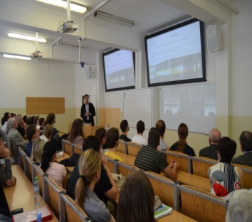
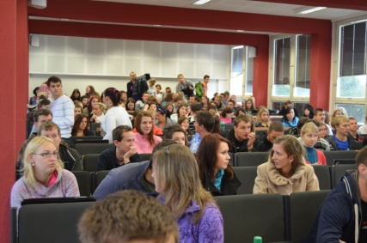
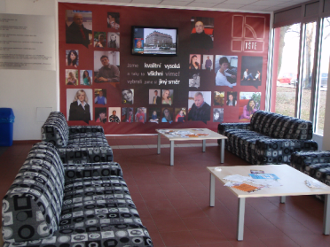
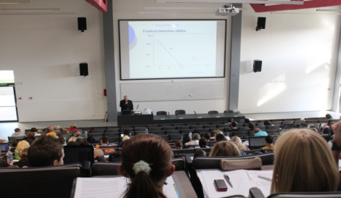
CAMPUS
modern facilities
dormitory
canteen
library
leisure-time activities
http://www.vstecb.cz

Slide 6
STUDY PROGRAMMES
Economics and Management
Corporate Economics major
Civil Engineering
Construction Management major
Building Construction major
Technology of Transport and Communications
Technology of Transport and Conveyance major
Engineering
Mechanical Engineering major
http://www.vstecb.cz

Slide 7
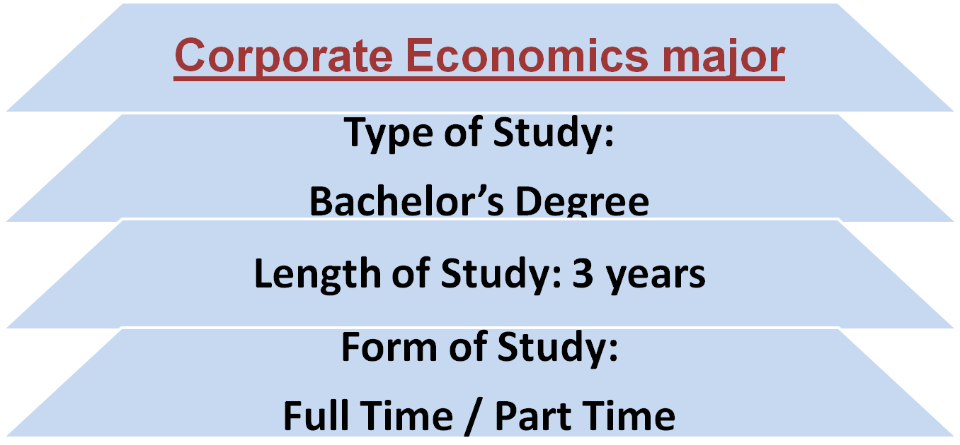
ECONOMICS AND MANAGEMENT
Degree Programme
http://www.vstecb.cz

Slide 8
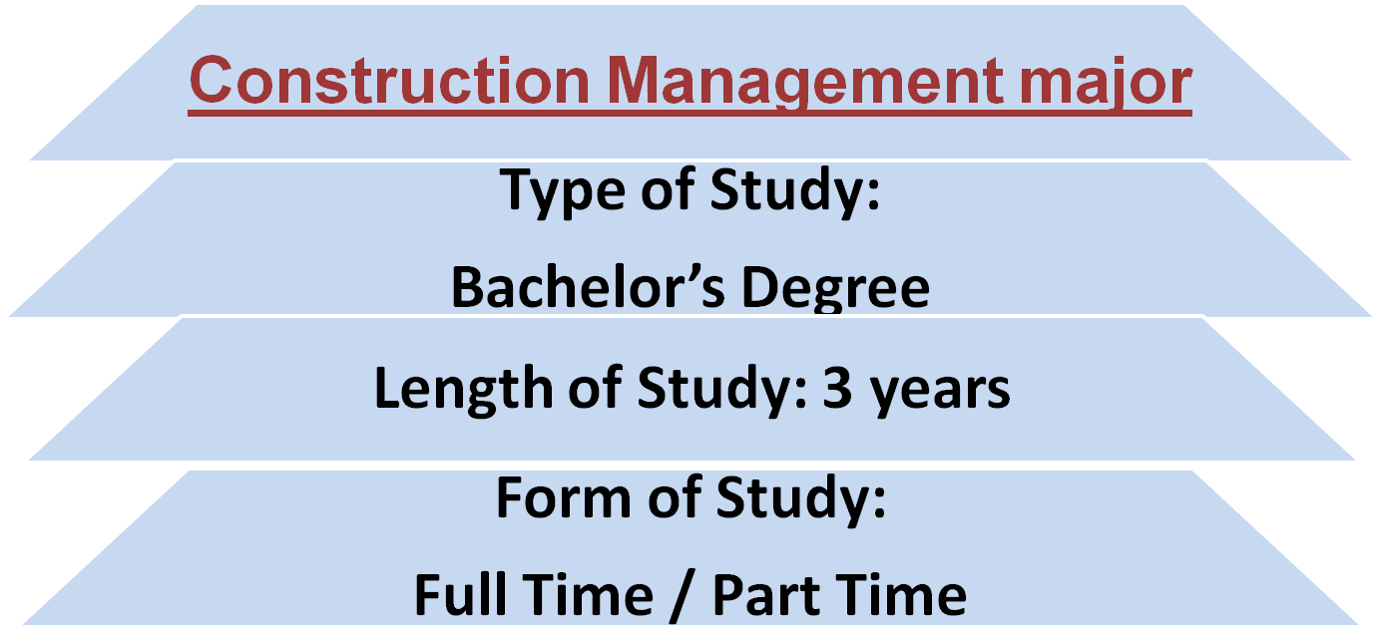
CIVIL ENGINEERING
Degree Programme
http://www.vstecb.cz

Slide 9
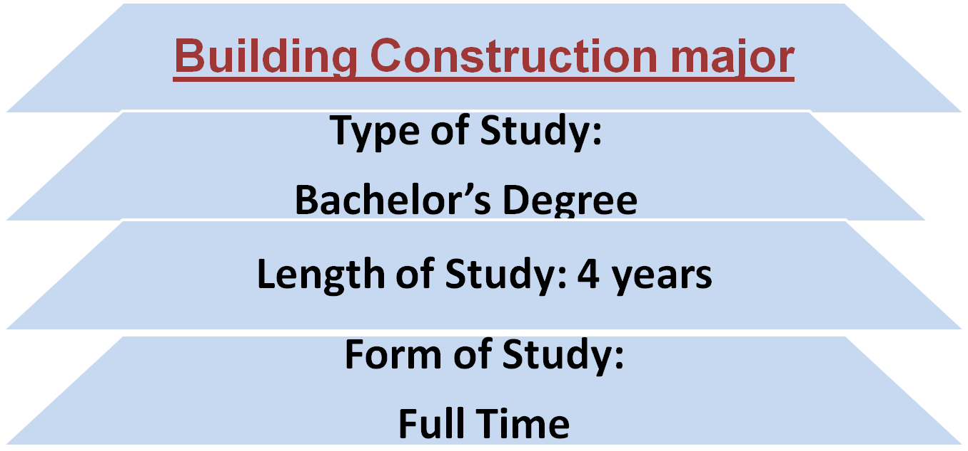
CIVIL ENGINEERING
Degree Programme
http://www.vstecb.cz

Slide 10
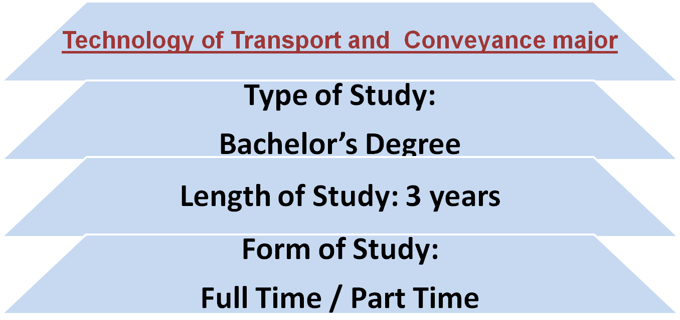
TECHNOLOGY OF TRANSPORT AND COMMUNICATIONS
Degree Programme
http://www.vstecb.cz

Slide 11
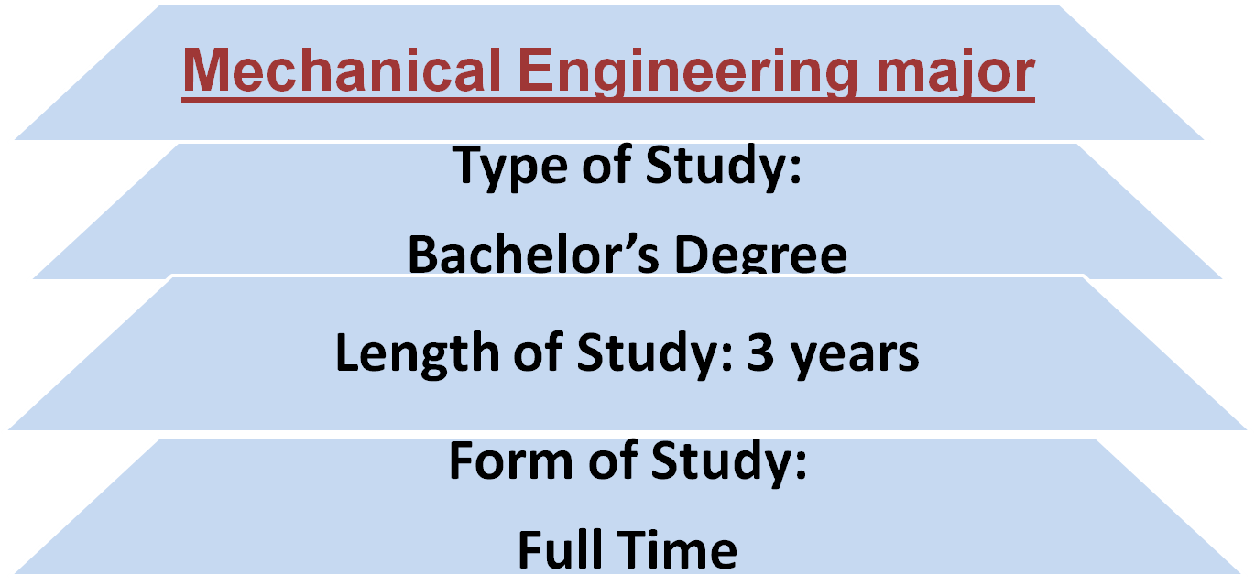
ENGINEERING
Degree Programme
http://www.vstecb.cz

Slide 12
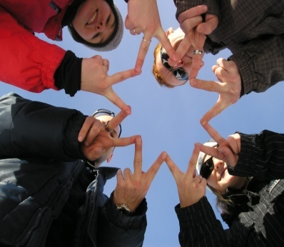
DEPARTMENTS
Department of Engineering
Department of Natural Sciences
Department of Foreign Languages
Department of Economics and Management
Department of Civil Engineering
Department of Transport and Logistics
http://www.vstecb.cz

Slide 13
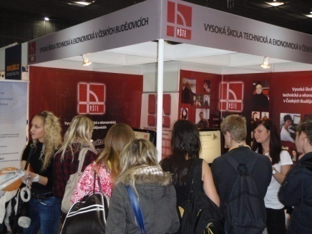
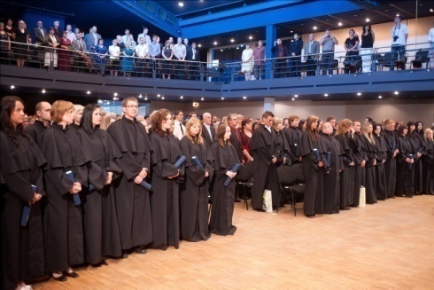
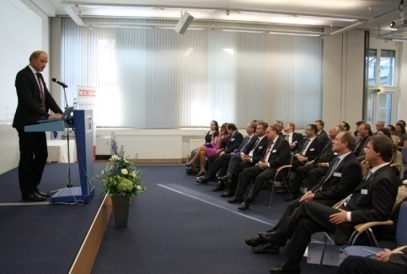
Thank you for your attention
http://www.vstecb.cz

